Slide 1
Ânderson Martins Pereira
Likes and deslikes

Slide 2
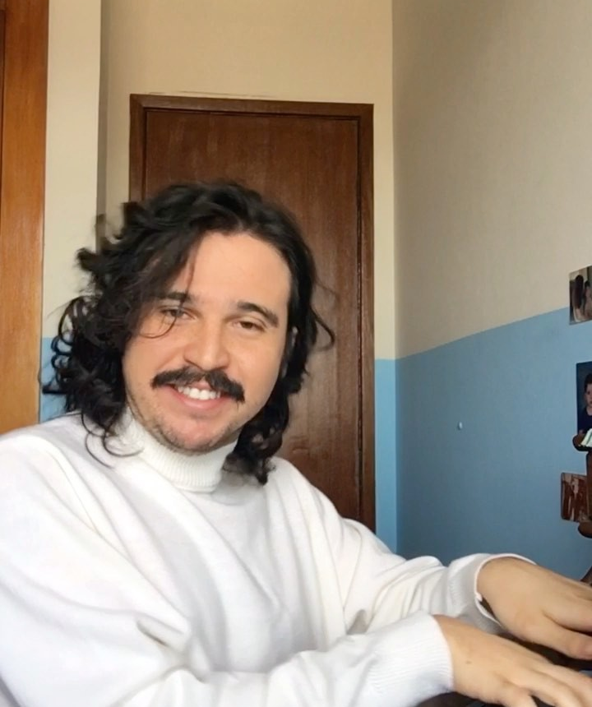
AVALIAÇÃO ABERTA
Aguardo respostas suas, ainda. Beijos científicos, Pfizer

Slide 3

Warm-up
1) Do you like to watch tv?
2) Do you prefer watch movies (films) or series?
3) What do you do in your free time ?

Slide 4

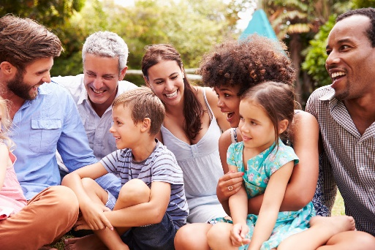
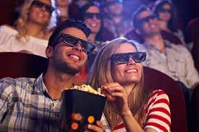
Warm-up
4) Which is the best?
Going to the movies
reading
Spending time with family

Slide 5

What do you like?
What do you like ?
What are you like?

Slide 6
What do you like?
What do you like ? I like to play card games, to date,
What are you like?
I am sensitive, funny, intelligent, hardworking

Slide 7

What do you like?
I like to play cards (action) I like playing cards (situation)

Slide 8


What do you like?
I love to go to the cinema/ going to the cinema
I really like to go to the cinema/ going to the cinema
I like to go to the cinema/ going to the cinema
I dislike going to the cinema
I don’t like to go to the cinema/ going to the cinema
I don’t like_____ at all.
I hate to go to the cinema/ going to the cinema

Slide 9
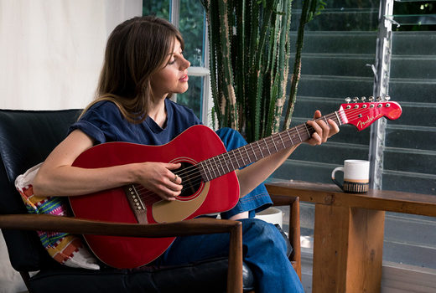
Leisure activities
Playing the guitar / to play the guitar

Slide 10
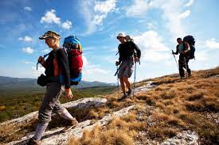
Leisure activities
Going hiking/ to go hiking

Slide 11
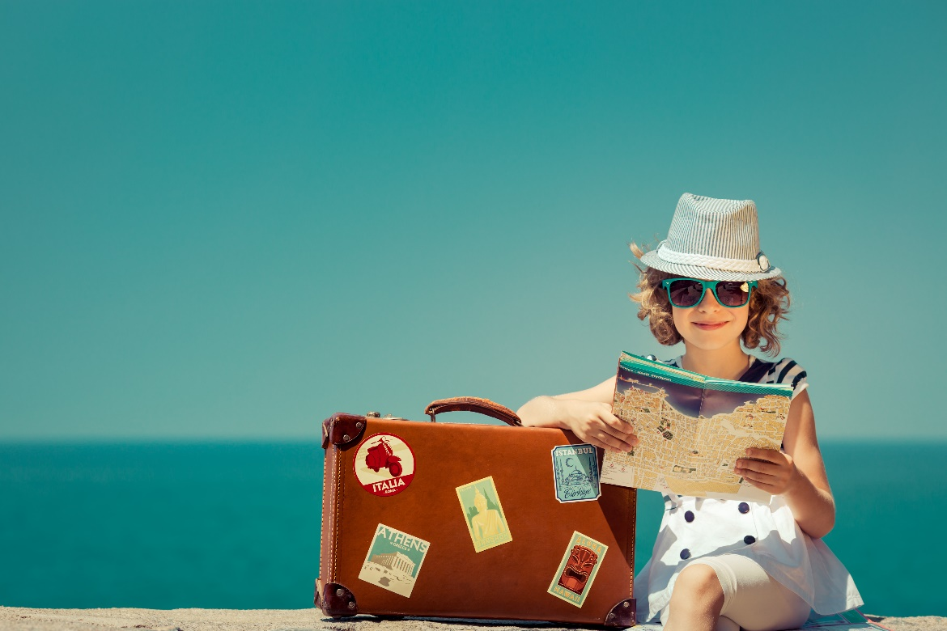
Leisure activities
Travelling/ to travel

Slide 12
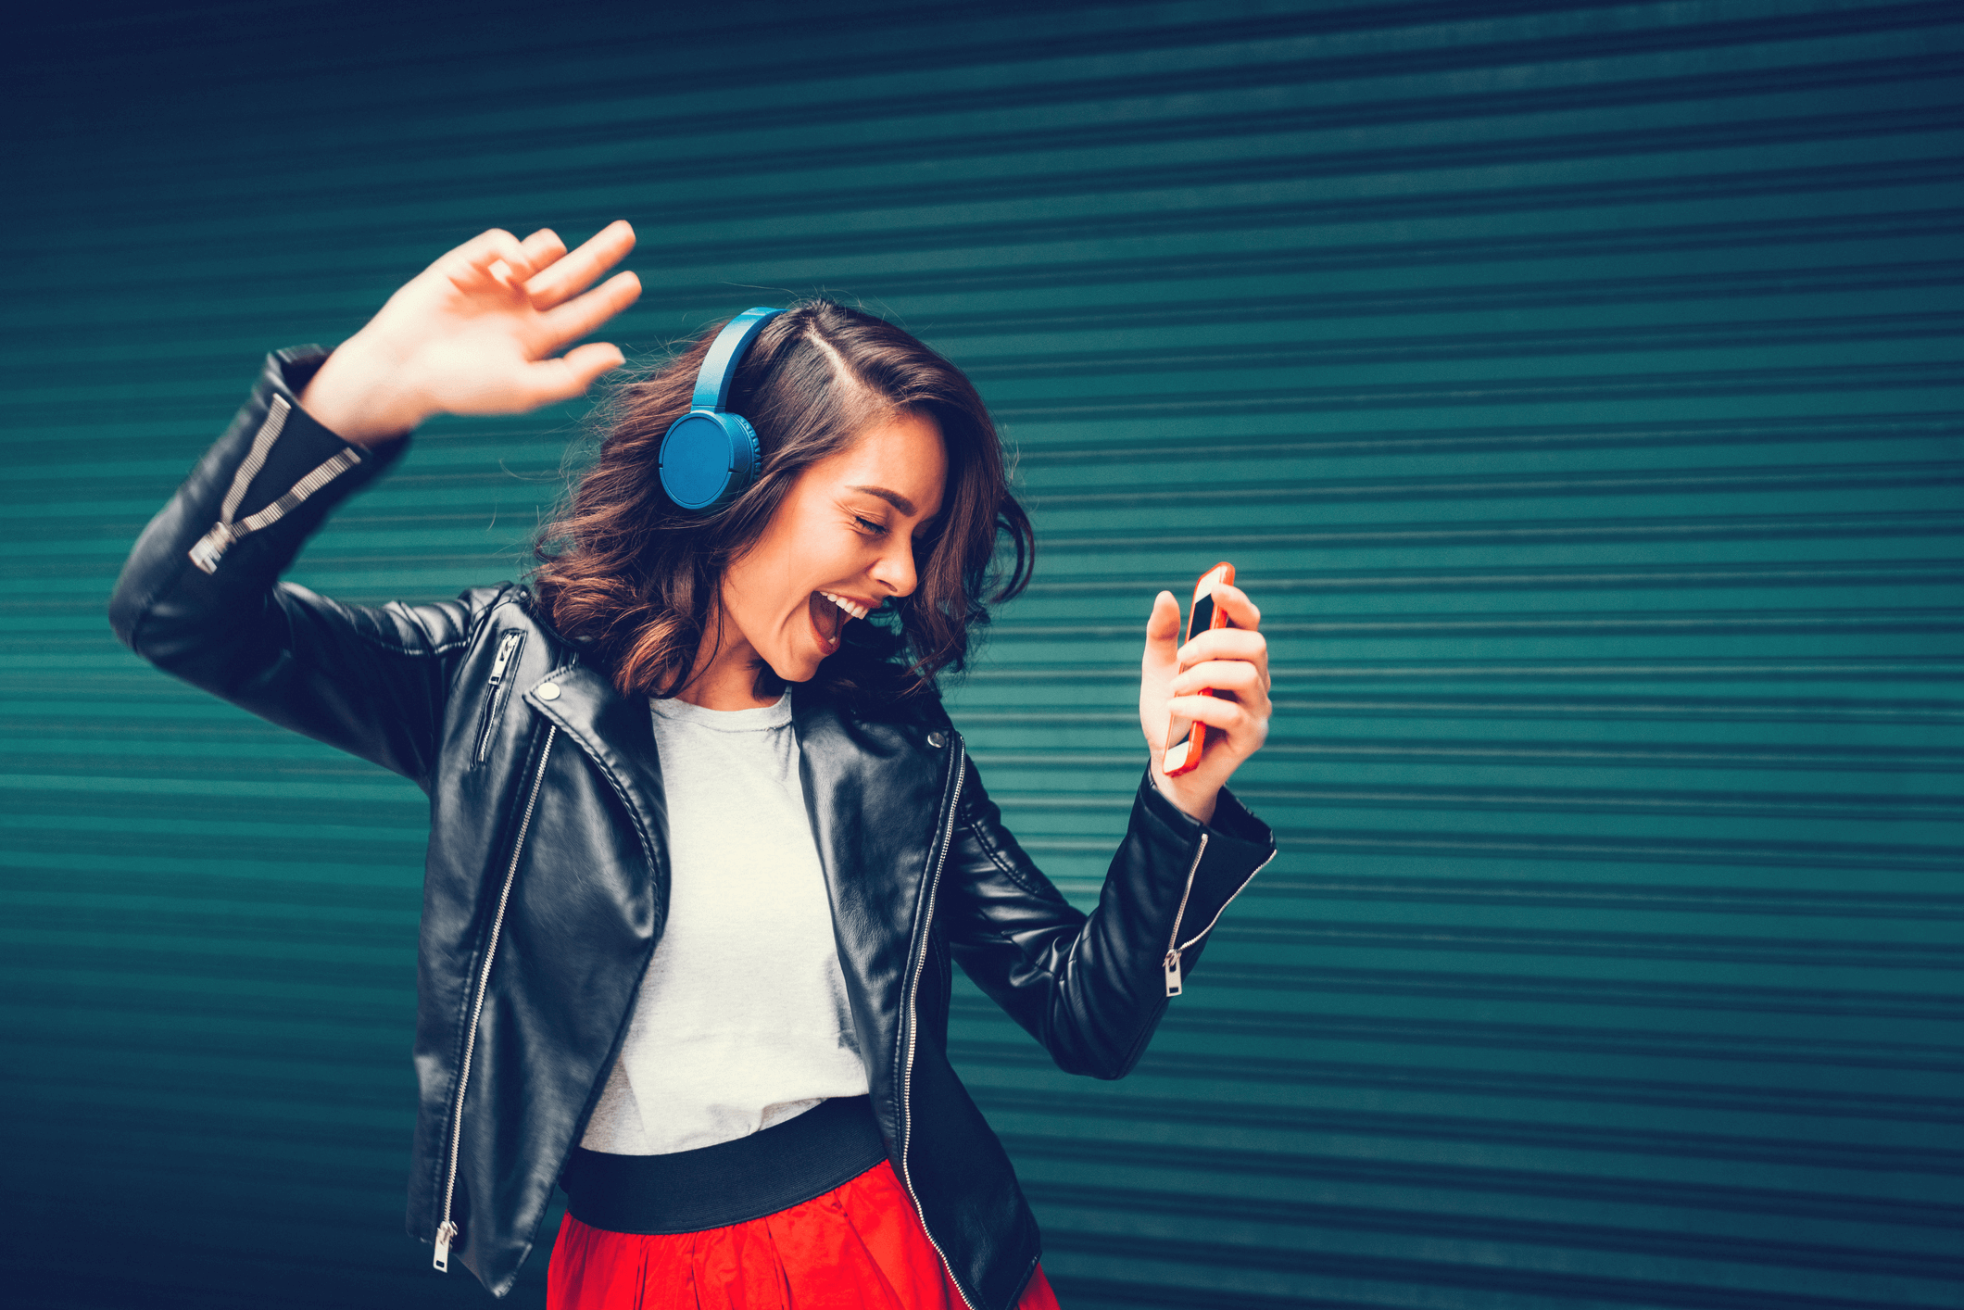
Leisure activities
Listening to music/ to listen to music

Slide 13
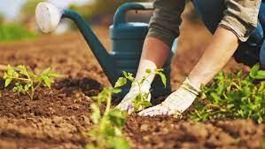
Leisure activities
Gardening/ to garden

Slide 14
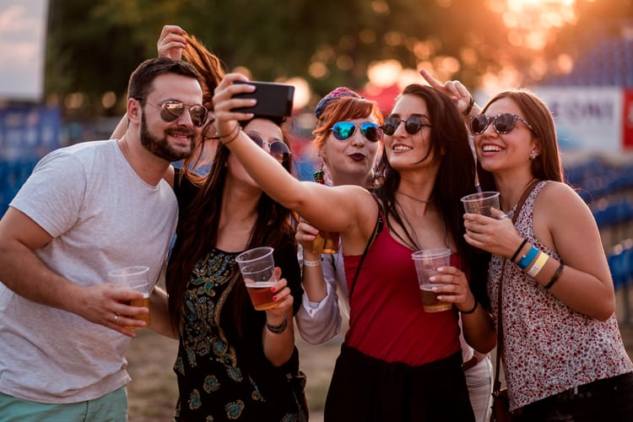
Leisure activities
Going out with friends/ to go out with friends

Slide 15
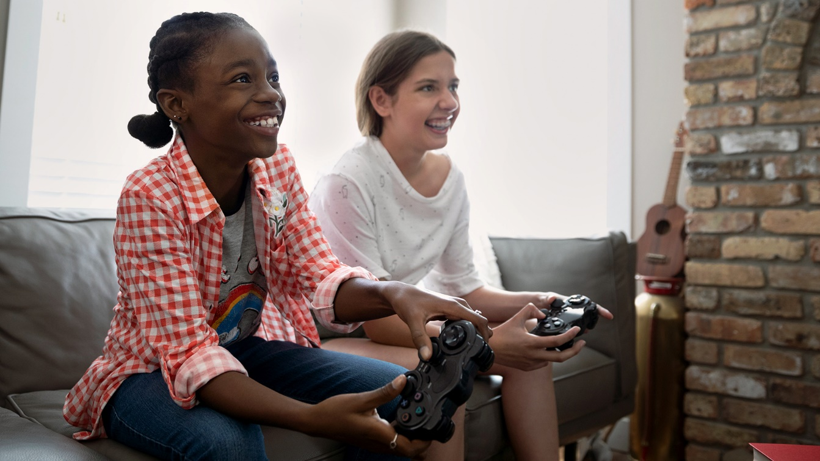
Leisure activities
Playing videogames/ to play videogames

Slide 16
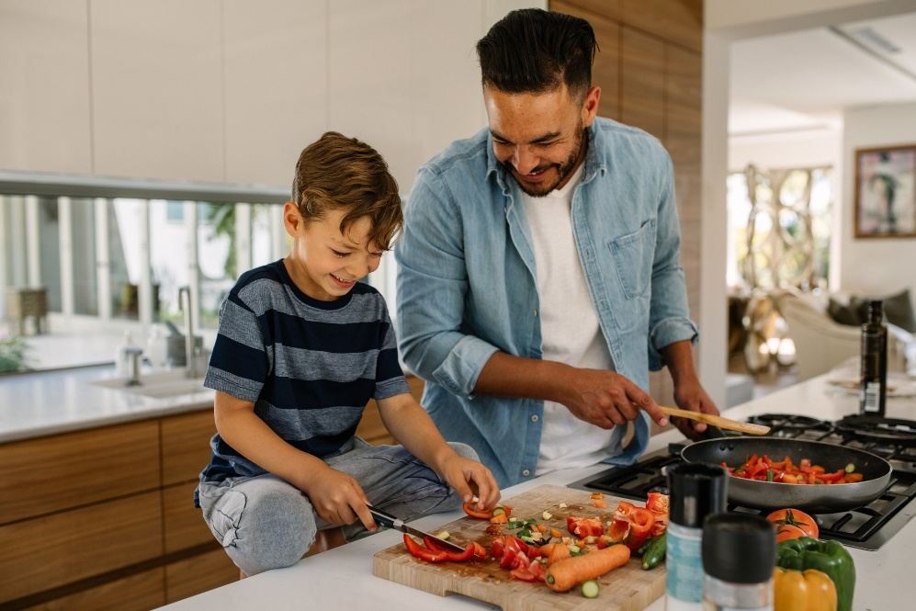
Leisure activities
Cooking/ to cook

Slide 17
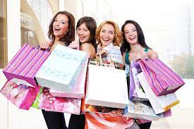
Leisure activities
Going shopping/ to go shopping

Slide 18
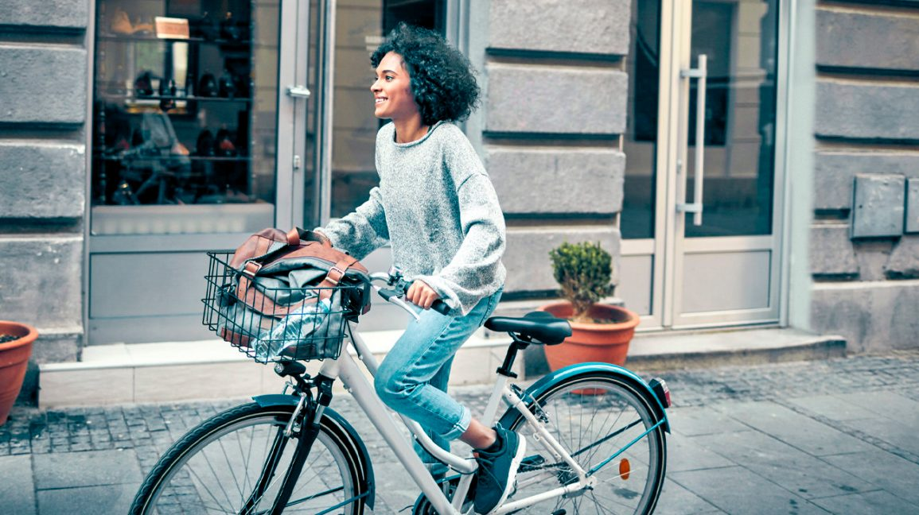
Leisure activities
Riding a bike/ to ride a bike

Slide 19
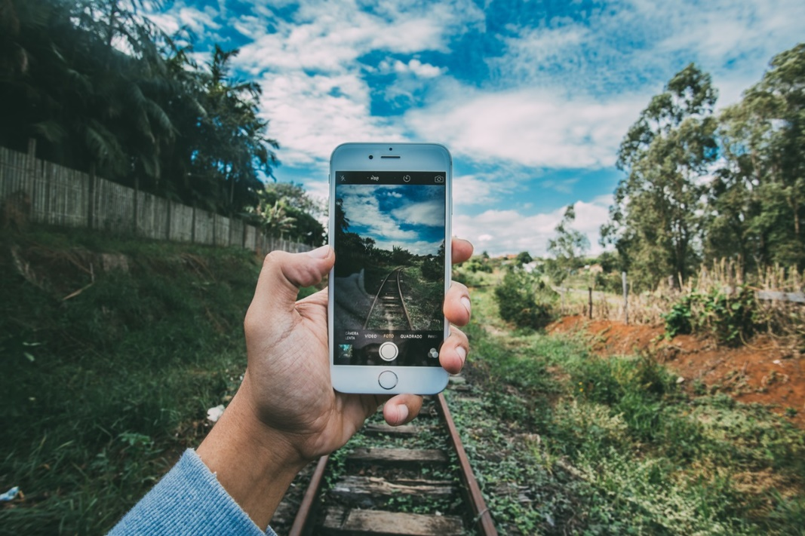
Leisure activities
Taking photos/ to take photos

Slide 20
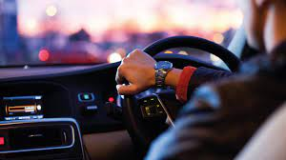
Leisure activities
Driving/ to drive

Slide 21
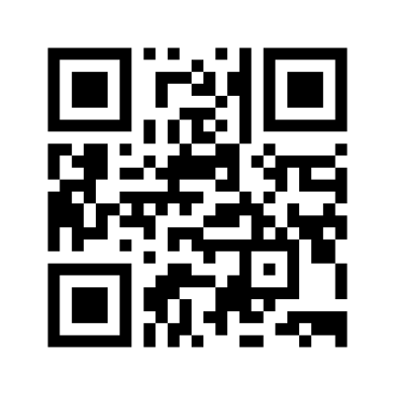
Mentimeter
What do you like doing?

Slide 22
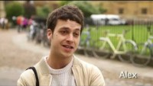
Listening
What do you like doing?
https://www.youtube.com/watch?v=6d6wVyuPBkM&ab_channel=JuanGomez

Slide 23
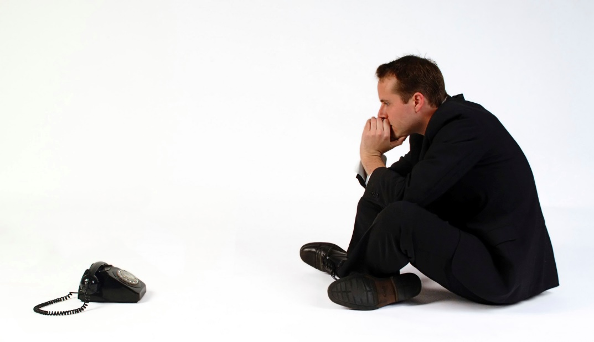
dislikes
Waiting / to wait

Slide 24
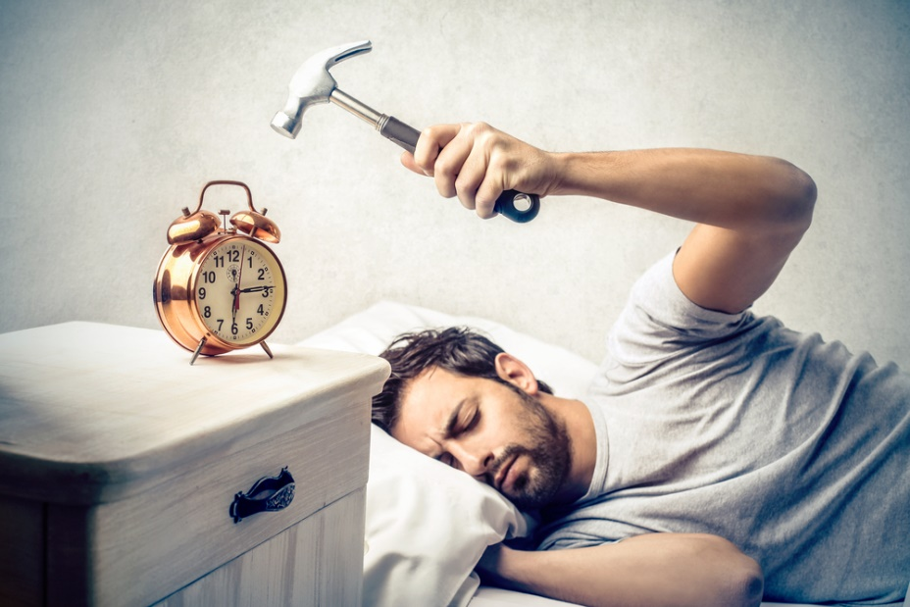
dislikes
Getting up early / to get up early

Slide 25
Listening
What do you like doing?
https://www.youtube.com/watch?v=6d6wVyuPBkM&ab_channel=JuanGomez

Slide 26

Mentimeter
What don’t you like doing?

Slide 27

Atividade final. Ninguém está livre!
Escrever um texto de quinze linhas a 30 sobre seu idolo em inglês. Utilize para isso o que aprendemos. O google tradutor pode ser usado para auxiliar em vocabulário, mas não na escrita. Ao verificar o uso indiscriminado será retirado nota.

Slide 28
Cronograma
Semana que vem eu vou dar monitoria, para quem quiser tirar dúvidas sobre o texto, sobre expressões. (dia 14)
Vocês entregam o texto no dia 16.
Dia 21, eu vou dar uma aulinha de revisão dos pontos principais que aprendemos.
Dia 28, vocês podem entregar atividades que não fizeram ou que tiraram nota menor do que a media (6,0)

