Slide 1
Ânderson Martins Pereira
Outras informações

Slide 2

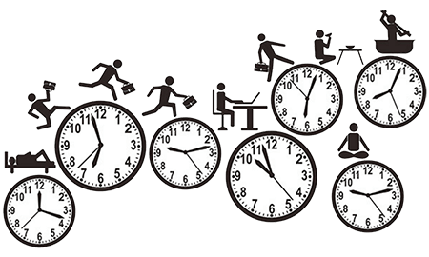
Reviewing last class
Do you remember what was day 4 about?
.

Slide 3


Reviewing last class
I practice yoga at 4 p.m.
Routine /Facts
I practice
You practice
He practices
She practices
It practices
We practice
They practice

Slide 4


Reviewing last class
I don’t smoke
You don’t smoke
He doesn’t smoke
She doesn’t smoke
It doesn’t smoke
We don’t smoke
They don’t smoke
I don’t smoke.

Slide 5

Reviewing last class
Do I eat vegetables?
Do you eat vegetables?
Does she eat vegetables?
Does he eat vegetables?
Does it eat vegetables?
Do we eat vegetables?
Do we eat vegetables?
Do you eat vegetables?

Slide 6
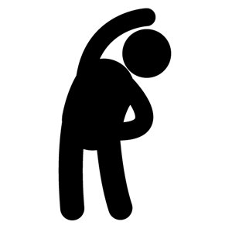
Warm-up
1) Do you like to go to the supermarket?
2) Where do you buy (compra) the goods (products) for your house?
3) What are the bad things about your local supermarket?

Slide 7
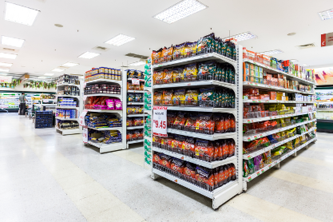
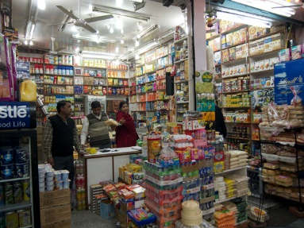
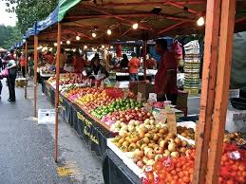
Warm-up
4) Which are better – big supermarkets, small grocery stores or outdoor markets?
big supermarkets
small grocery stores
outdoor markets

Slide 8

How long?
duration
How long does it take for you to take a shower?
It takes me 10 minutes.
How long does it take to finish the movie?
It takes 15 minutes.
How long does it take for you to do the shopping?
It takes me 40 minutes.

Slide 9
How long?
duration
How long does it take to deliver the food in the supermarket?
It takes 15 minutes

Slide 10
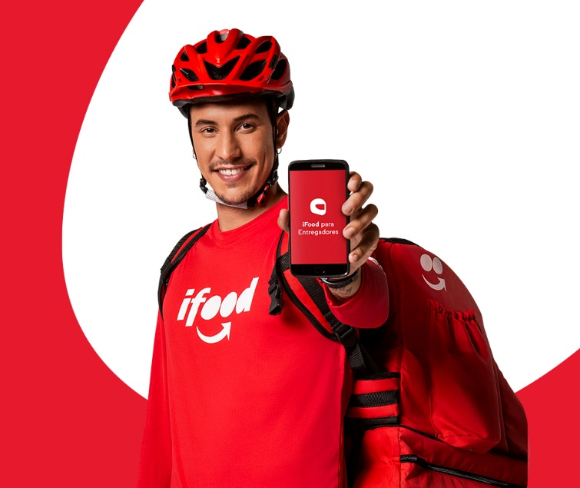
How long?
duration
How long does it take to deliver the food in Ifood?

Slide 11

How long?
We use the expression about when we are not
certain about the time with precision
How long does it take for you to do
the contacts?
It takes me about 20 minutes.

Slide 12

How long?
How long does it take for you to have breakfast?
morning

Slide 13


How far?
distance
How far is your house from IFFAR?
It is ten kilometers.
What words can we use to describe distance?

Slide 14

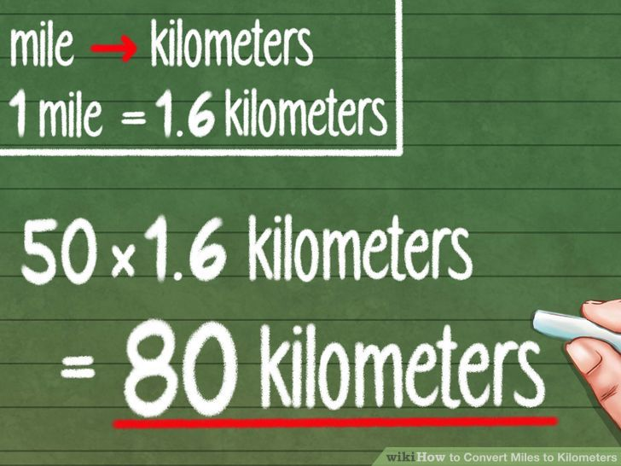

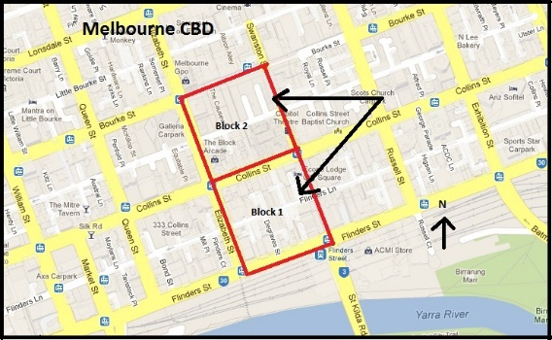
How far?
measure
Blocks
Metres

Slide 15

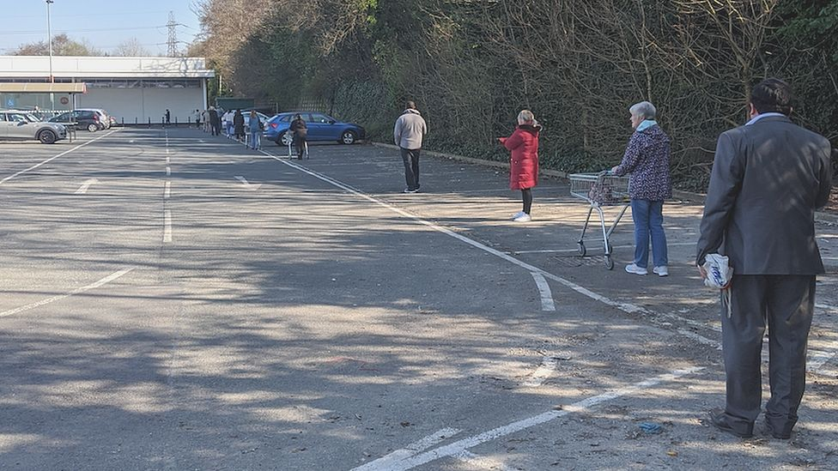
How far?
distance
How far is your house from the supermarket?

Slide 16
How far?
distance
How far is your house from IFFAR?
It is one kilometer.
How far is Peruzzo from BAklizi?
How far is Dal bem (Manuel Viana) from your house?
How far is Manoel Viana from Alegrete?

Slide 17
How Far?
How Far is your house from your friend’s house?
distance

Slide 18

How often?
100%
Always
Usually
Frequently
Often
Sometimes
Occasionally
Rarely
Seldom
Hardly ever
Never
How often do you ….
50%
0%

Slide 19
How often?
100%
Always
Usually
Frequently
Often
Sometimes
Occasionally
Rarely
Seldom
Hardly ever
Never
How often do I go shopping for mayonnaise?
50%
I occasionally go shopping for mayonaise
0%

Slide 20
How far?
distance
How often do buy vegetables?
I usually buy.
How often do you buy meat?
How often do you eat salad?
How often do you eat junk food?

Slide 21

How many times?
1x – once
2x-twice
3x- three times
4x- four times
5x – five times
6x - six times
7x – seven times
8x – eight times
9x – nine times
10 - times
How many times do you ….?

Slide 22
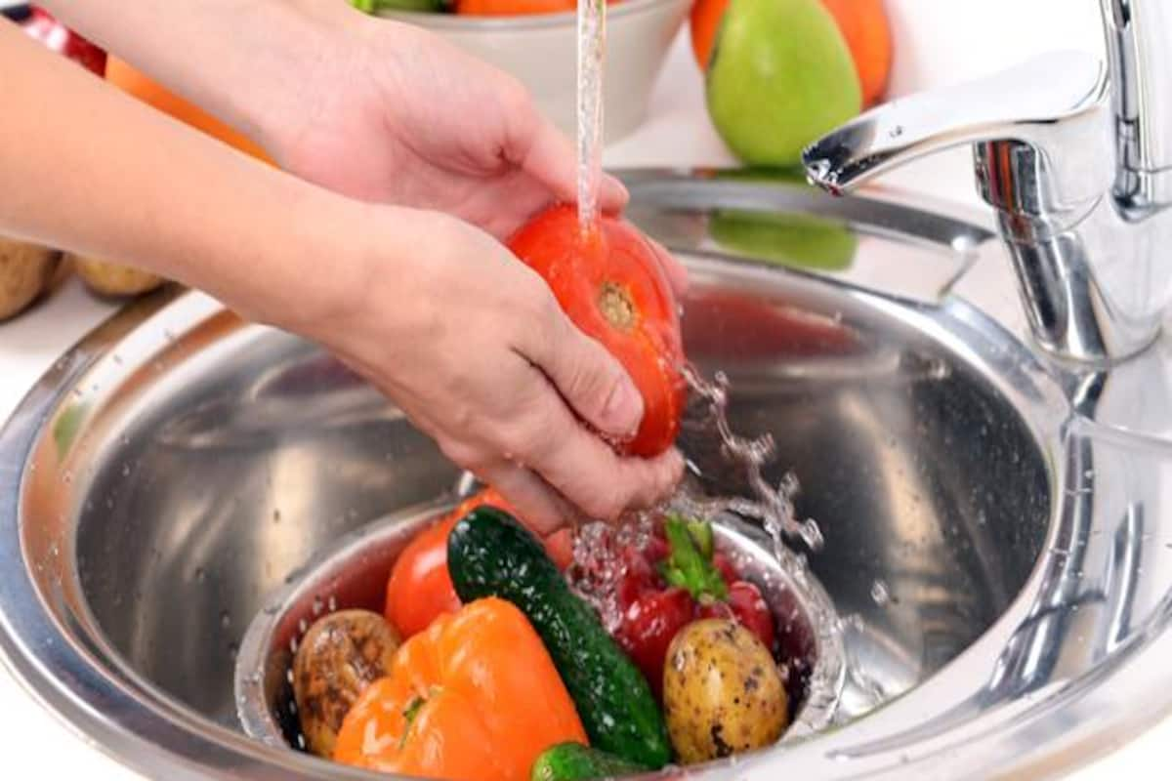
How many times?
How many times do you wash the vegetables?

Slide 23
How many times?
How many times do you wash the vegetables?
Once.
Because they are organic.

Slide 24
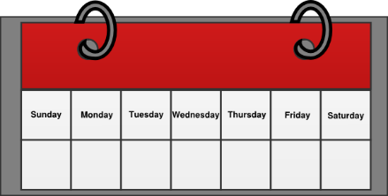

How many times?
How many times do you ….?
1x – once
2x - twice
3x - three times
4x - four times
5x – five times
6x - six times
7x – seven times
8x – eight times
9x – nine times
10 - times
a week
January, February, March…
a month
2014, 2016, 2017…
a year

Slide 25
How many times do you shop online?
How many times do you ….?
1x – once
2x - twice
3x - three times
4x - four times
5x – five times
6x - six times
7x – seven times
8x – eight times
9x – nine times
10 - times
a week
January, February, March…
a month
2014, 2016, 2017…
a year

Slide 26


