Slide 1
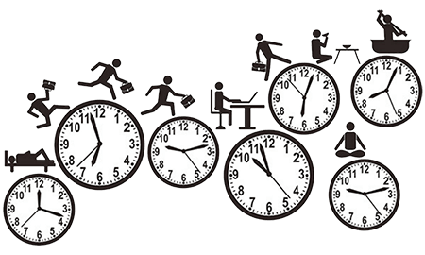
Routine/ Facts
Ânderson Martins Pereira

Slide 2


O que você faz todos os dias.
What do you do everyday?
.

Slide 3
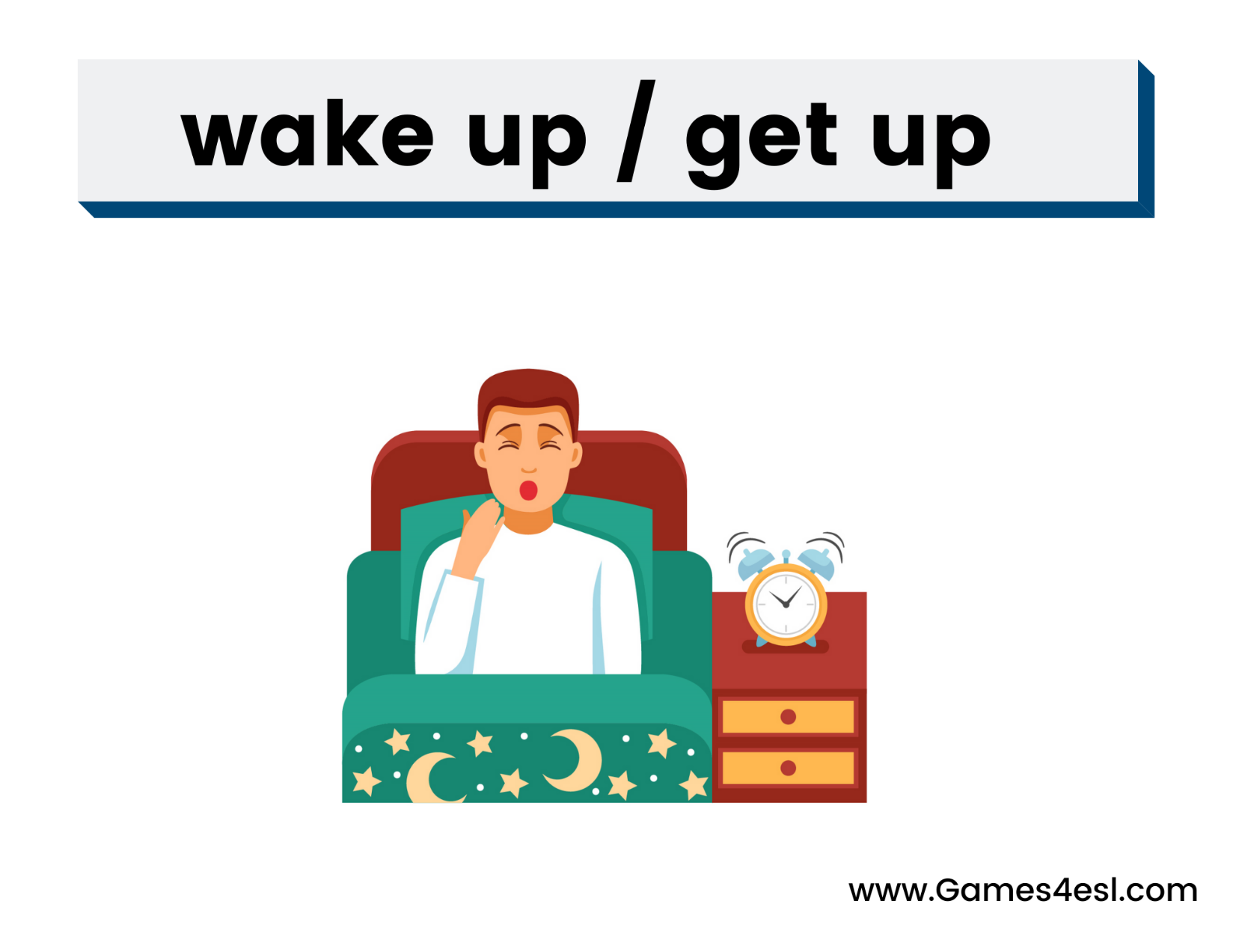

Slide 4
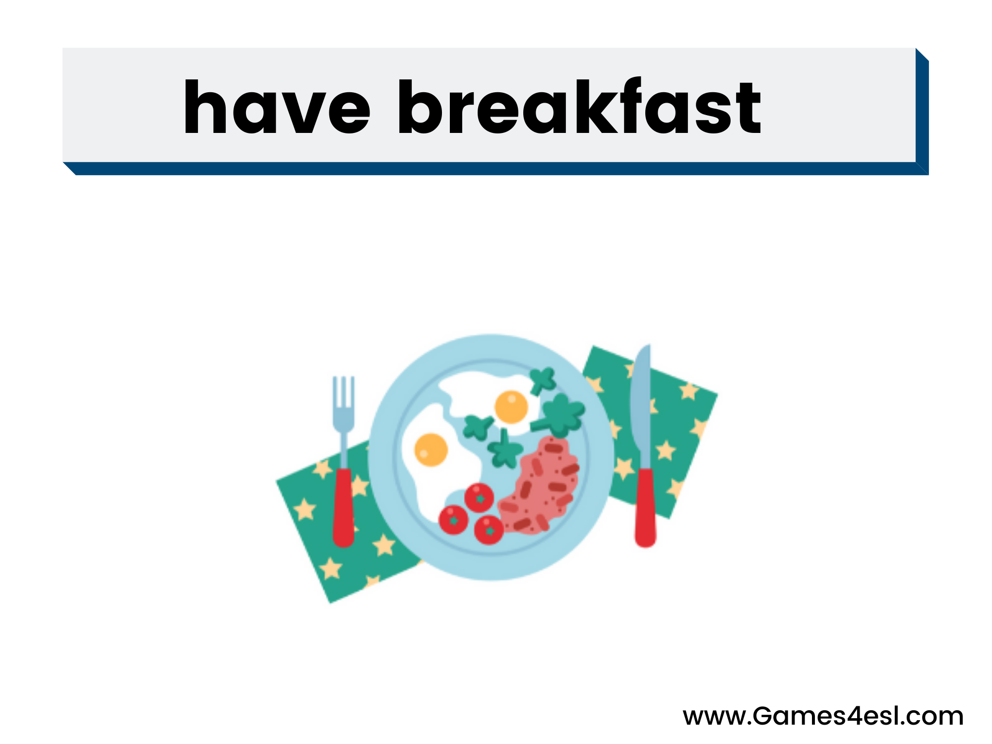

Slide 5
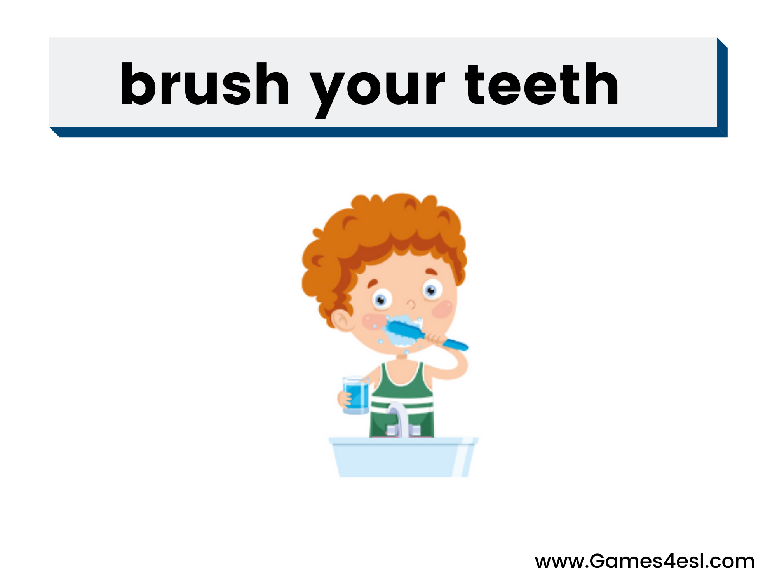

Slide 6
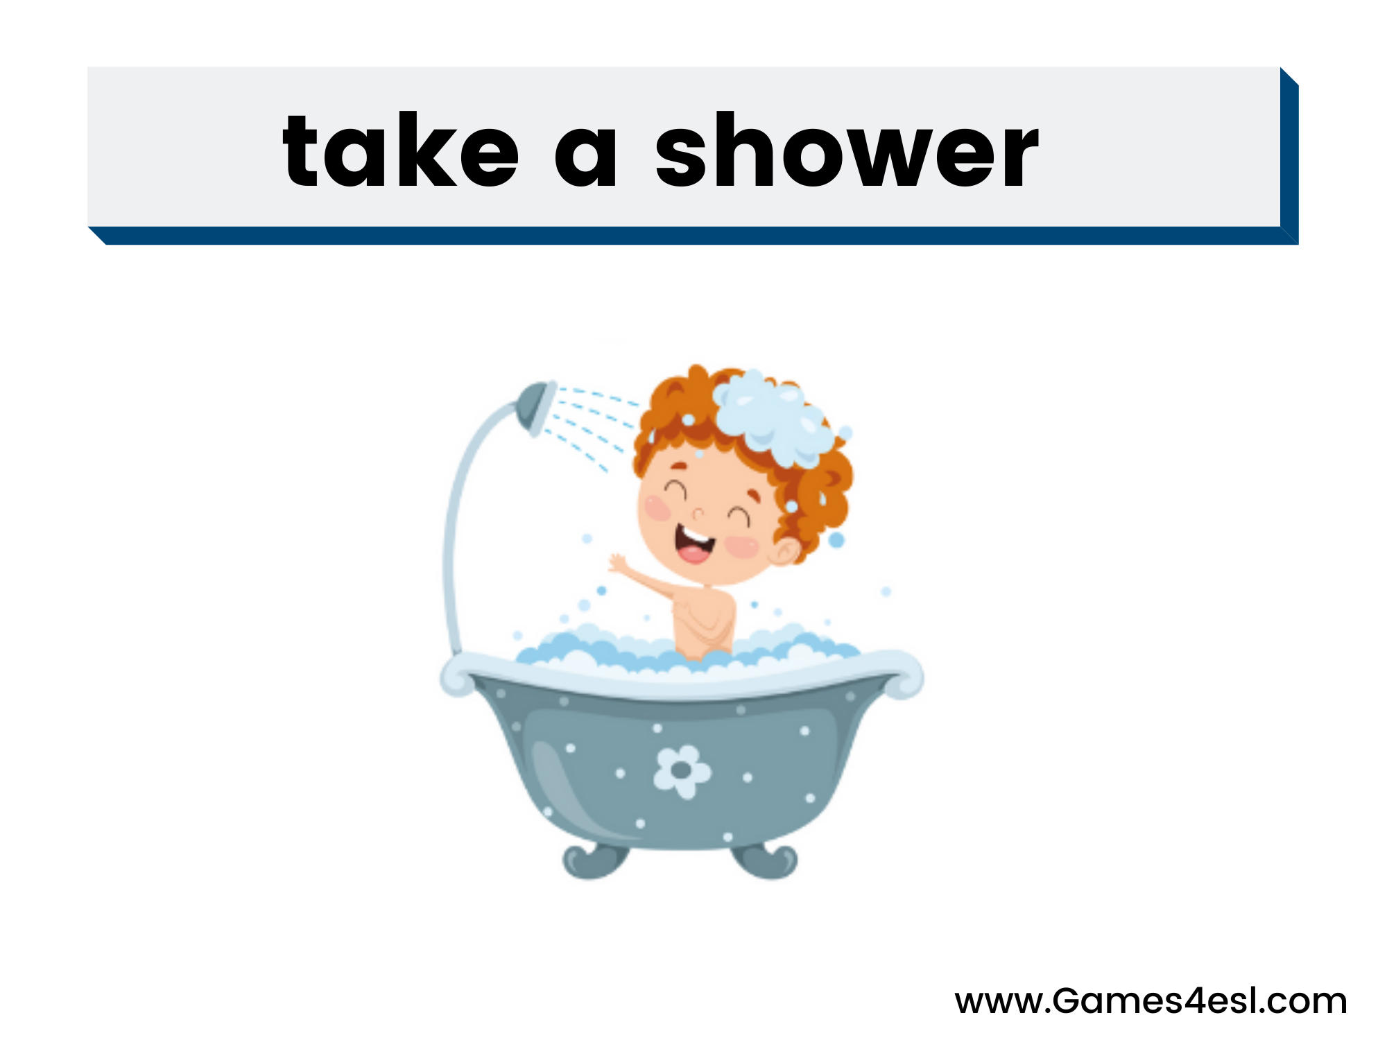

Slide 7
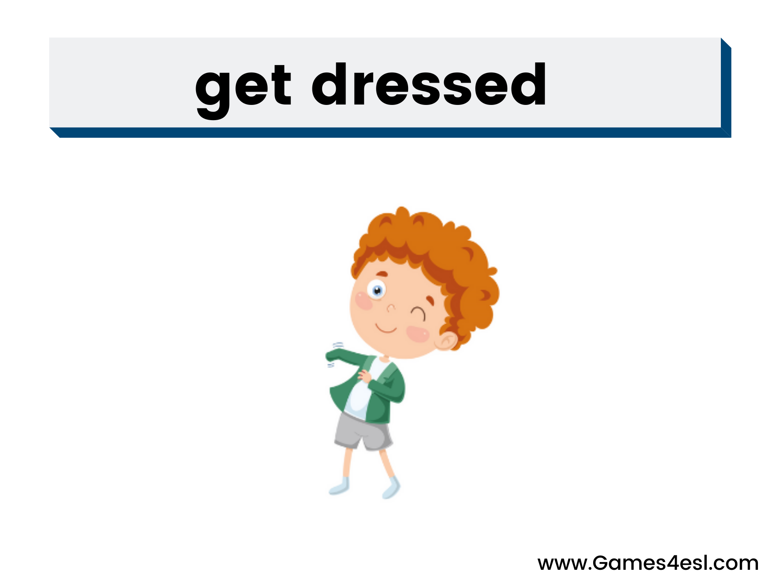

Slide 8


Slide 9


Slide 10
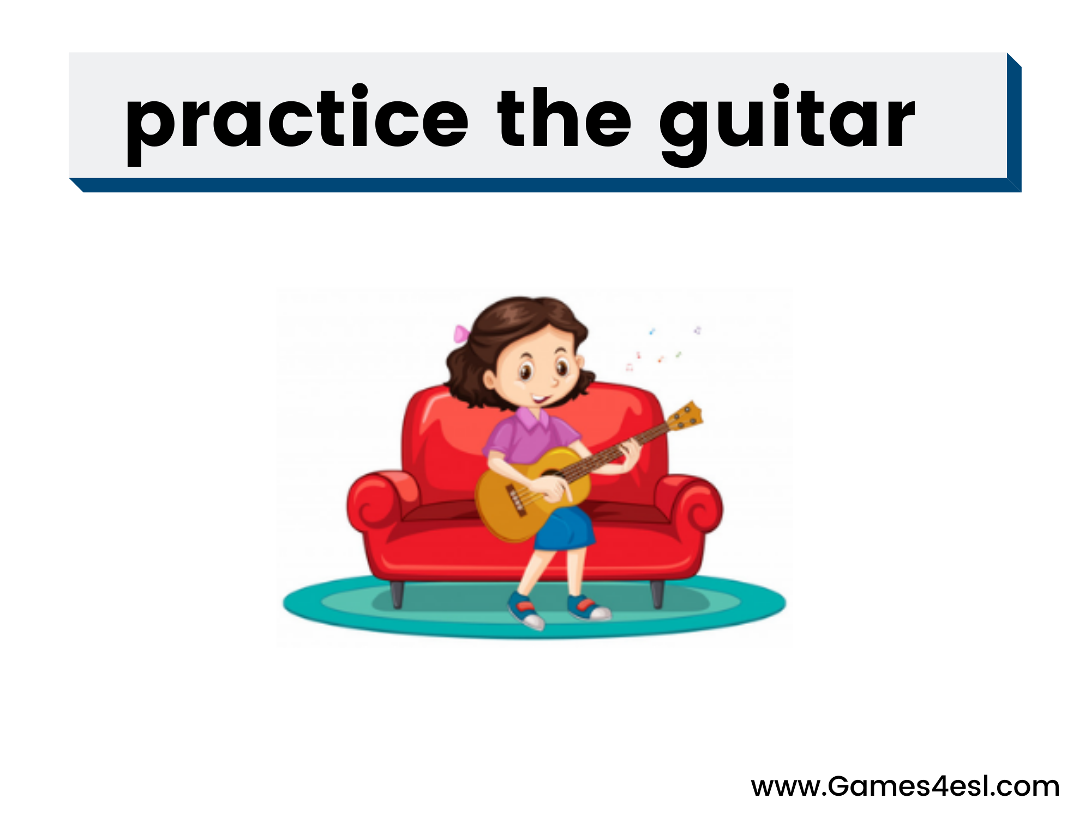

Slide 11
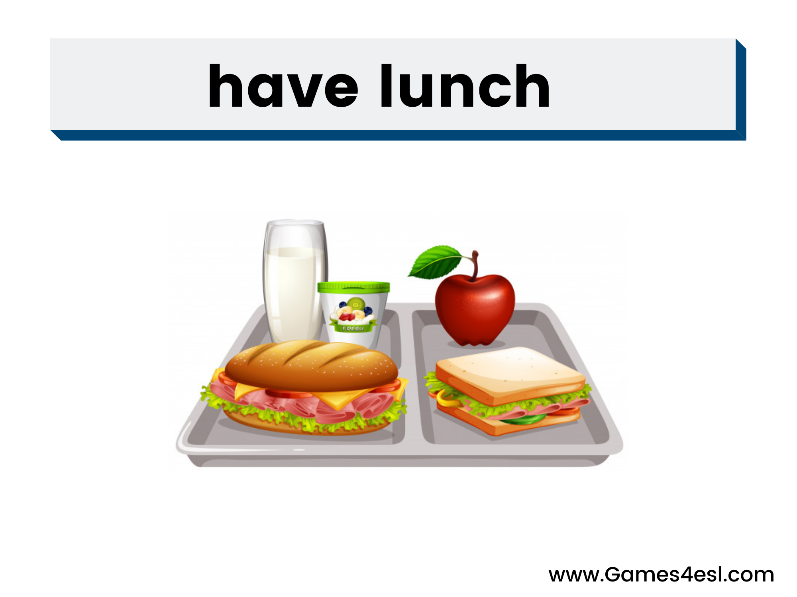

Slide 12
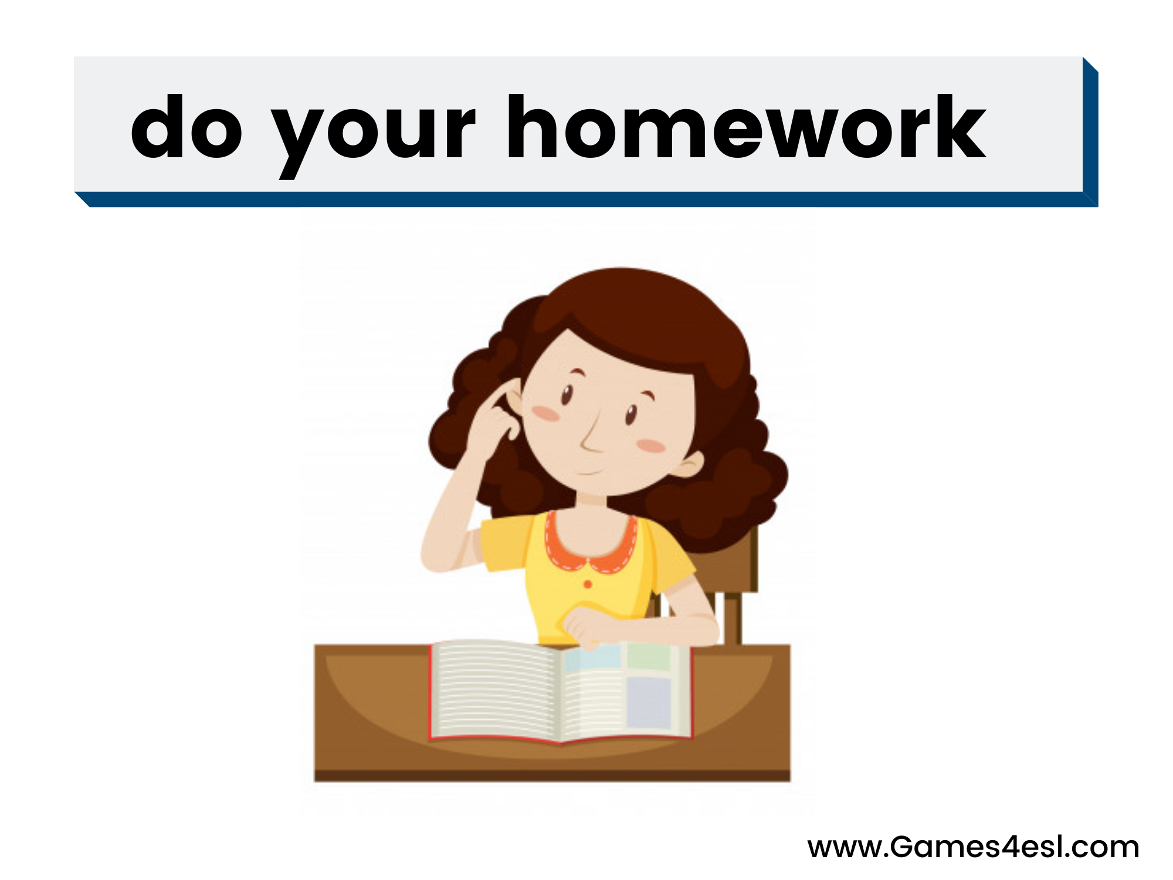

Slide 13
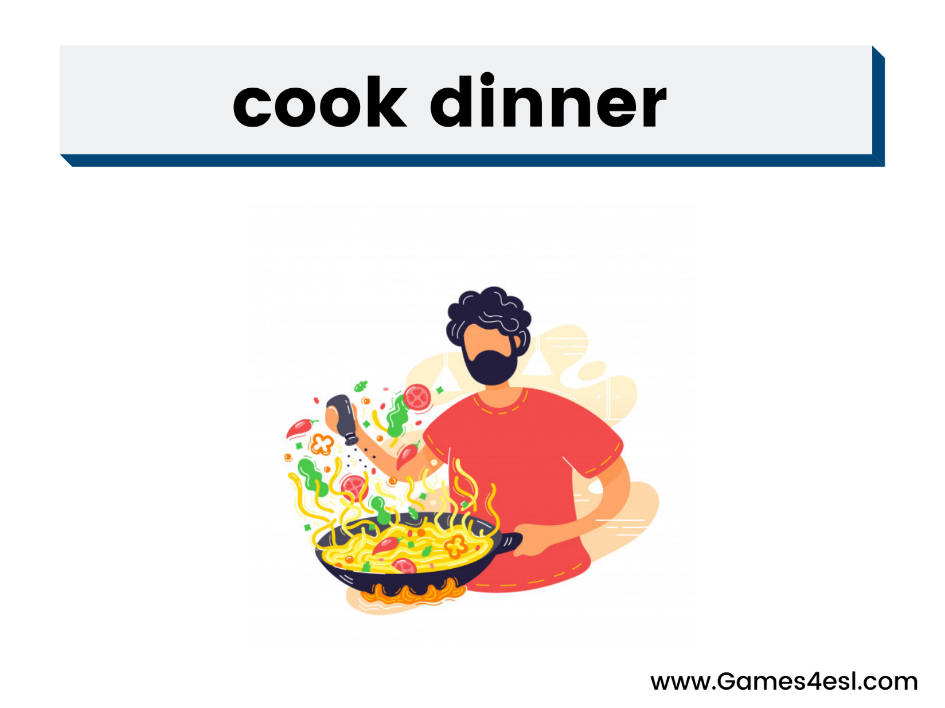

Slide 14


Slide 15


Slide 16
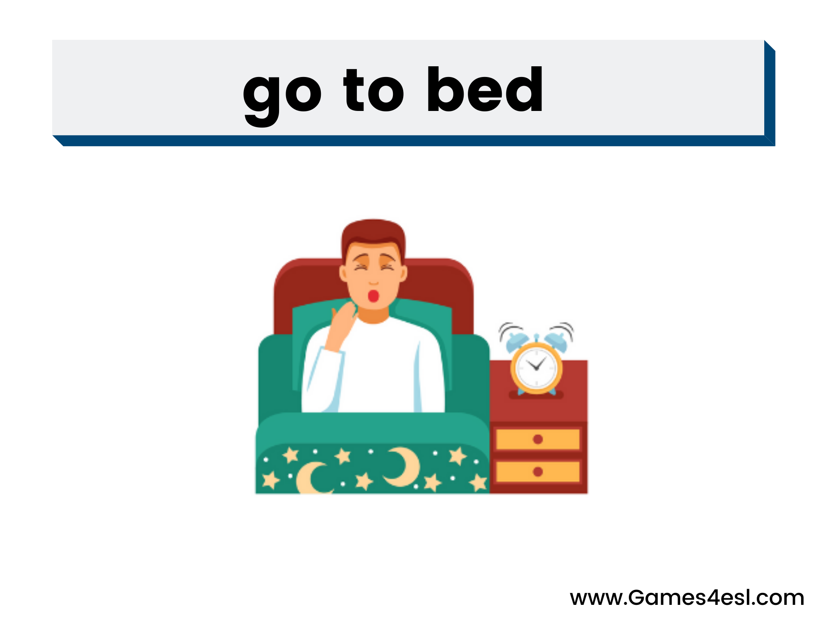

Slide 17
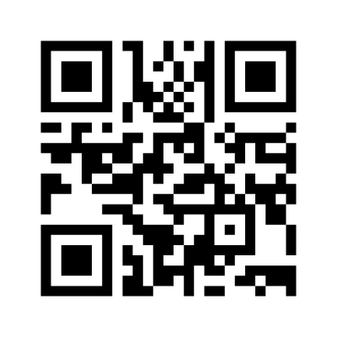
Exercise

Slide 18
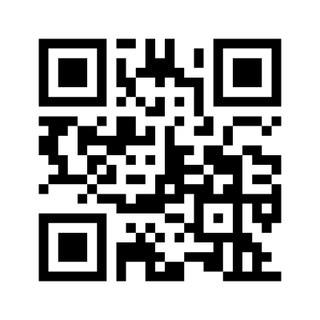
Exercise2

Slide 19


I practice yoga at 4 p.m.
Routine
/Facts
I practice
You practice
He practices
She practices
It practices
We practice
They practice

Slide 20
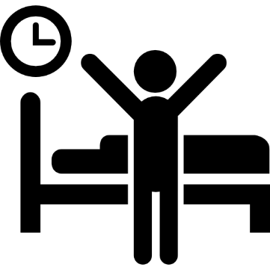
I wake up at 8 a.m.
Routine
/Facts
I wake up
You wake up
He wakes up
She wakes up
It wakes up
We wake up
They wake up

Slide 21
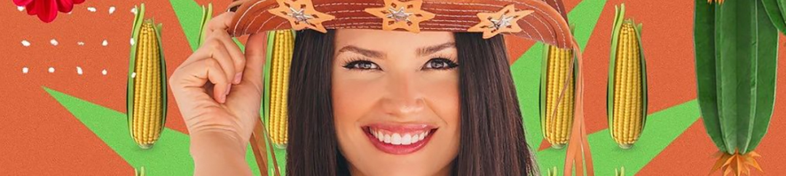
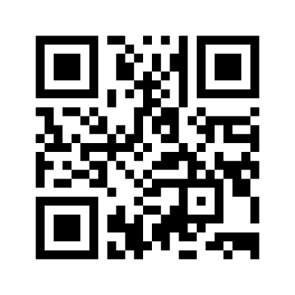


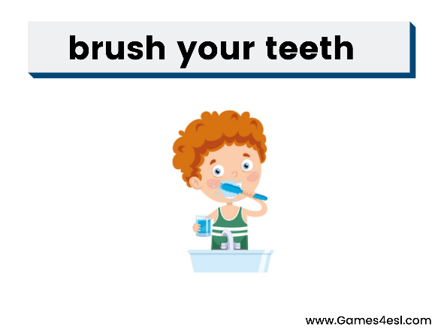






Slide 22


Slide 23


Rotine and facts
I don’t smoke
You don’t smoke
He doesn’t smoke
She doesn’t smoke
It doesn’t smoke
We don’t smoke
They don’t smoke
I don’t smoke.

Slide 24

Rotine and facts
I don’t smoke
You don’t smoke
He doesn’t smoke
She doesn’t smoke
It doesn’t smoke
We don’t smoke
They don’t smoke
I don’t smoke.

Slide 25

Interrogative
Do I eat vegetables?
Do you eat vegetables?
Does she eat vegetables?
Does he eat vegetables?
Does it eat vegetables?
Do we eat vegetables?
Do we eat vegetables?
Do you eat vegetables?

Slide 26
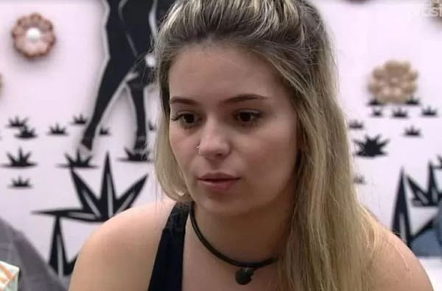
Pergunte no chat
Does she_______?
Yes, she does.
No, she doen’t.

