Slide 1
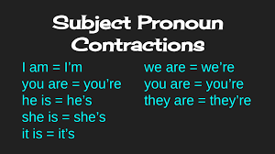

Slide 2
Eu sou/ estou
Nós somos/estamos
Você é/ está
Vocês são/estão
Ele é/ está
Eles são/ estão.
Elas são/ estão
Ela é/ está
Ele/Ela é/ está

Slide 3
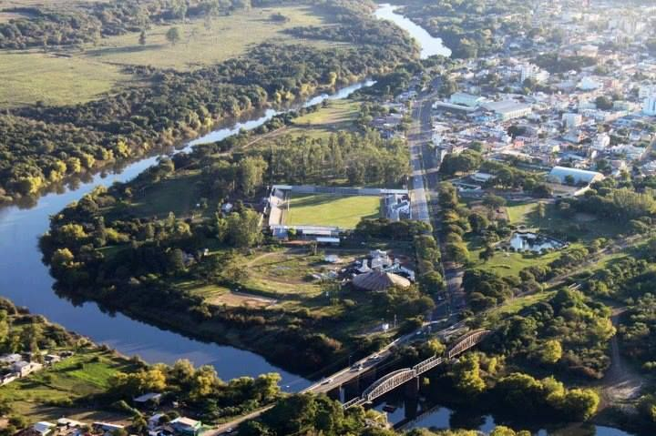
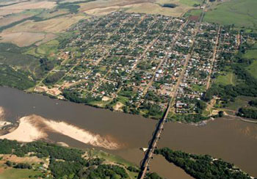
Where do you live?
I live in Alegrete
I live in Manoel Viana

Slide 4

Where do you live?
16s

Slide 5
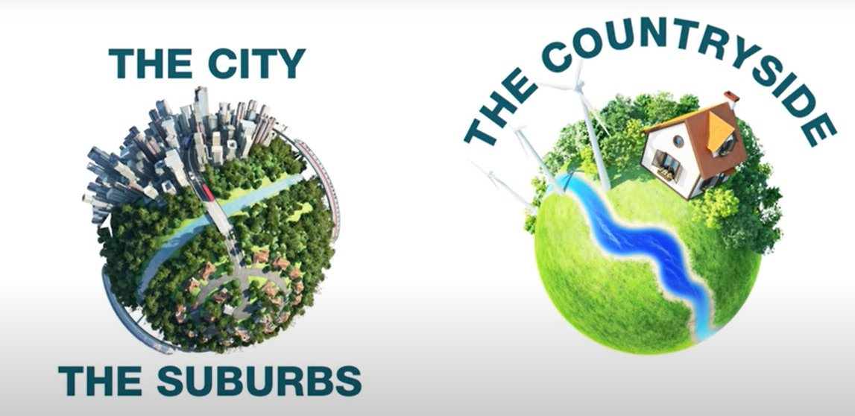
Where do you live?
I live in ......

Slide 6
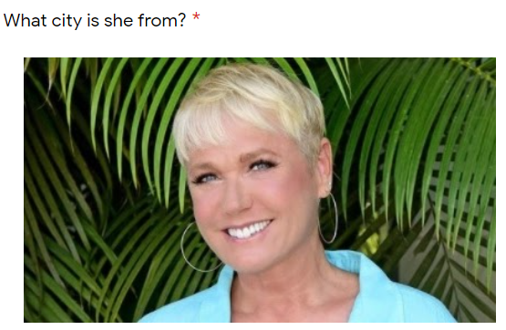
She is from Santa Rosa

Slide 7
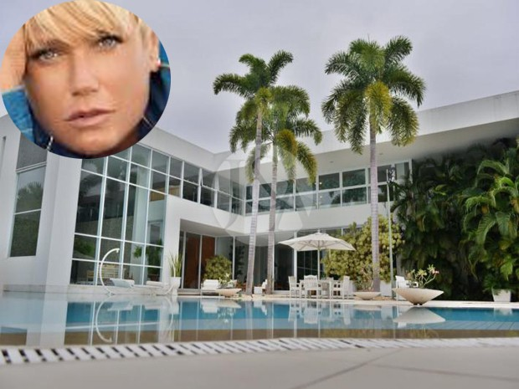
She lives in Rio de Janeiro

Slide 8
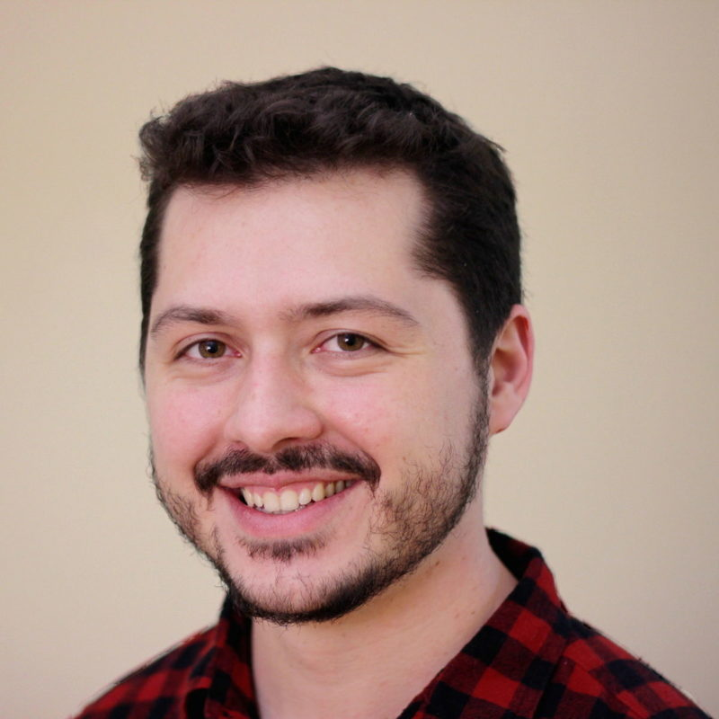
Who - quem
Who is he?

Slide 9
How old is he?

Slide 10




How old is he?

Slide 11
How old is he? He is ABOUT 37 Years old.

Slide 12
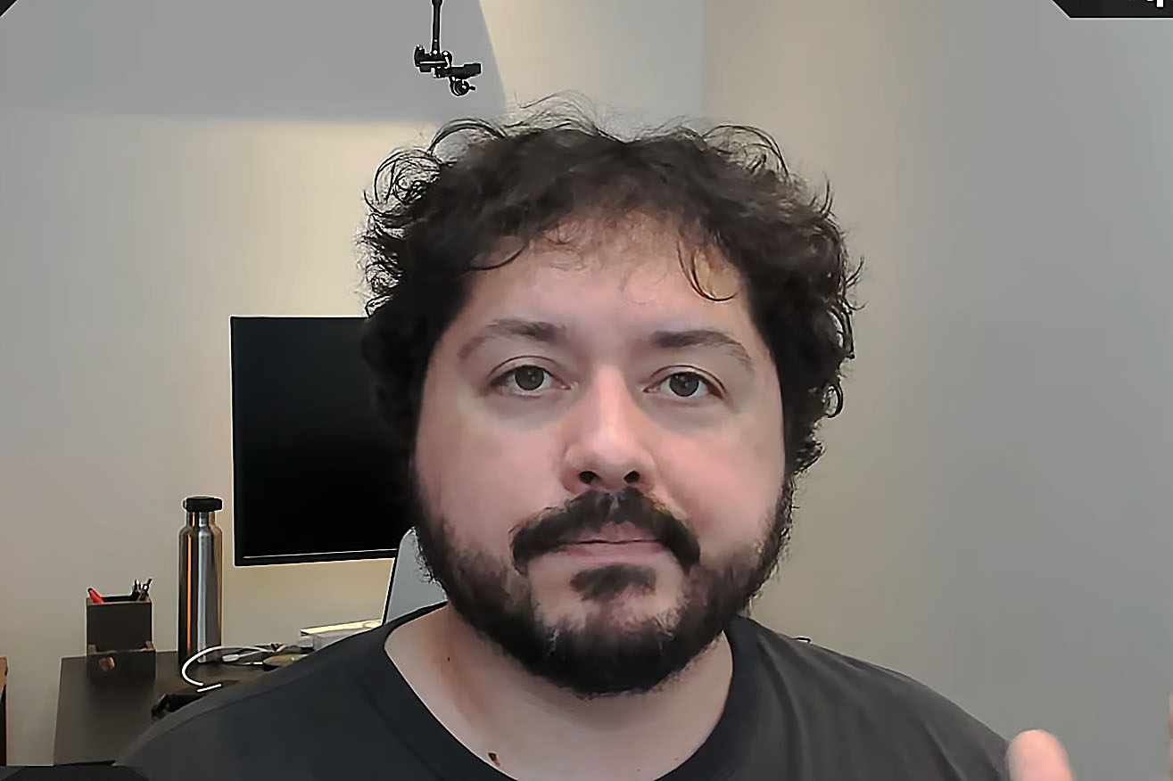
Is he Atila?

Slide 13
Yes, he is
No, he is not
Is he Atila?

Slide 14
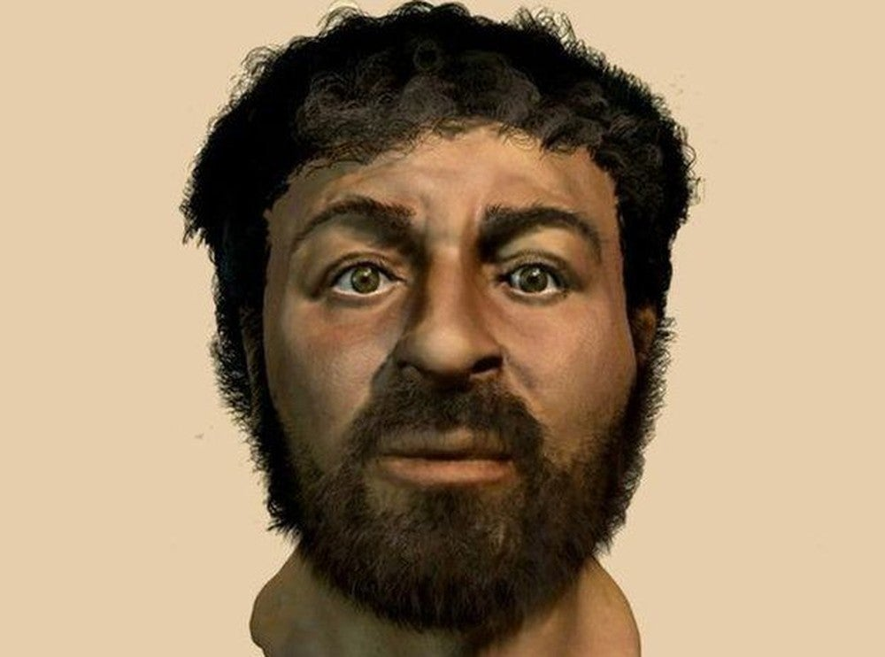
Yes, he is.
No, he is not.
No, he isn’t.
Is he Atila?

Slide 15
Who is he?

Slide 16
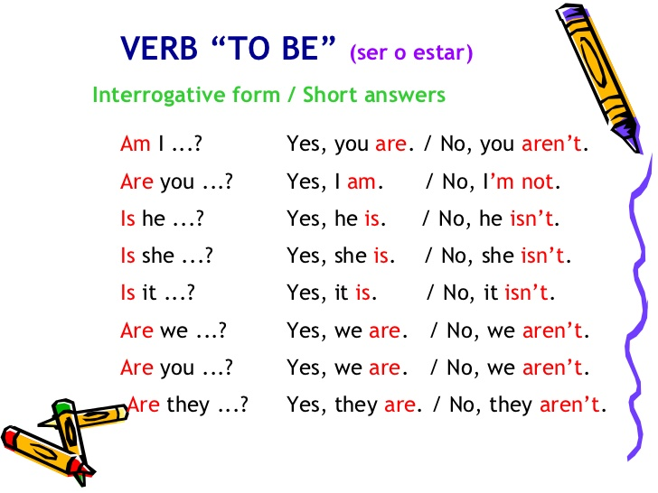

Slide 17
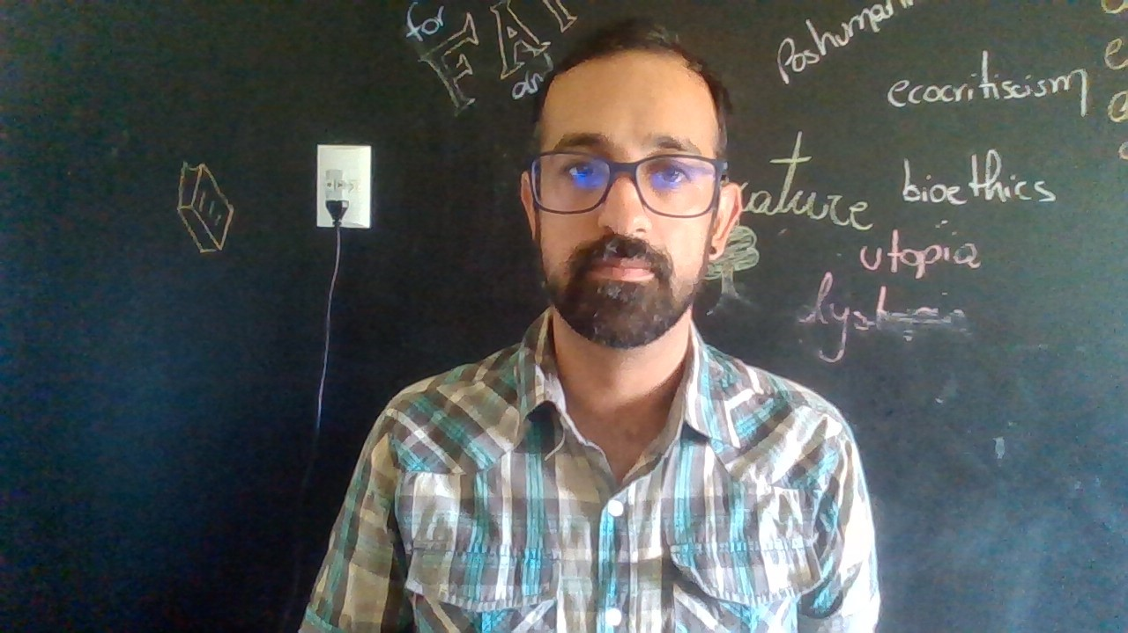
Yes, you are.
No, you are not
Am I a youtuber?

Slide 18

Yes, we are.
No, we are not
Are you students?

Slide 19
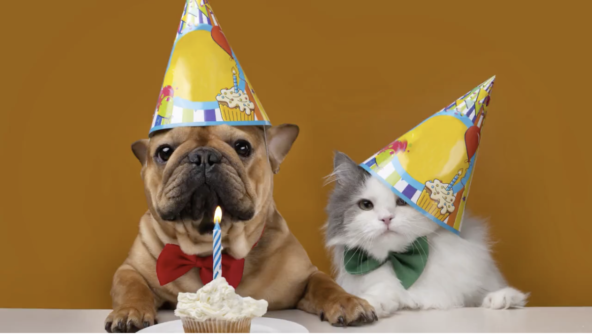
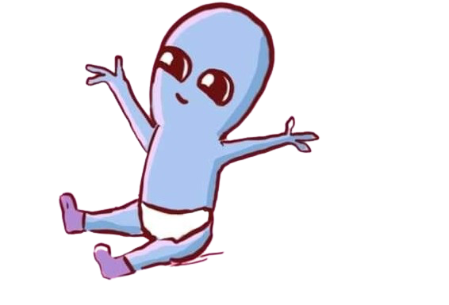
When is your birthday?
It’s on May 3rd.
month
ordinal number

Slide 20
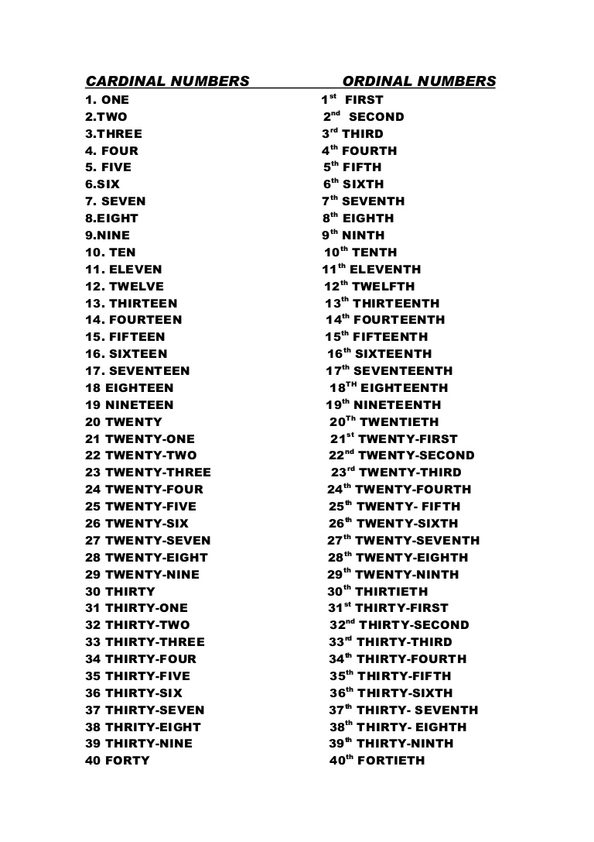
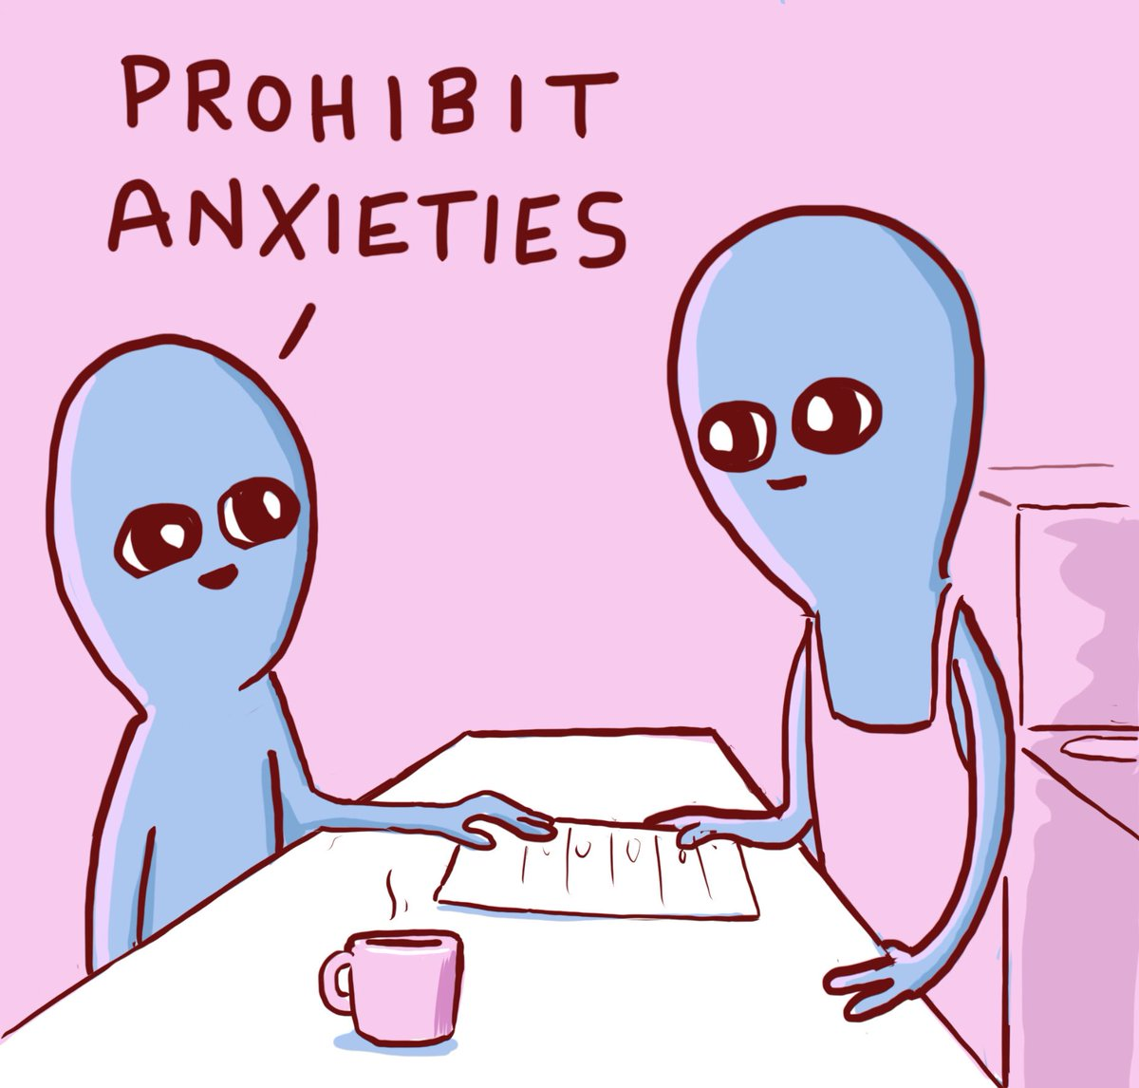

Slide 21
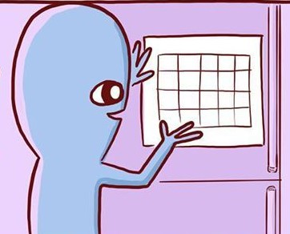
MONTHS
JANUARY
FEBRUARY
MARCH
APRIL
MAY
JUNE
JULY
AUGUST
SEPTEMBER
OCTOBER
NOVEMBER
DECEMBER

Slide 22
MONTHS
JANUARY
FEBRUARY
MARCH
APRIL
MAY
JUNE
JULY
AUGUST
SEPTEMBER
OCTOBER
NOVEMBER
DECEMBER
My birthday is on May 6th.
It is on May 6th.

Slide 23
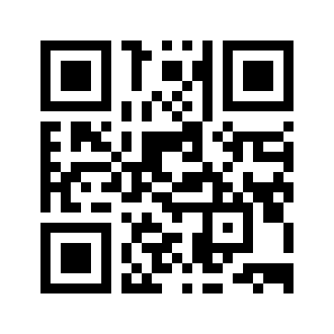

Acesse o link e vamos fazendo os exercícios simultaneamente.
https://www.menti.com/86ik45a7ef

