Slide 1
Going to

Slide 2

Warm-up
- Do you have pets? How many?
Have you ever thought about helping animals?
What would be difficult?
Do you think is possible to organize an NGO (non-profit organization)?

Slide 3
Warm-up
Let’s watch the video to find out!

Slide 4
Warm-up
What happen in the vídeo?
What is the vídeo message?
Do you think people get more sensitive by helping animals?
Can you name the animals in the vídeo?

Slide 5
Drawing time

Slide 6
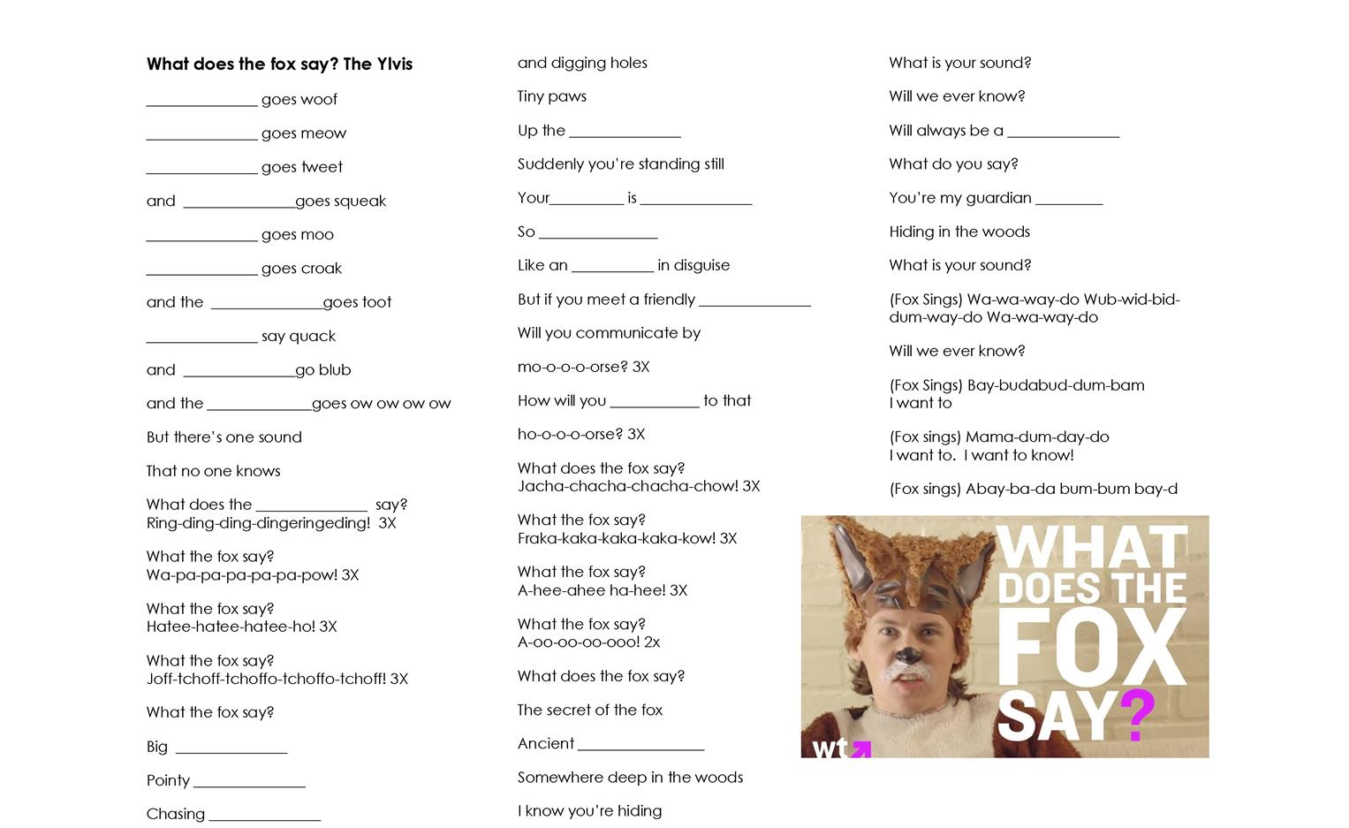
What does the fox say

Slide 7




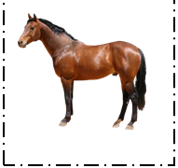




Let’s remember the video
Lets immagine we are going to help domesticated animals, Take a look at these animals. What are their names? Are they domesticated or wild?
Notes:
Write their answer on the board.

Slide 8
Are you going to open an NGO or a company to help animals?
Notes:
Write their answer on the board.

Slide 9
Let’s remember the video
Are they going to open the center tomorrow?
Notes:
Write their answer on the board.

Slide 10
Let’s remember the video
Are you going to open the center tomorrow?
Notes:
Write their answer on the board.

Slide 11
Let’s remember the video
When are you going to open the center?
Notes:
Write their answer on the board.

Slide 12
Let’s remember the video
And who is going to sponsor the project?
Notes:
Write their answer on the board.

Slide 13
Let’s remember the video
And who is going to sponsor the project?
Some businessmen are going to sponsor the project.
Notes:
Write their answer on the board.

Slide 14
About your pet
Do you have a pet?
What is your pet’s name?
How old is it?
Is it a big or a small pet?
What pets would you like to have in the future?
Notes:
If they say they don’t have a pet, here you ask them to imagine they have one and decide some information about it.

Slide 15

Today
Are you going to feed your pet?
Notes:
Write their answer on the board.

Slide 16

Today
Are you going to play with your pet?
Notes:
Write their answer on the board.

Slide 17

Today
Are you going to give your pet a bath?
Notes:
Write their answer on the board.

Slide 18

Today
Are you going to walk your pet?
Notes:
Write their answer on the board.

Slide 19

Today
Are you going to train your pet?
Notes:
Write their answer on the board.

Slide 20
Past, Present or Future?
Are you going to feed your pet?
I am going to feed my pet.
I am not going to train my pet.
Notes:
Write their answer on the board.

Slide 21
Past, Present or Future?
Are you going to feed your pet?
I am going to feed my pet.
I am not going to train my pet.
FUTURE
Notes:
Write their answer on the board.

Slide 22
Abstract or concrete?
Are you going to feed your pet?
I am going to feed my pet.
I am not going to train my pet.
Notes:
Write their answer on the board.

Slide 23
Abstract or concrete?
Are you going to feed your pet?
I am going to feed my pet.
I am not going to train my pet.
CONCRETE
Notes:
Write their answer on the board.

Slide 24
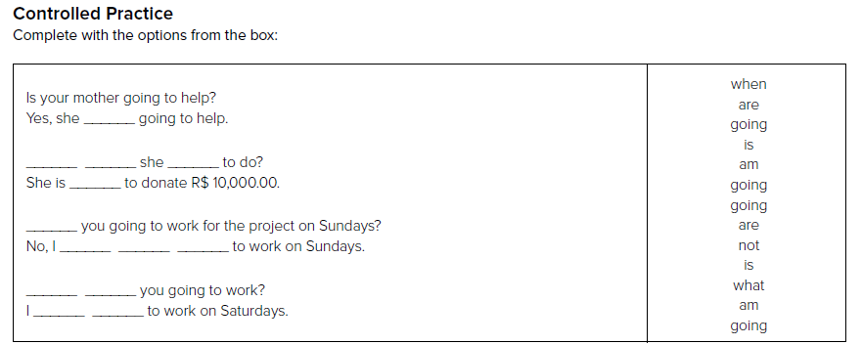
Pratice
Notes:
Write their answer on the board.

Slide 25
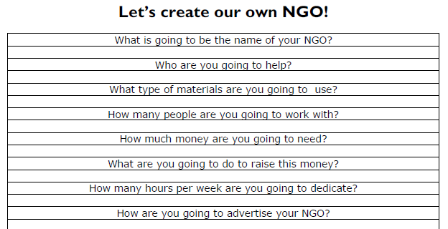
Practice
Notes:
Write their answer on the board.

