Slide 1
Aula sobre Will

Slide 2

Warm-up
Do you like to travel?
What is your favorite place to go on vacation?
How often do you travel?
How far is it from your house?
How long do you normally stay there?

Slide 3







Warm-up
What is important to do when you decide to travel?
Learn the culture
Check the weather forecast
Buy travel tickets
Pack
Learn about the food
Check the hotspots

Slide 4


Let’s travel!
Let’s imagine we will travel to any place in the world!
First, let’s decide some things.

Slide 5


Let’s travel!
1) Where will we go?

Slide 6




Let’s travel!
2) When will we go?
Summer
Winter
Fall
Spring

Slide 7









Let’s travel!
3) What will the weather be like there at this time of the year?
Sunny
Snowy
Cloudy
Foggy
Rainy
Windy
Stormy
Hail

Slide 8

Let’s travel!
3) What about the temperature?
Freezing
Cold
Cool
Warm
Hot
Boiling hot

Slide 9






Let’s travel!
4) Who will we go with?
Family
Girlfriend
Boyfriend
Husband
Wife
Brother
Cousin
Mother
Sister
Son
Father
Uncle
Daughter
Pets
Grandmother
Friends
Aunt
Grandfather

Slide 10







Let’s travel!
5) What will we do there?
Go to museums
Go hiking
Visit hotspots
Visit historical places
Eat typical food
Go to parties

Slide 11





Let’s travel!
6) What clothes will we take?
Let’s pack!
Imagine you need to pack for our trip! Remember the weather of the place while choosing what to take!
Take flashcards of your clothes and put them in your suitcase.
After that, report to the group.

Slide 12




Let’s travel!
7) Finally! Let’s go!
9) We arrived at the airport to finally travel to our planned destination!
10) It’s raining a lot! A storm is coming!

Slide 13

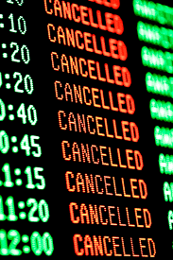


What now?
11) Our flight was cancelled!
Let’s decide…
What will we do?
Where will we go?

Slide 14
Practice
These sentences are in the present, past or future?
We will go to...
We will go in (summer/ winter/fall/spring)
It will be (sunny/rainy/cloudy...)
We will go with...
I will take...

Slide 15
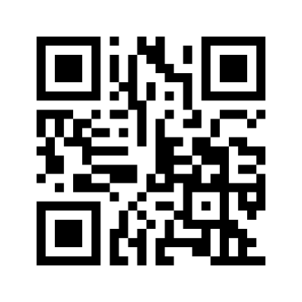
Practice
Acesse o link no chat

Slide 16
Practice
These sentences are in the present, past or future?
We will go to...
We will go in (summer/ winter/fall/spring)
It will be (sunny/rainy/cloudy...)
We will go with...
I will take...
FUTURE

Slide 17
WILL
And what’s the difference in these situations?
I will go to Canada.
It's raining! I will open my umbrella!
Tomorrow it will be sunny.

Slide 18
WILL
And what’s the difference in these situations?
Abstract plan
I will go to Canada.
It's raining! I will open my umbrella!
Tomorrow it will be sunny.
Spontaneous decision
Natural phenomena

Slide 19




WILL
We use will to talk about future events. But not all the future events.
When?
Where?
How?
Abstract plans
natural phenomena
Spontaneous decision

