Slide 1
HAVE/ There is and there are

Slide 2
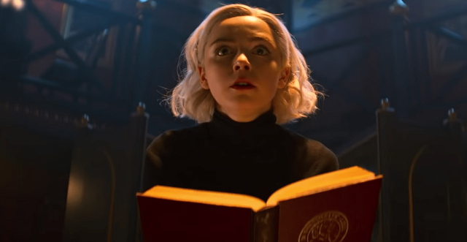
possession
Sabrina’s book is red.
Her book is red.

Slide 3
Possession(possessives)-> to have
She has a book

Slide 4
to have -> affirmative
I have a book
You have a book
She has a book
He has a book
It has a book
We have a book
They have a book

Slide 5


to have -> Negative
I don’t have a book
You don’t have a book
She doesn’t have a book
He doesn’t have a book
It doesn’t have a book
We don’t have a book
They don’t have a book

Slide 6
to have -> Interrogative
Do I have a book?
Do You have a book?
Does She have a book?
Does He have a book?
Does It have a book?
Do We have a book?
Do They have a book?

Slide 7
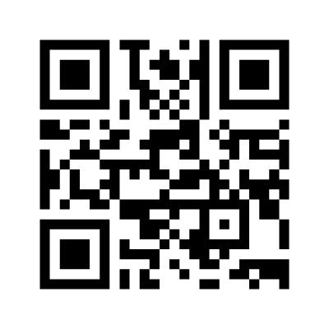
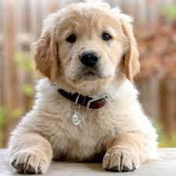
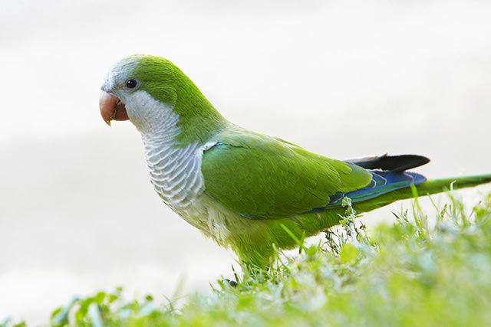
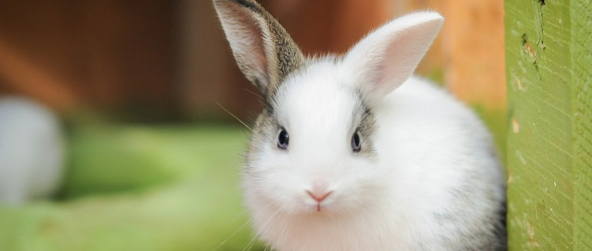
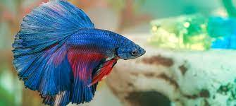
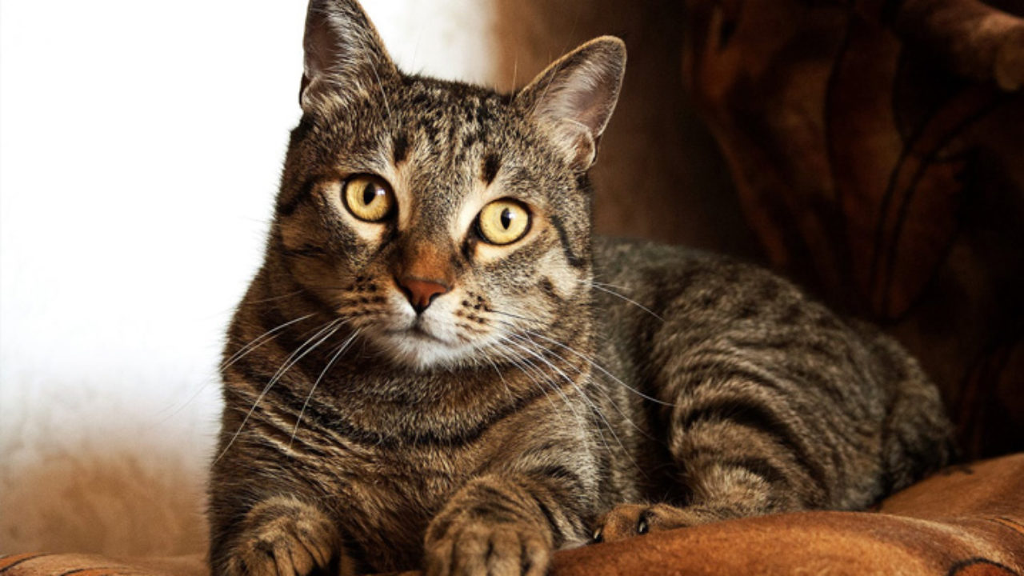
Do you have pets?
a dog.
a bird.
a rabbit.
a cat.
a fish.
No pets.

Slide 8
Do you have____? Yes, I do/ No, I don’.t

Slide 9
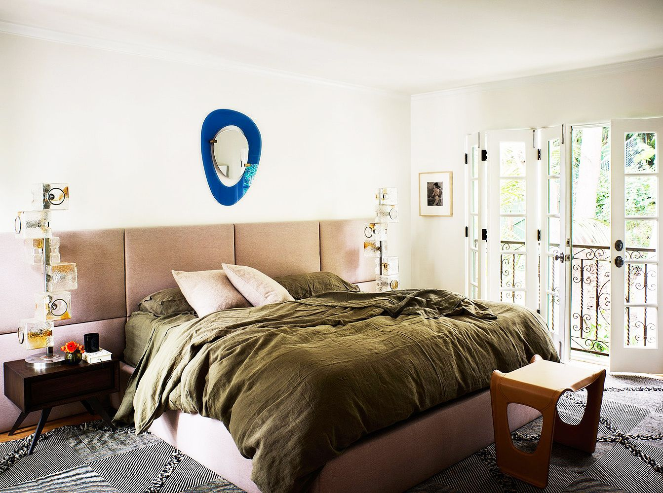
1.
Do you have?
Do you have____? Yes, I do/ No, I don’.t
Bedroom
Mirror
frame
French door
Pillows
Window(imagine)
mug
Blanket
book
Bedside table
stool
Carpet

Slide 10
Does she have____? Yes, she does/ No, she doesn’t Does he have____? Yes, he does/ No, he doesn’t Do they have____? Yes, they do/ No, they don’t

Slide 11
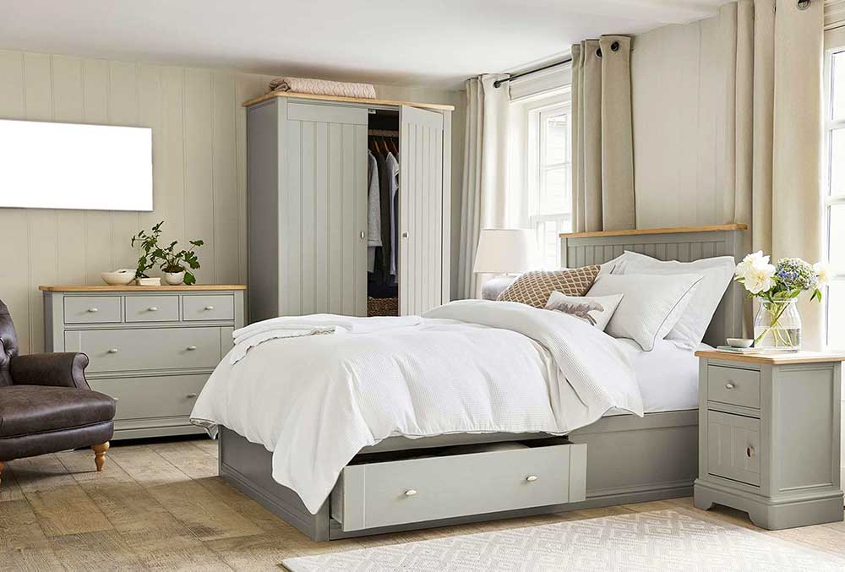
Does she have____? Yes, she does/ No, she doesn’t Does he have____? Yes, he does/ No, he doesn’t Do they have____? Yes, they do/ No, they don’t
Parents’ Bedroom
curtains
closet
Lampshade
plants
vase
mug
Arm -chair

Slide 12

There is and there are
When I don’t want to imply possession
(Quando eu não quero demonstrar a posse)

Slide 13


Slide 14
Interrogative
Singular
Is there ____ ?
Yes, there is.
No, there isn’t
Plural
Are there ?
Yes, there are.
No, there aren’t
Negative
Singular
There is not ____ (emphatic)
The isn’t _____ (normal)
Plural
There are not _____ (emphatic)
There aren’t ______(normal)

Slide 15
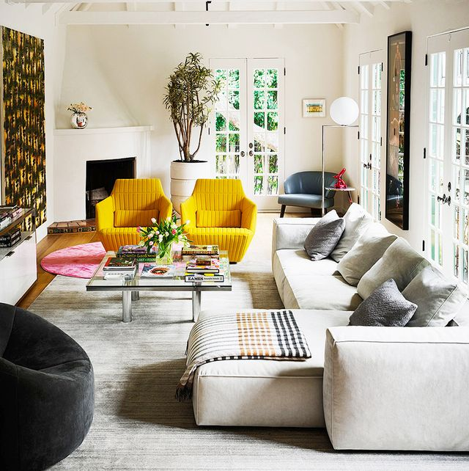
Is thre? Are there?
lampshade
plants
Living room
curtains
Fireplace
Arm-chair
cussion
Coffee table
Sofa
beanbag
carpet

Slide 16
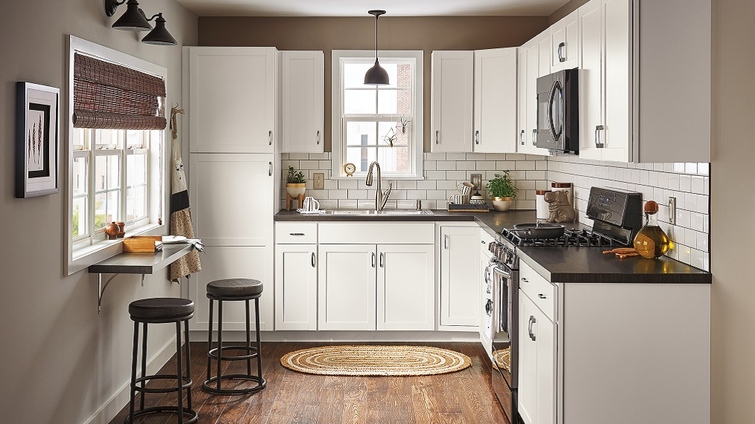
Is thre? Are there?
lamp
microwave
kitchen
curtains
Tap
frame
sink
Stove
Table
Sofa
Cabinets
Oven
carpet
Cabinets
Stool

Slide 17
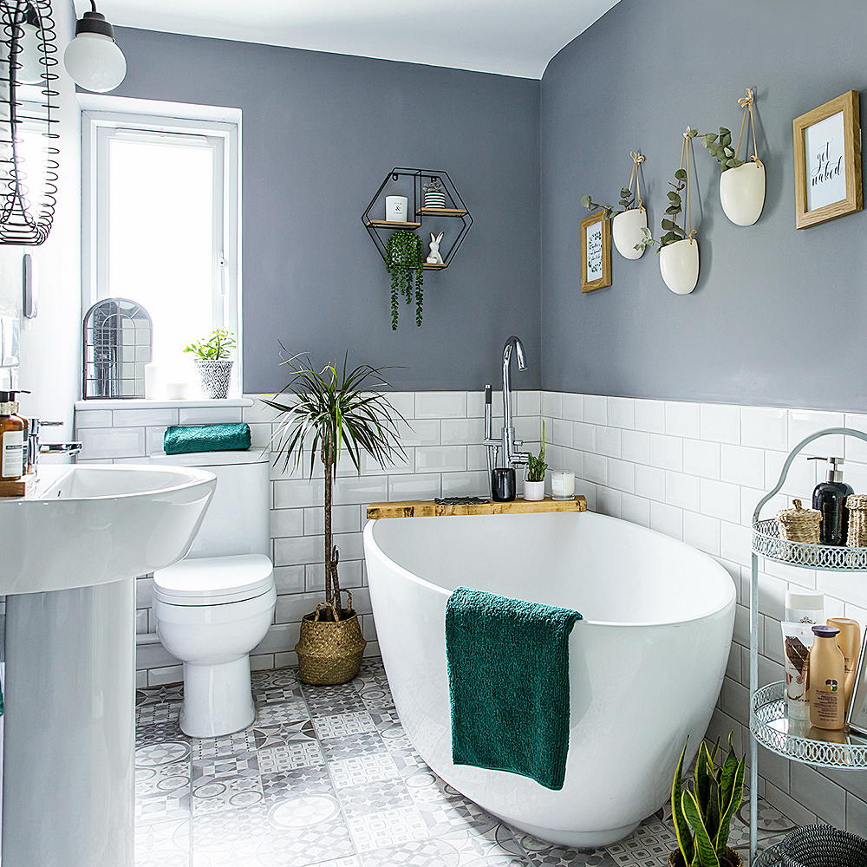
Is thre? Are there?
lamp
decoration
bathroom
window
mirror
Tap
tap
Soap
sink
Shelves
Bathtub
Toilet
towel

Slide 18
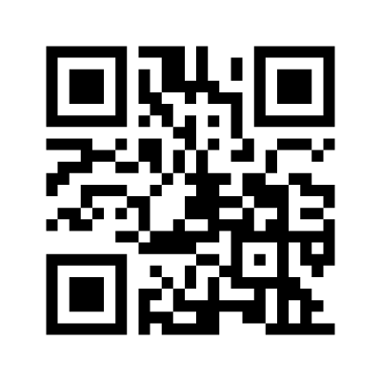
exercícios

Slide 19
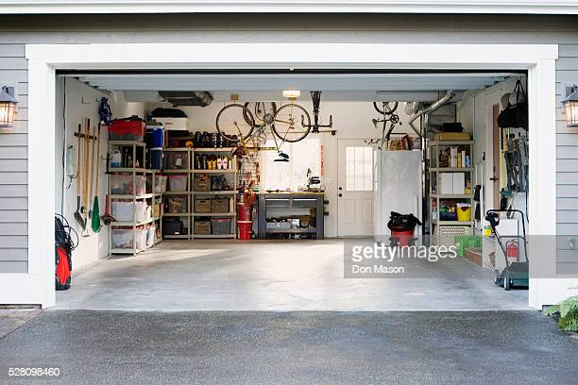
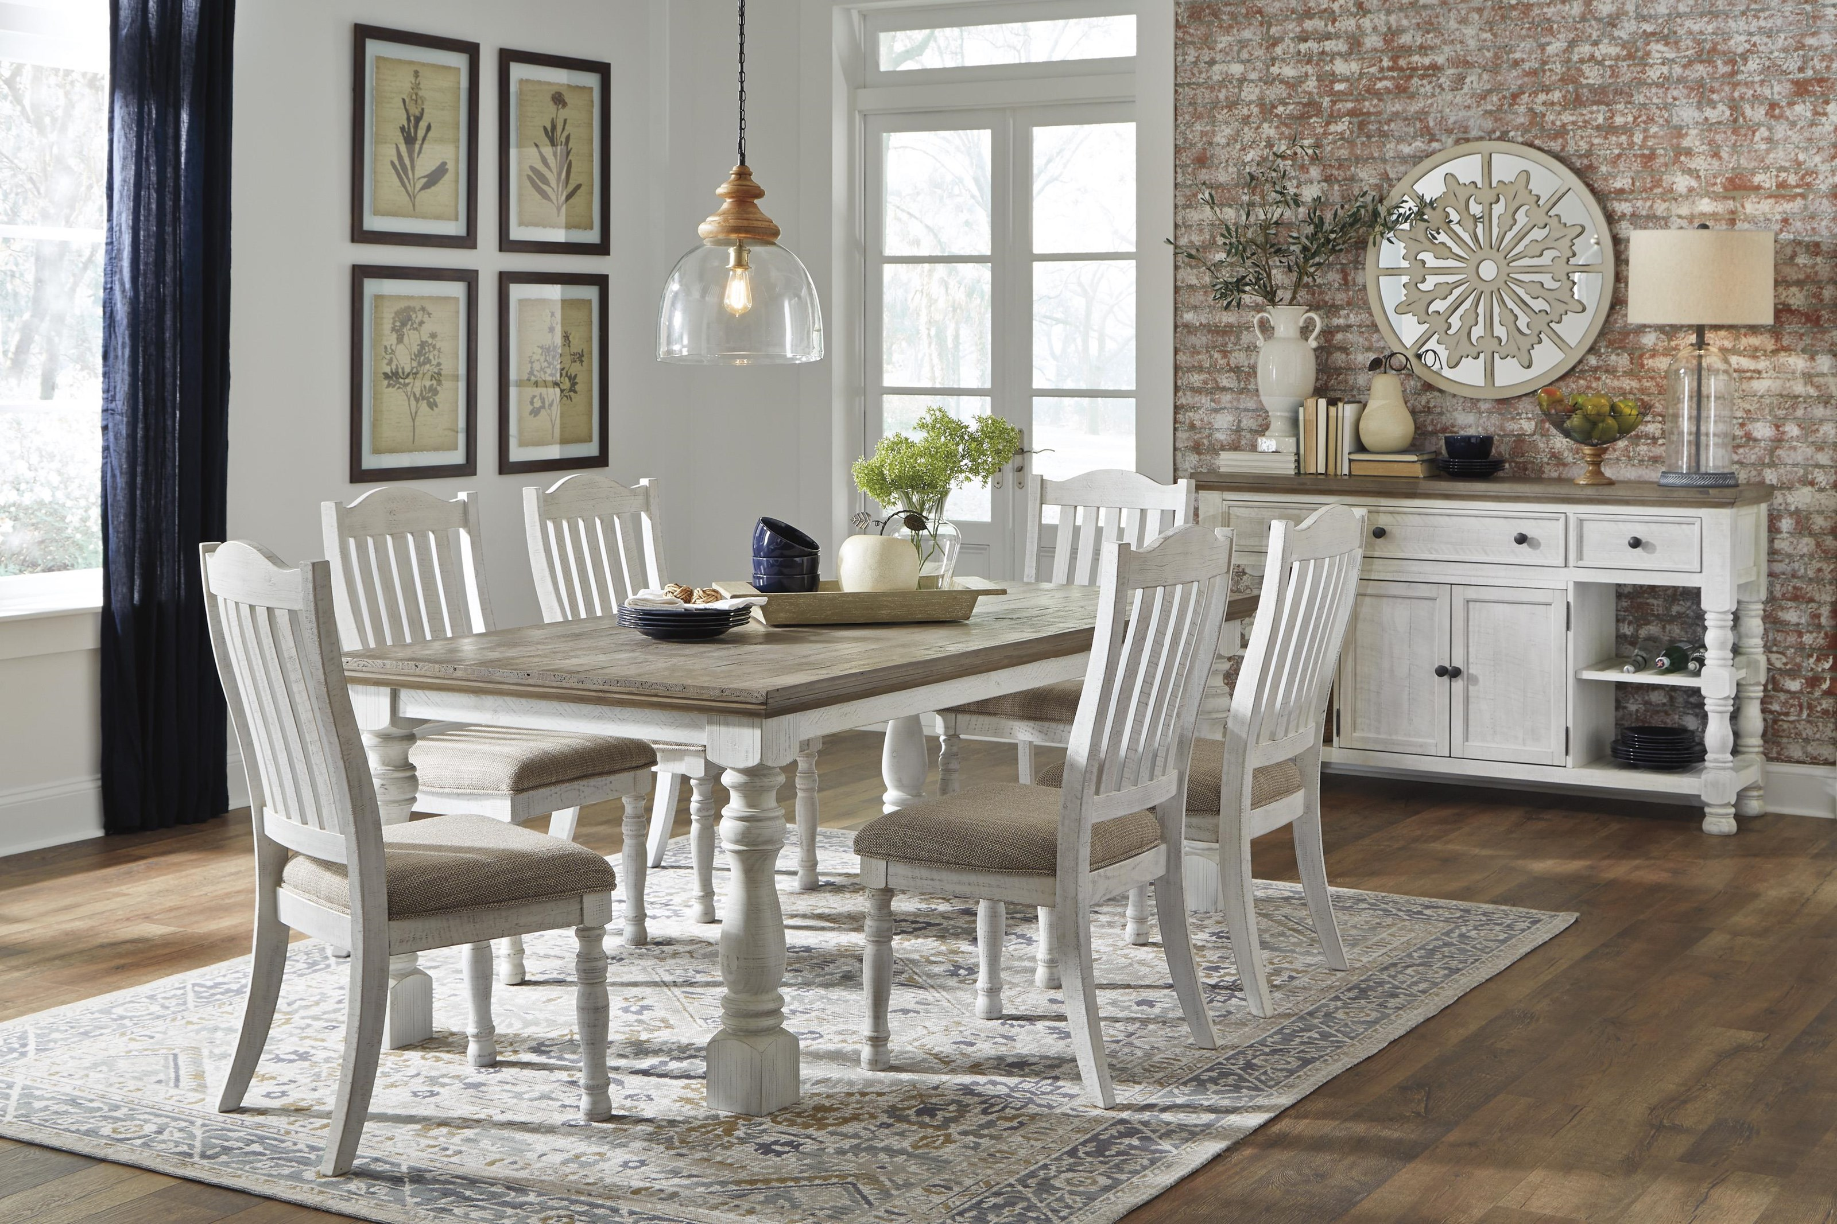
Outras partes da casa
Garage
Dining room

Slide 20
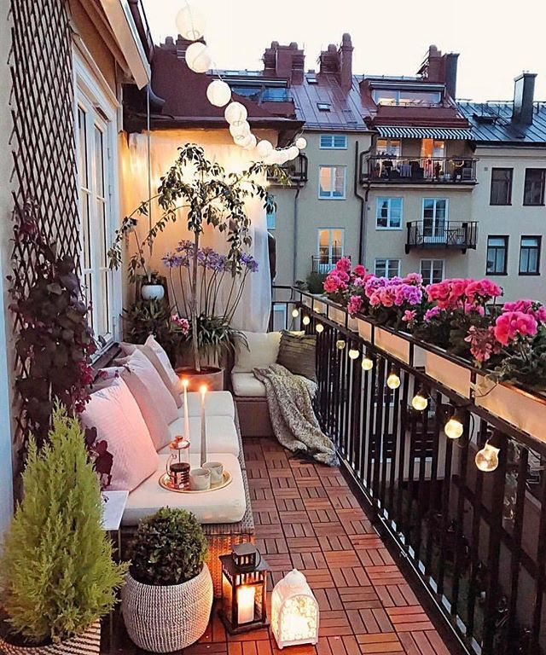
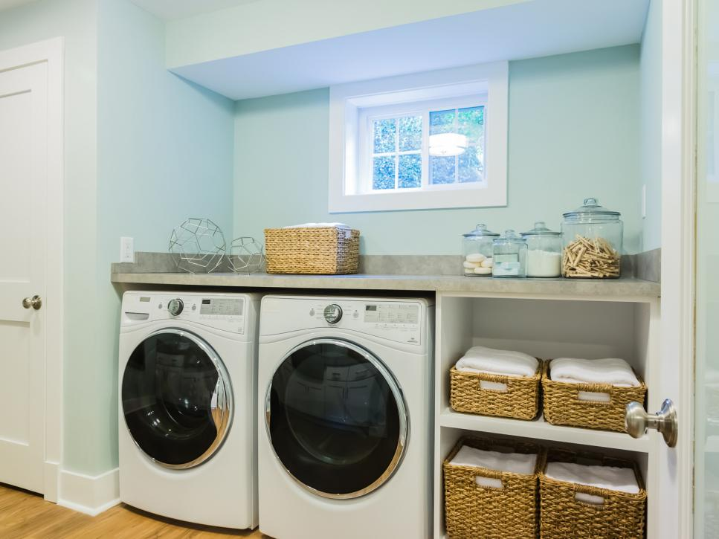
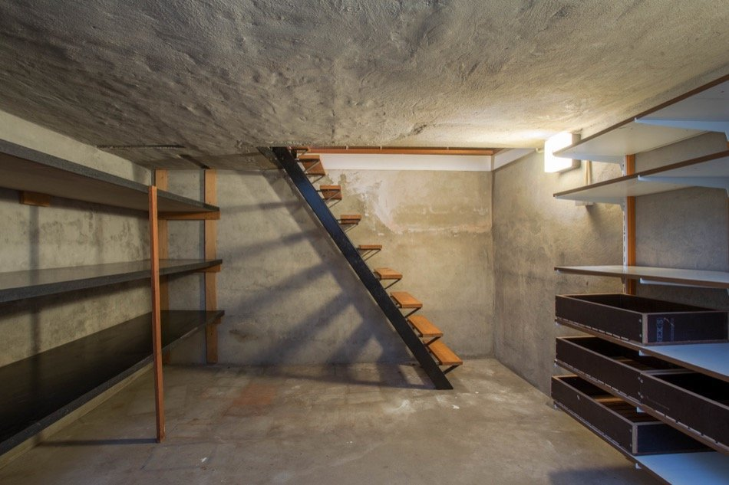
Outras partes da casa
Laundry room
Basement
Balcony

Slide 21
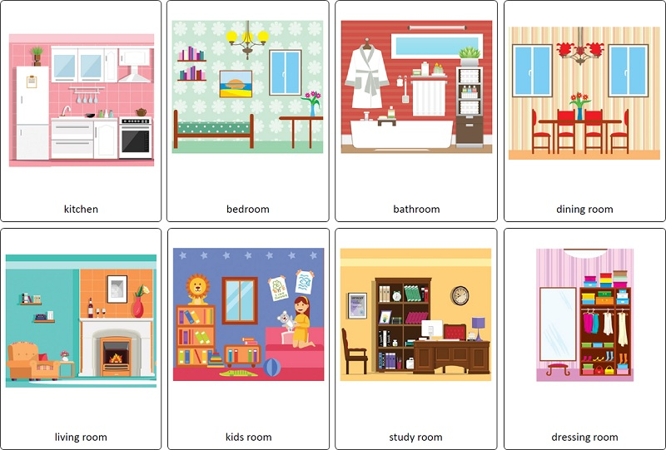
What is your favorite room?

