Slide 1
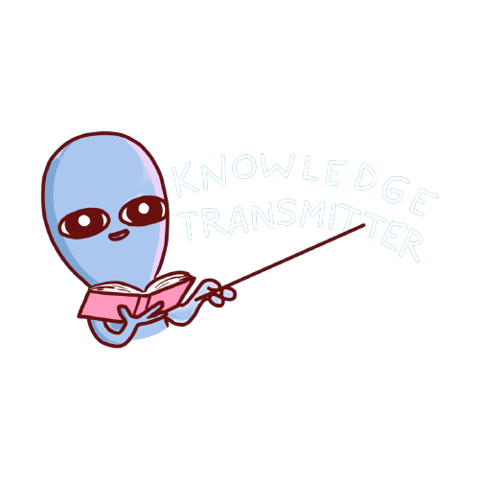
LÍNGUA INGLESA
1º ano
Professor Ânderson Martins

Slide 2
Vamos falar sobre o primeiro questionário?

Slide 3




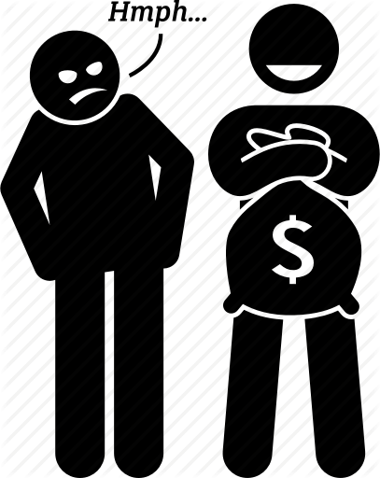







What are you like?
Hard-working
Vain
funny
Envy
Easy going
Lazy
Aggressive
Moody
Chatty
Friendly
Grumpy
Organized

Slide 4
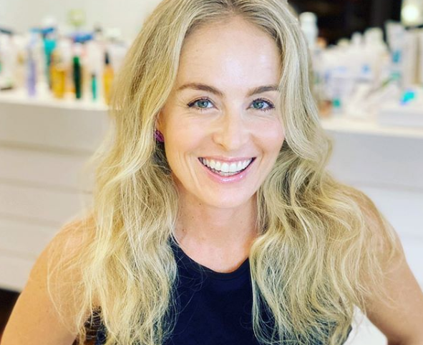
What is Angelica like?
Hard-working
Vain
funny
Envy
Easy going
Lazy
Aggressive
Moody
Chatty
Friendly
Grumpy
Organized

Slide 5
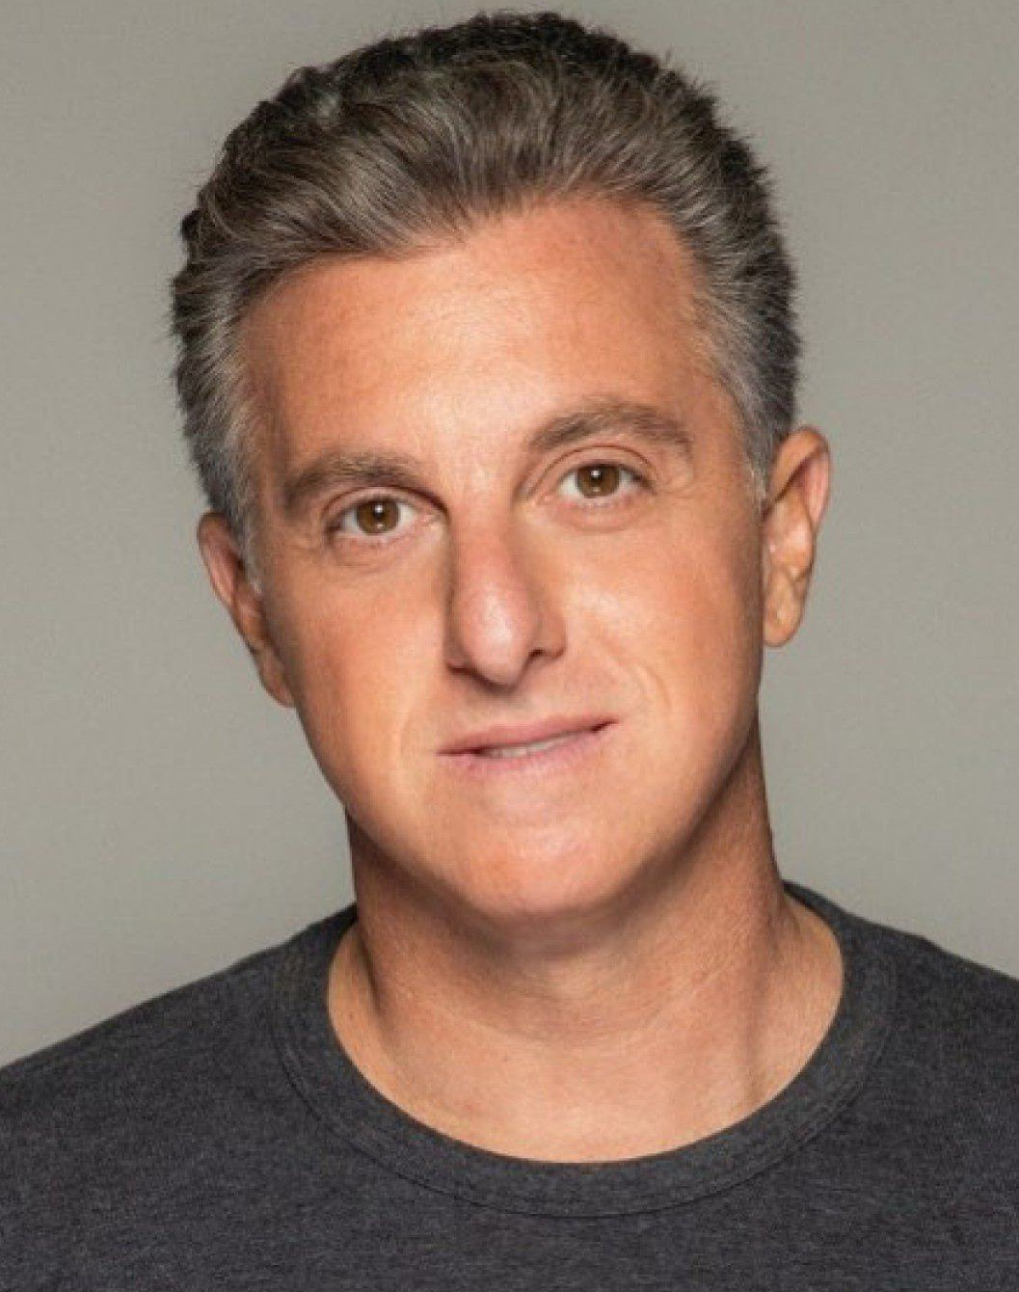
What is Luciono Huck like?
Hard-working
funny
Vain
Easy going
Lazy
Envy
Chatty
Moody
Aggressive
Grumpy
Organized
Friendly

Slide 6
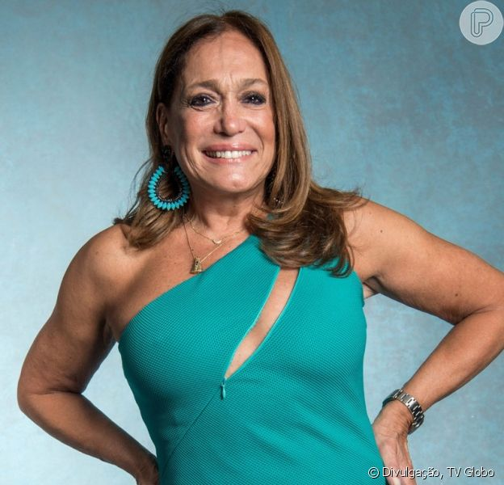
What is Susana Vieira like?
Hard-working
Vain
funny
Envy
Easy going
Lazy
Aggressive
Moody
Chatty
Friendly
Grumpy
Organized

Slide 7
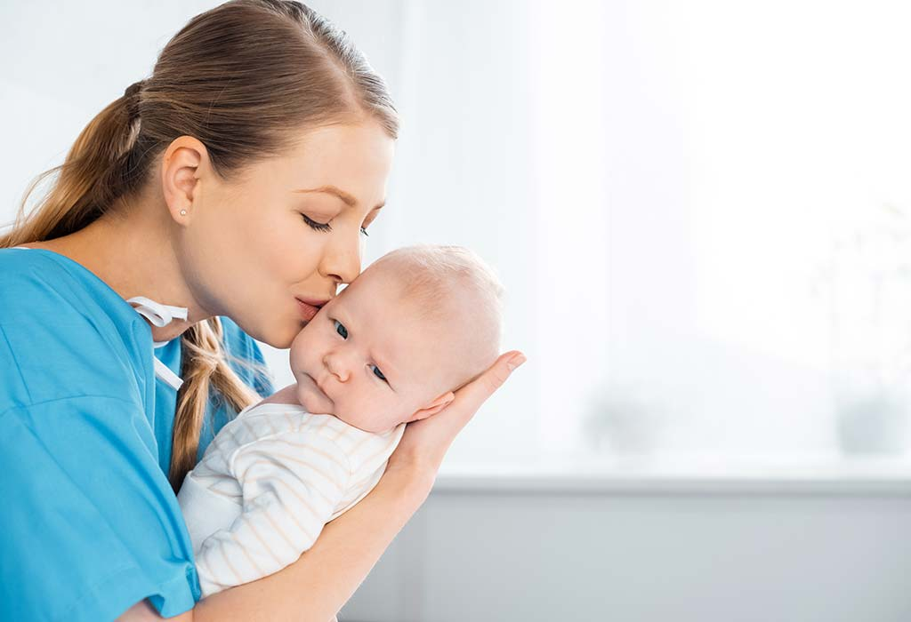
What is your mother like?
Hard-working
Vain
funny
Envy
Easy going
Lazy
Aggressive
Moody
Chatty
Friendly
Grumpy
Organized

Slide 8
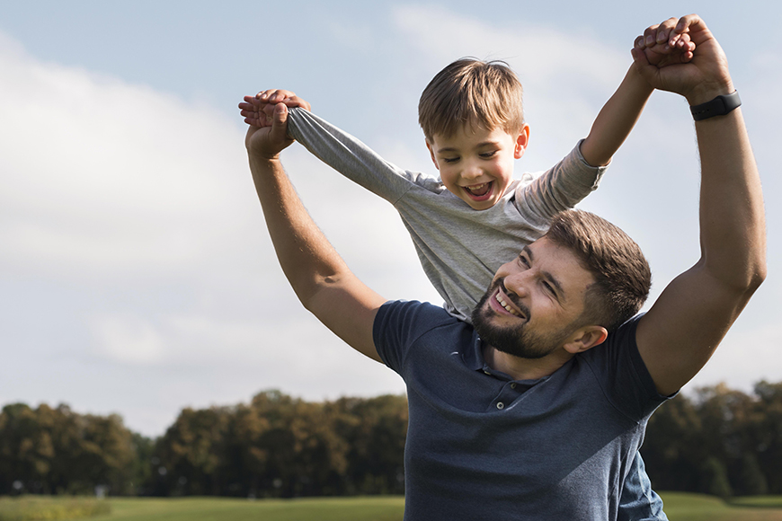
What is your father like?
Hard-working
Vain
funny
Envy
Easy going
Lazy
Aggressive
Moody
Chatty
Friendly
Grumpy
Organized

Slide 9
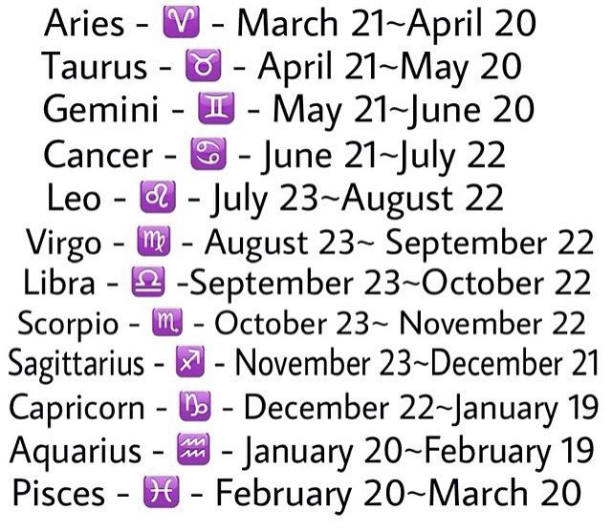
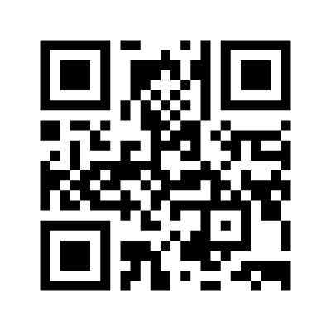
https://www.menti.com/eaer4ozp71

Slide 10
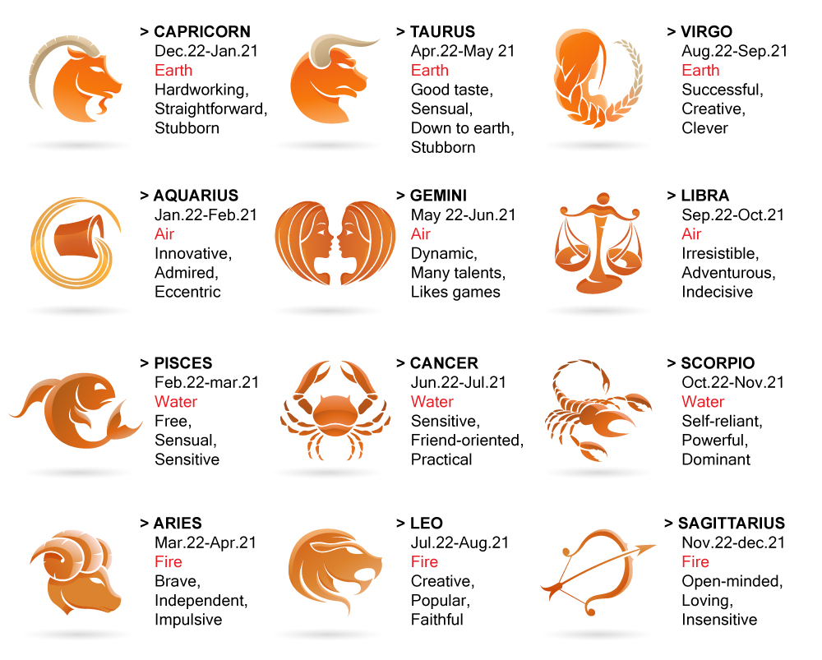

Slide 11
Sensitive – sensível
Sensible -sensato

Slide 12
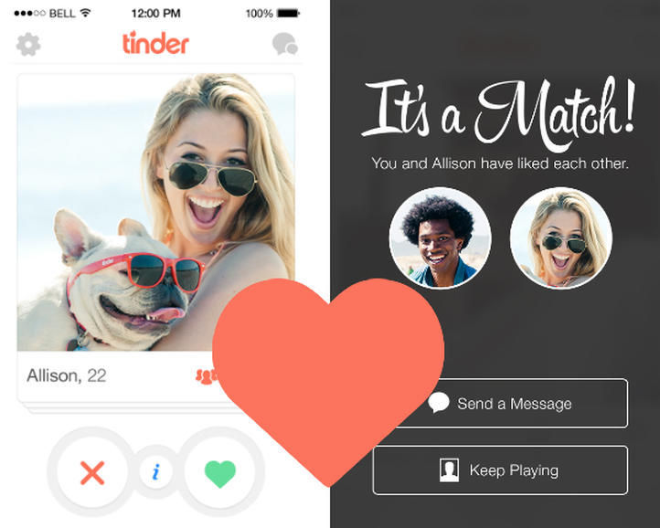
Taling about your sign and you, does it match?
What do you like people to be like?

Slide 13
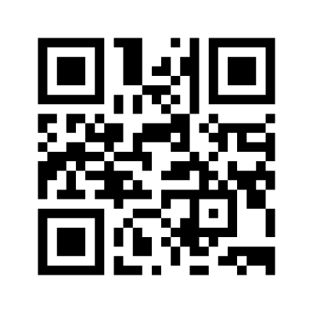
https://www.menti.com/yotuv4ef5v

Slide 14

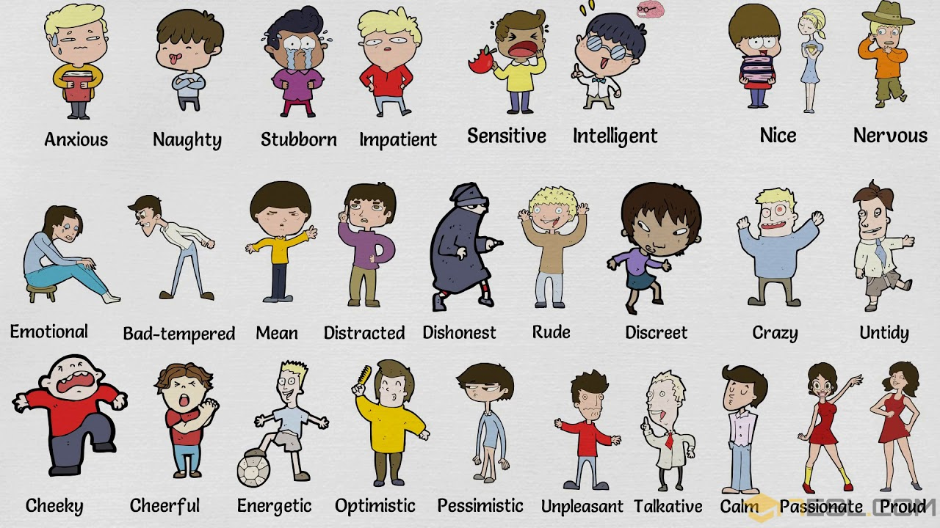
What are people like on Instagram?

Slide 15
What are people like on their bios.

Slide 16
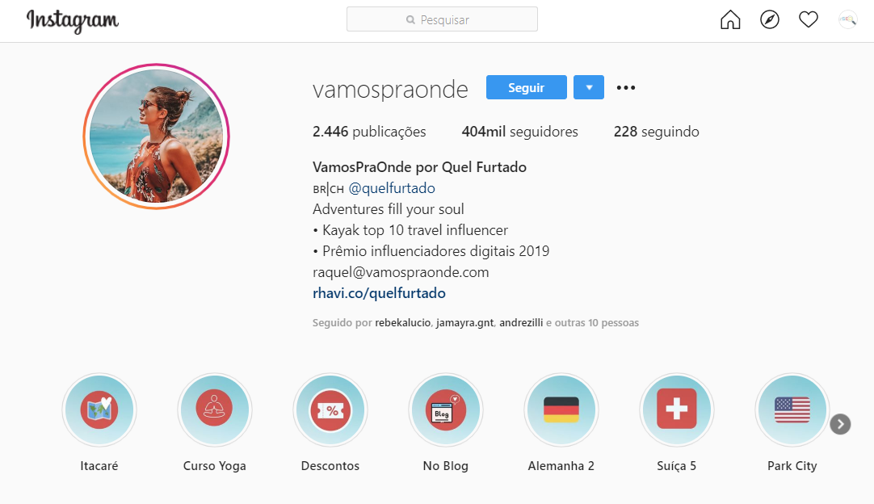
What are people like on their bios.

Slide 17
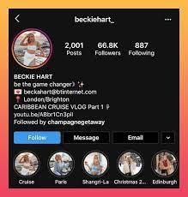
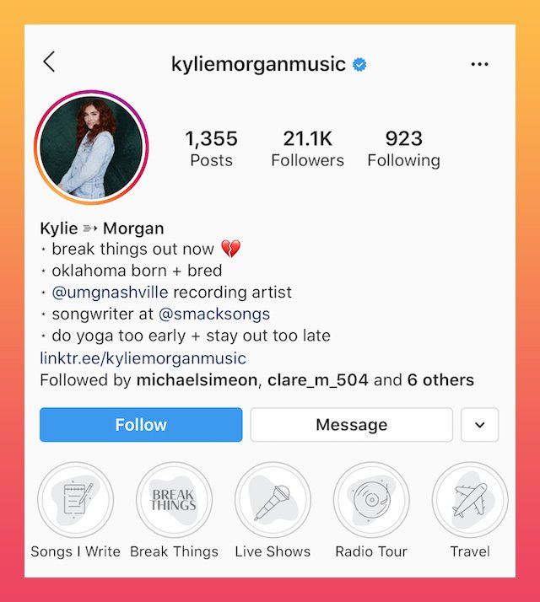
What are people like on their bios.

Slide 18

What are people like on their bios.

Slide 19
Next Week 2 activities
Questionário envolvendo emocional status, sign and personality

Slide 20
Next Week 2 activities
Encontre 3 perfis do instagram (em inglês) e comente sobre quais informações você conseguiu entender dos perfis. Tente conectar com o que você está apresendendo em aula. Mande um texto ou fotos que mostrem o perfil e seu ponto de vista sobre eles.

