Slide 1

Who are you?

Slide 2


Who are you?
I am Ânderson.
My name is Ânderson.
I am the Ânderson.
Ânderson.

Slide 3
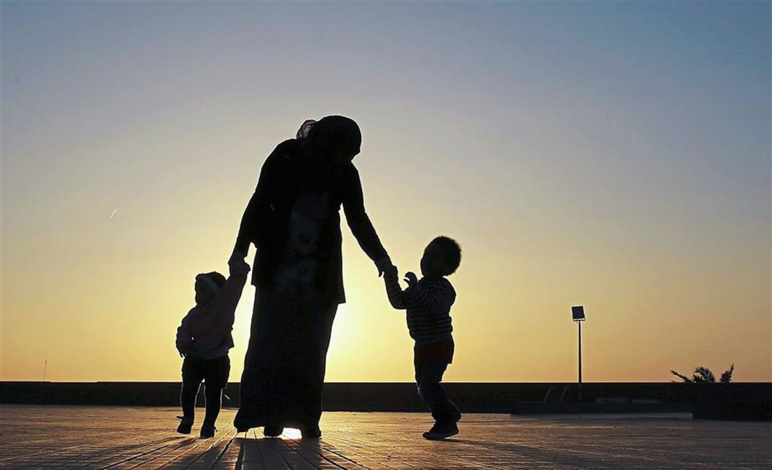
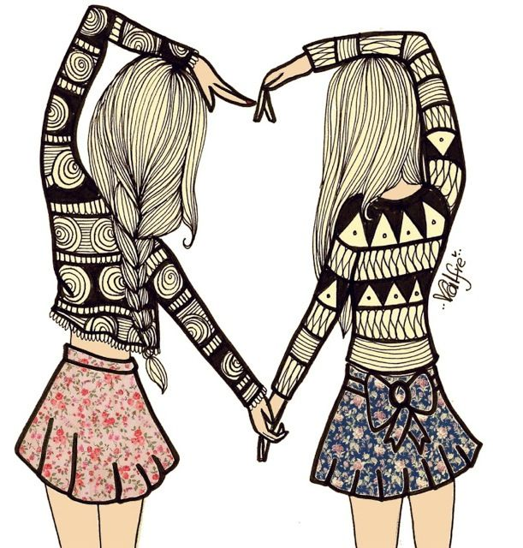

When is somebody’s birthday?
Mother
Father
Best friend

Slide 4
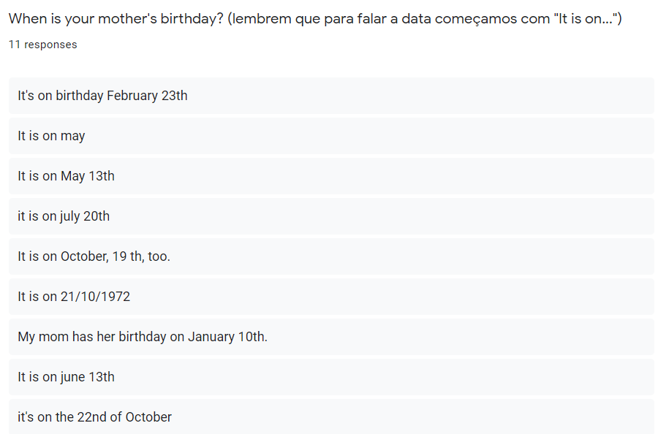
Capital letter (Letra maiúscula)
A vírgula normalmente separa números em datas (October 19th, 1975)
10/21/1972
possível
October 22nd

Slide 5
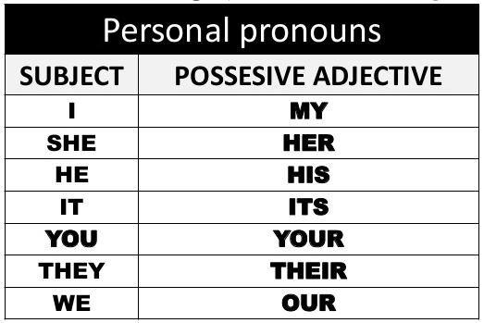
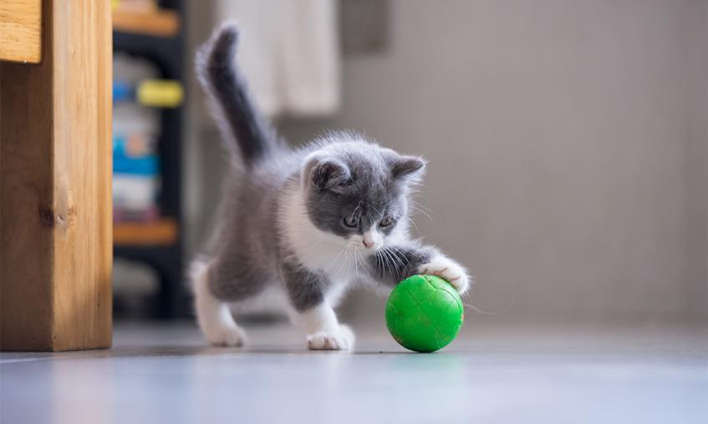
Its ball is green

Slide 6
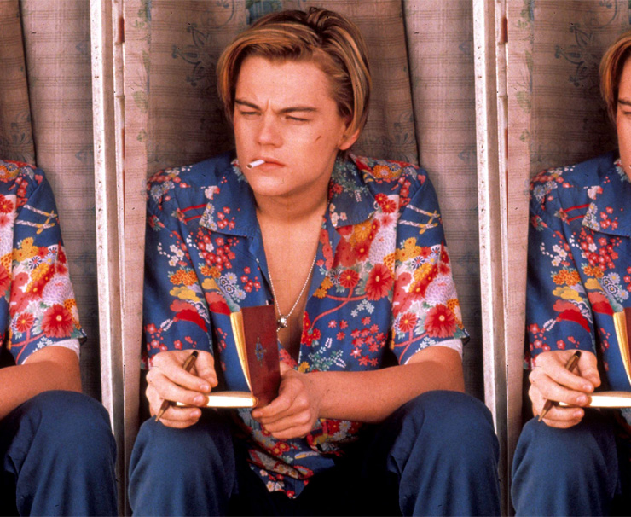
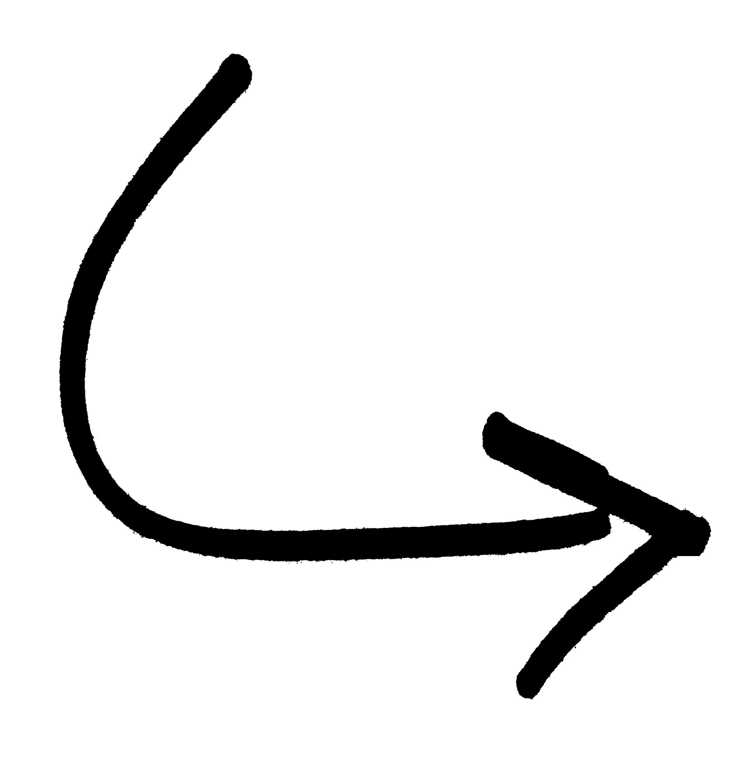
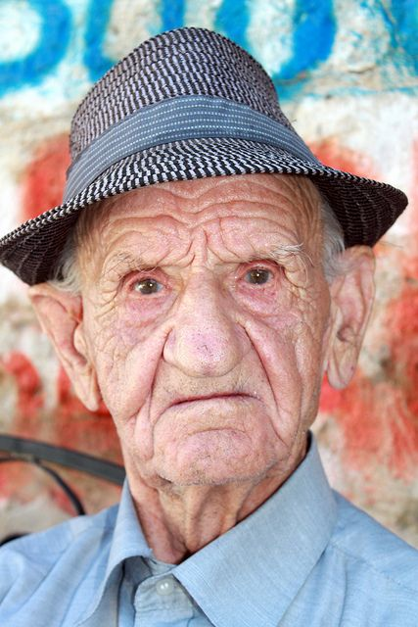
His book is old.

Slide 7
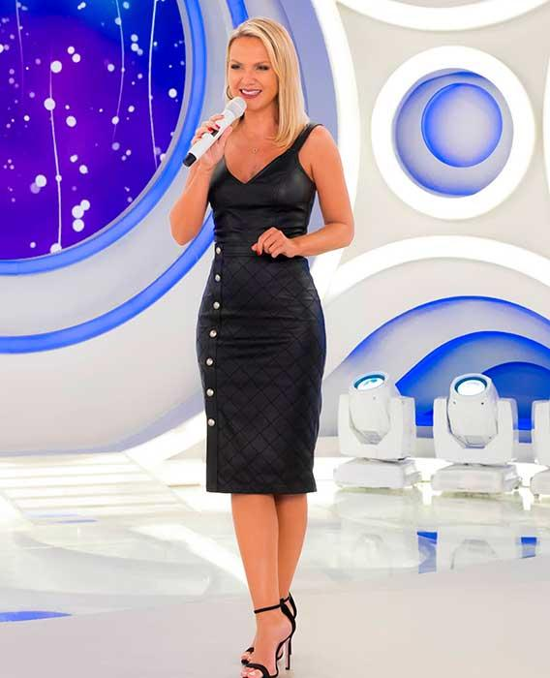
Her microfone is beautiful
Eliana’s microphone is beautiful

Slide 8
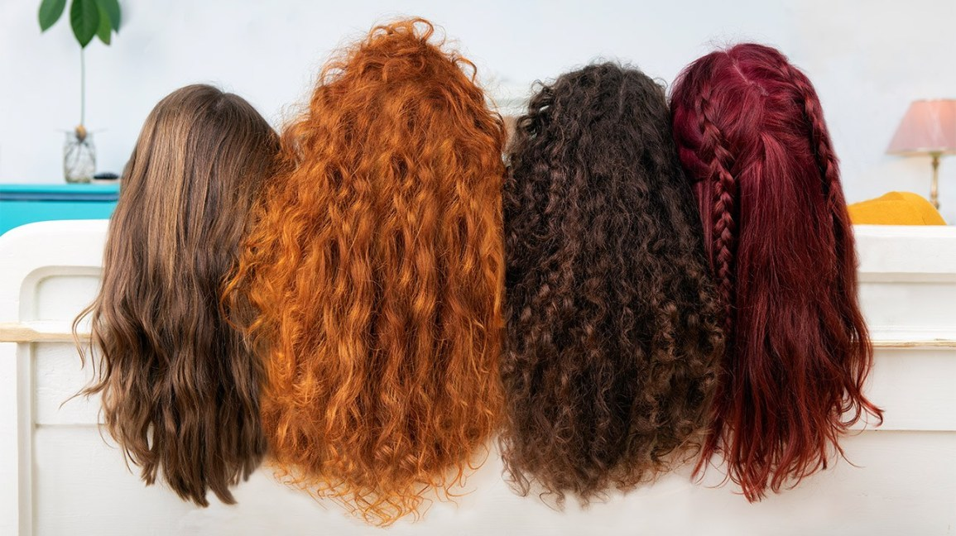
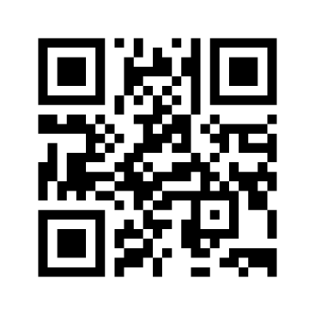
Exercício
https://www.menti.com/6kc2xihm62
HAIR

Slide 9
Se liga
Então, quando alguém pergunta: “When is your mother’s birthday?” eu posso responder:
Her birthday is on…. (o aniversário dela é….)
Ou
It is on …. (é….)

Slide 10
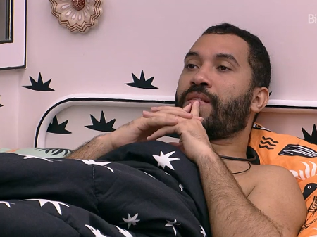
Possessives
Como eu digo
“O aniversário da minha mãe é …”?

Slide 11
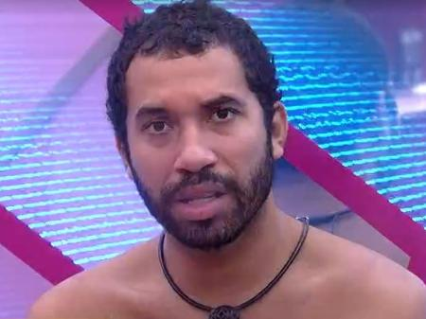
Produção?!
Pode ser: “my mother birthday is….”

Slide 12
Possessives
My mother’s birthday is on May 10th
My father’s name is Paulo.
My mothers’ birthday are on December.

Slide 13
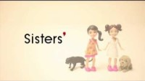

Slide 14
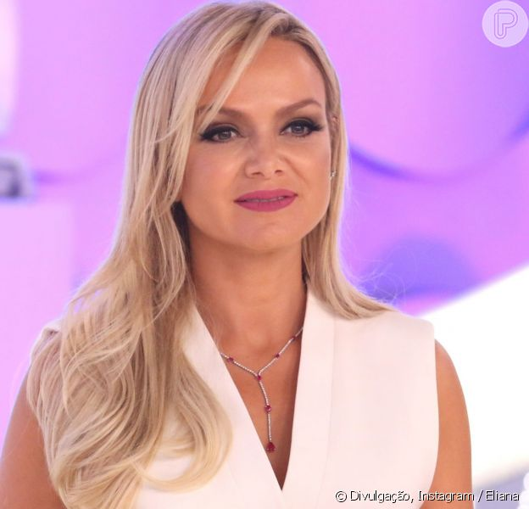
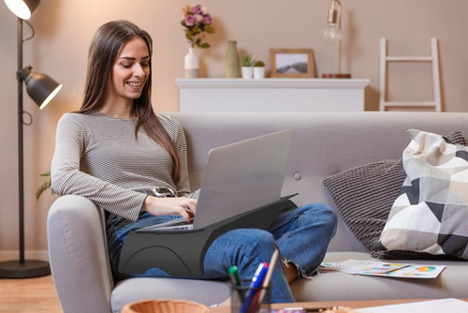
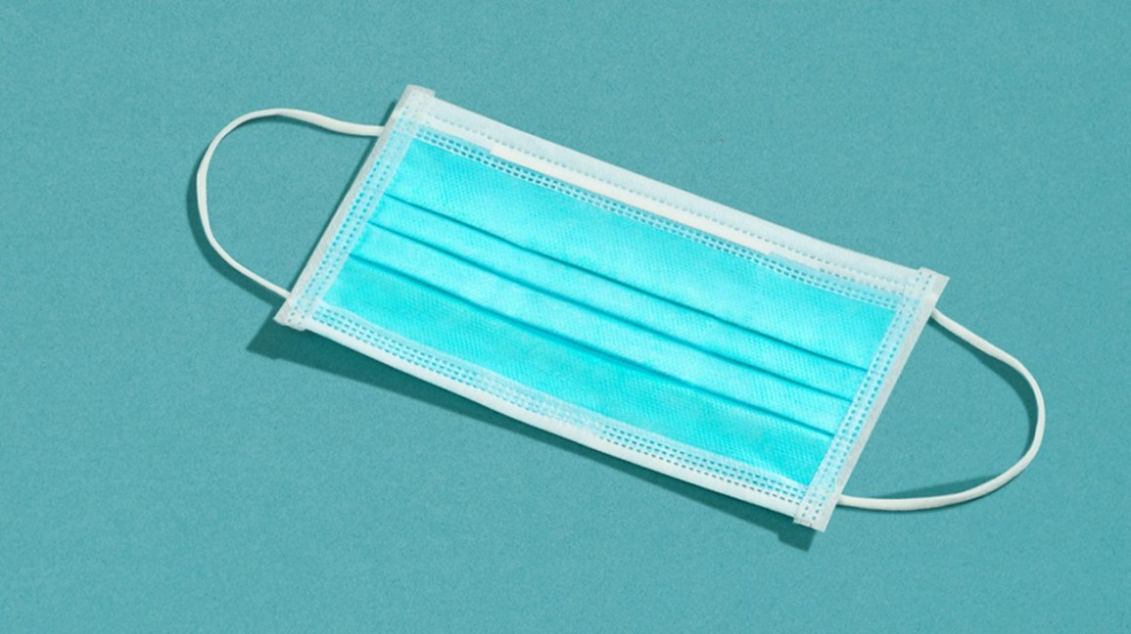
Possessives
Eliana
(possuidor)
Mask
(possuído)
Comfortable
(dizer algo sobre o possuído)

Slide 15
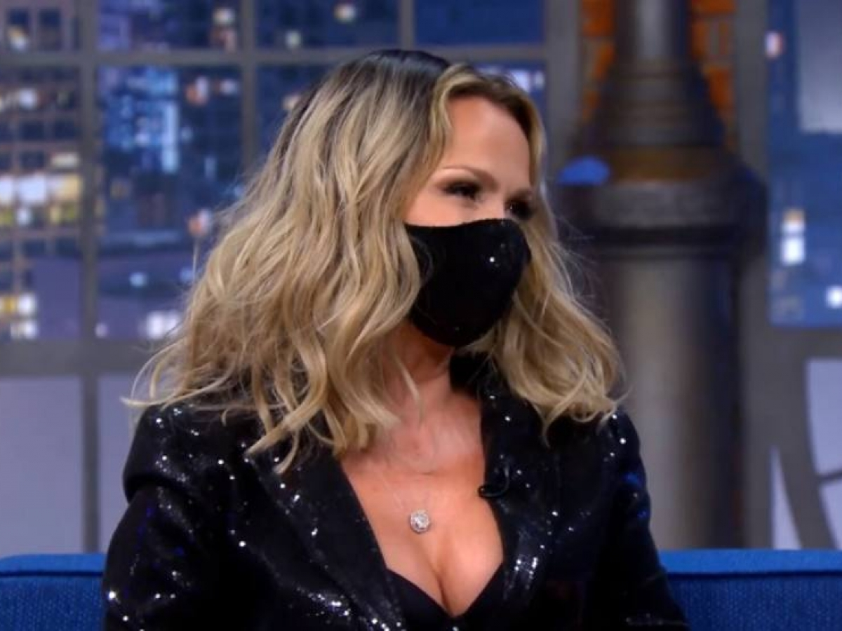
Eliana’s mask is confortable
her mask is confortable

Slide 16
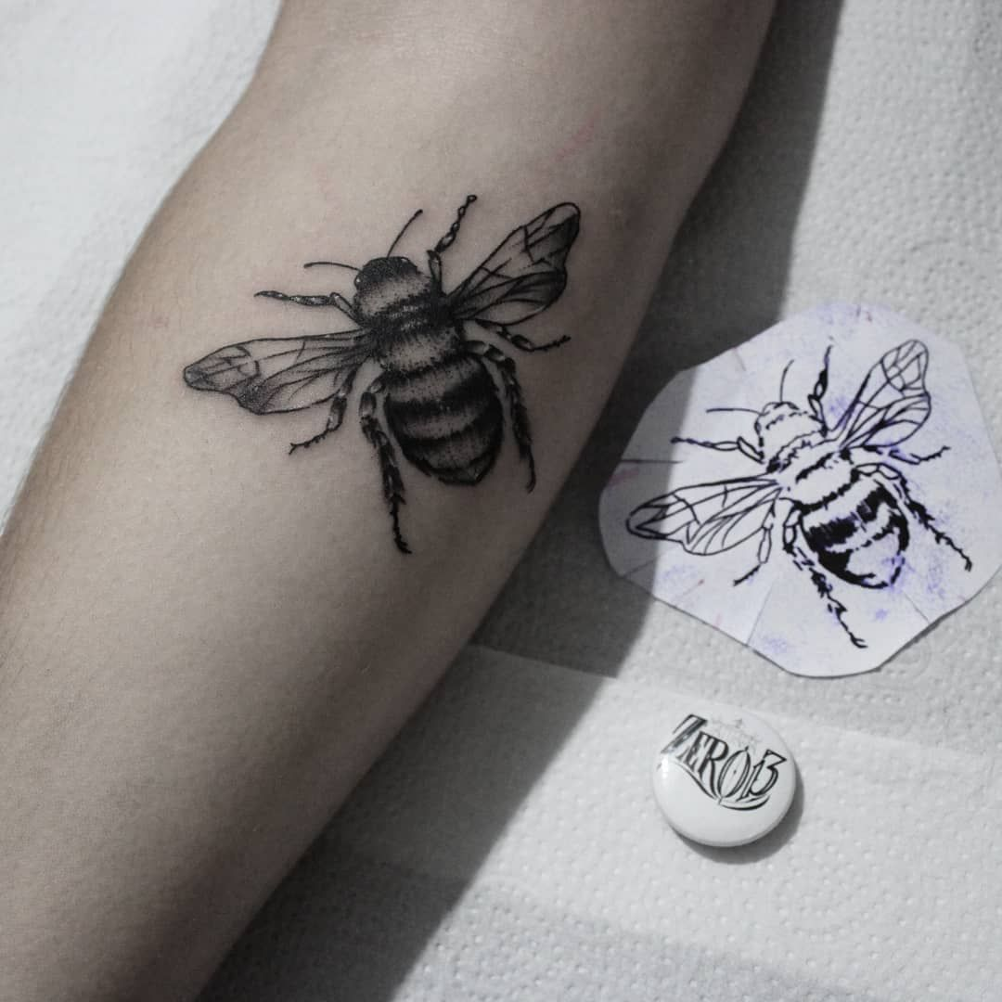
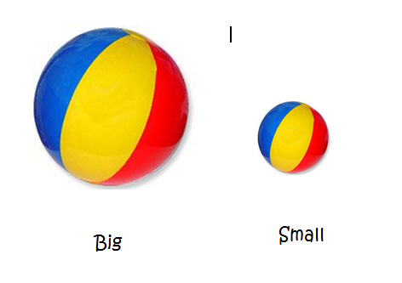
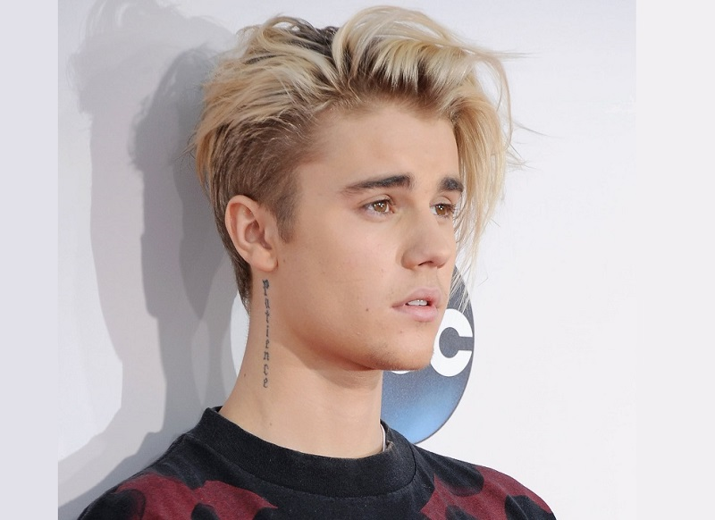
Possessives
Justin
(possuidor)
tattoo
(possuído)
big
(dizer algo sobre o possuído)

Slide 17
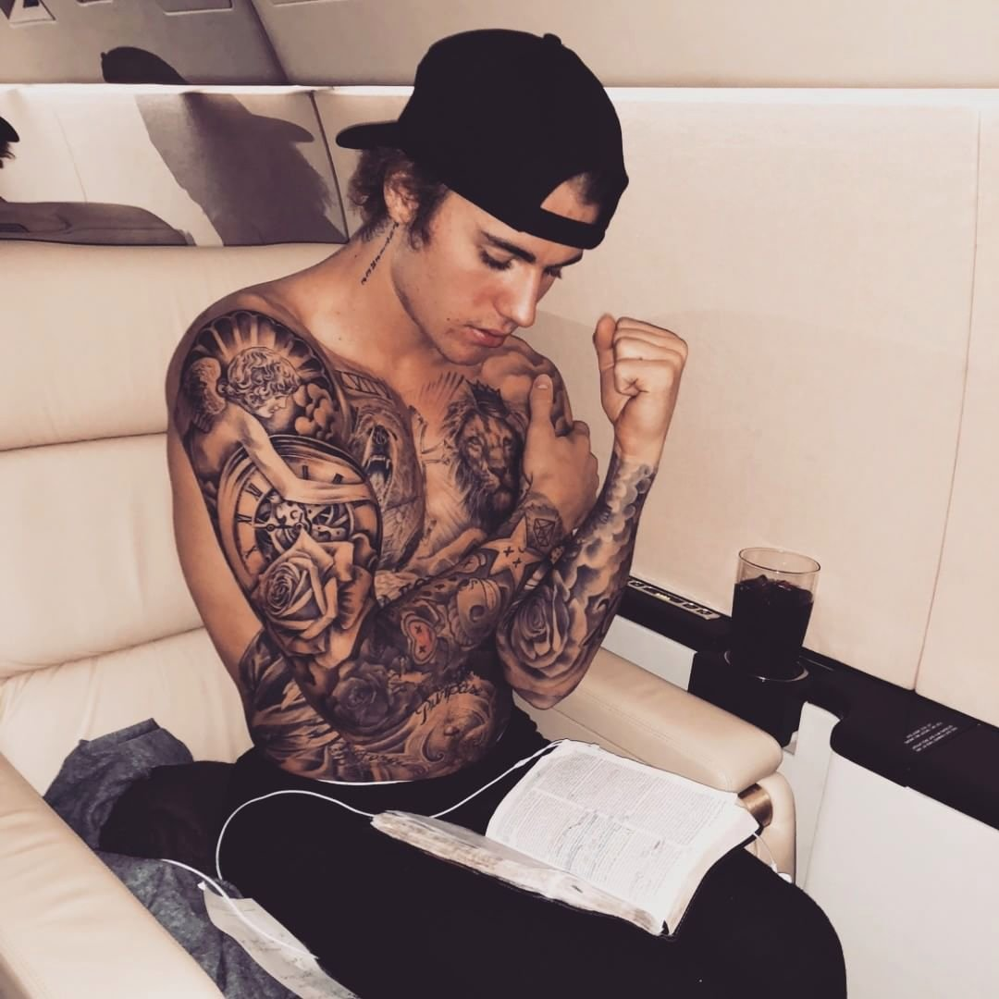
Justin’s tattooes are big
His tattooes are big

Slide 18
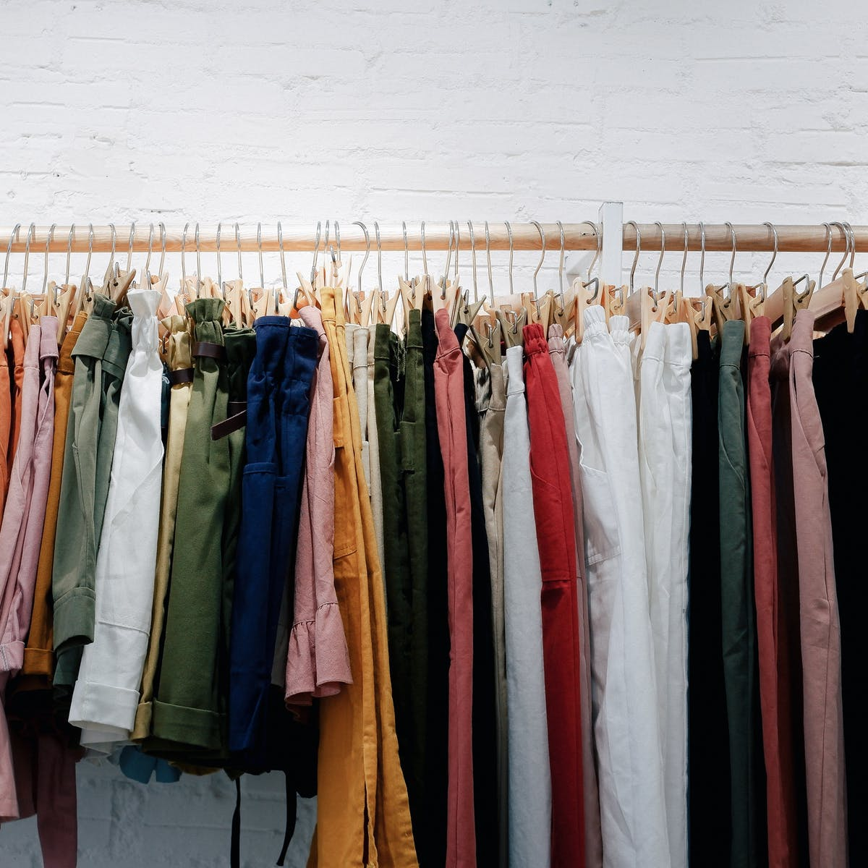
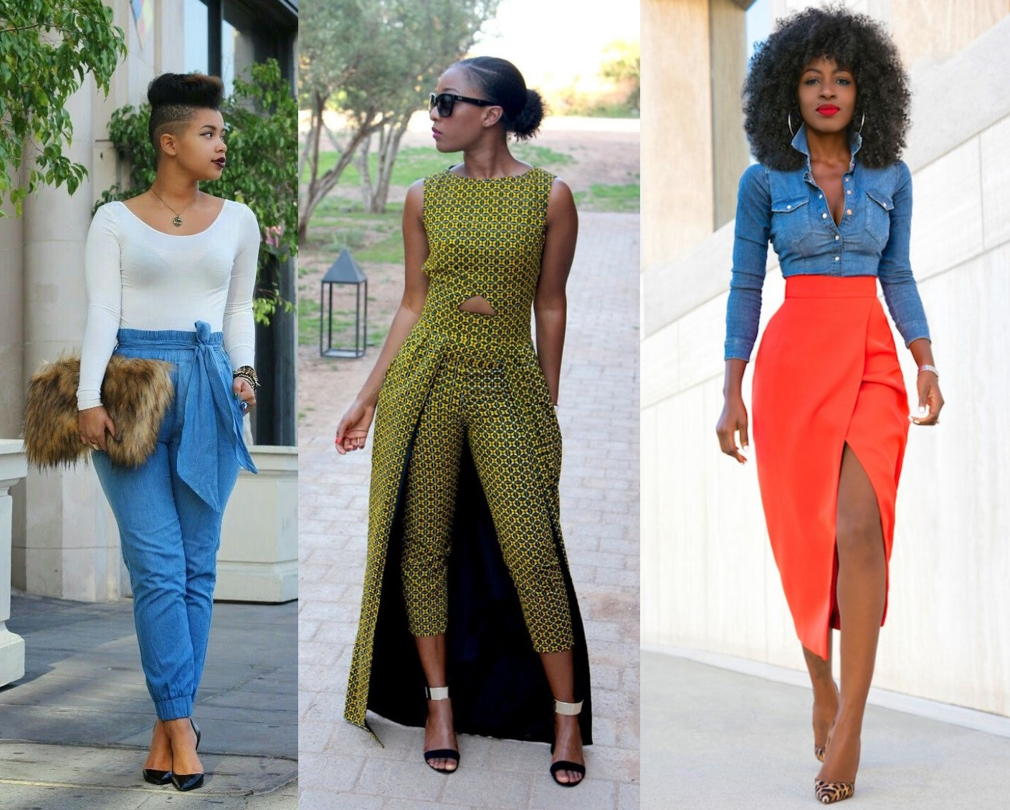
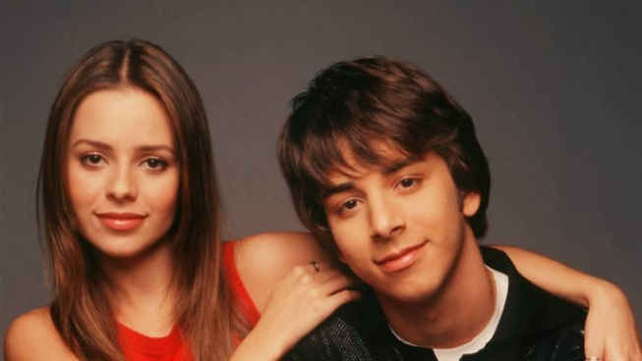
Possessives
Sandy e Jr.
(possuidor)
Clothes
(possuído)
Stylish
(dizer algo sobre o possuído)

Slide 19
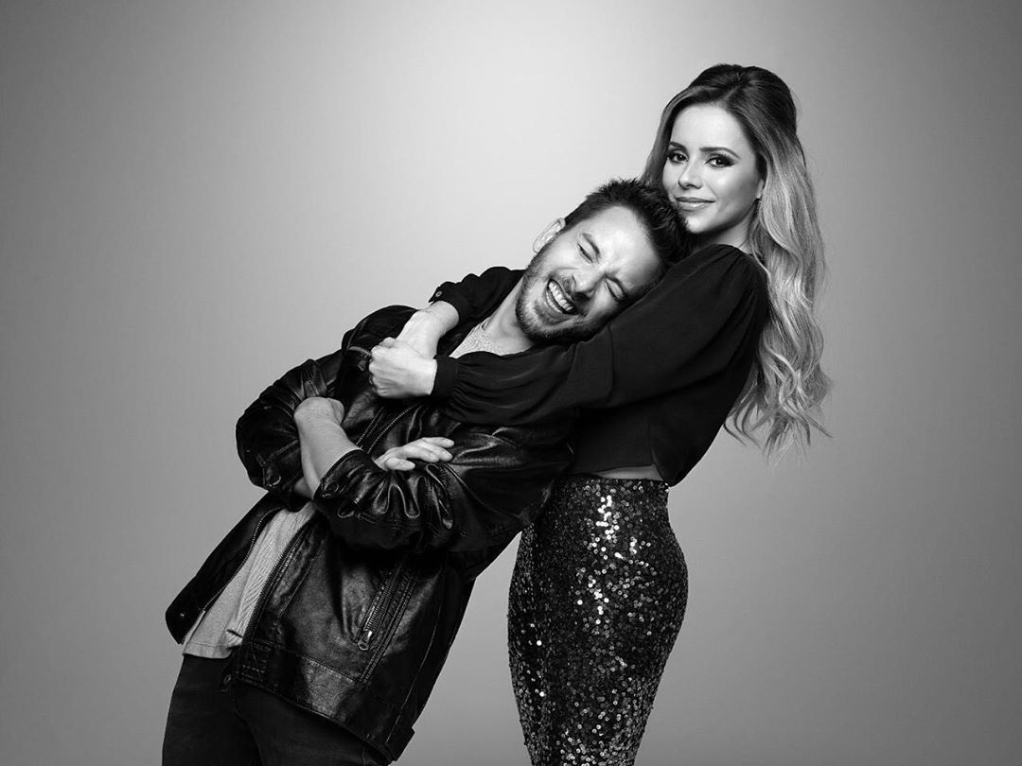
Sandy and Junior’s clothes are stylish.
Their clothes are stylish

Slide 20
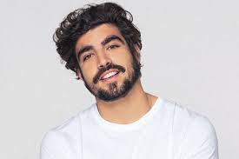
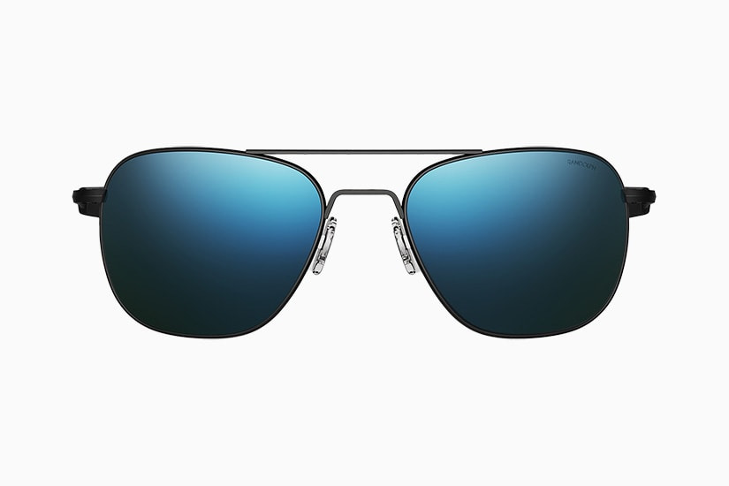
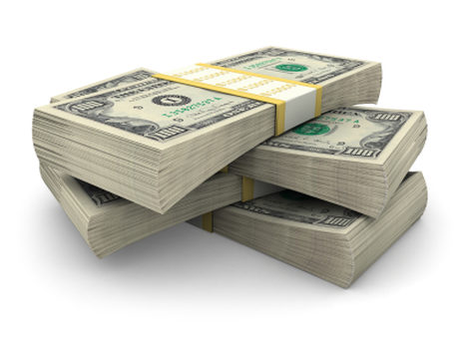
Exercício
https://www.menti.com/6kc2xihm62
Caio Castro
(possuidor)
sunglasses
(possuído)
expensive
(dizer algo sobre o possuído)

Slide 21
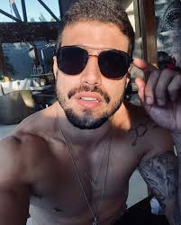
Caio castro’s sunglasses are expensive
His sunglasses are expensive

