Slide 1
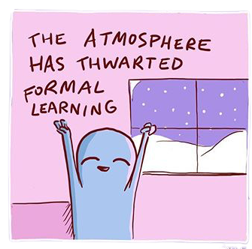
LÍNGUA INGLESA
1º ano
Professor Ânderson

Slide 2

WELCOME TO YOUR ENGLISH CLASS

Slide 3


Where are you from?
I am from Mars.

Slide 4
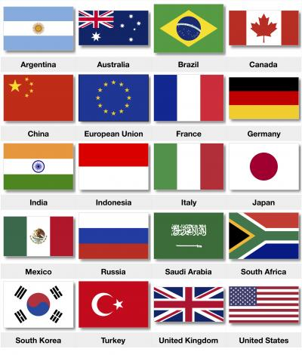
Where are you from?
I am from _____?

Slide 5
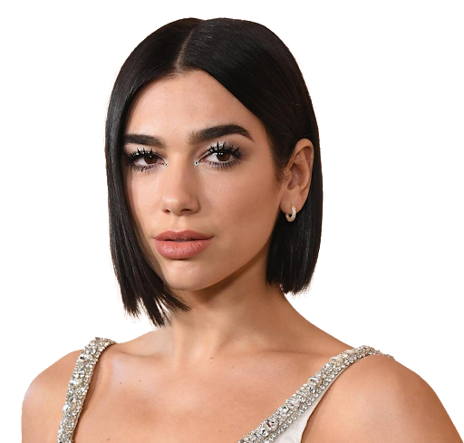
What is her name?
Her name is _____.
She is _____.

Slide 6
Where is she from?
She is from _____?

Slide 7
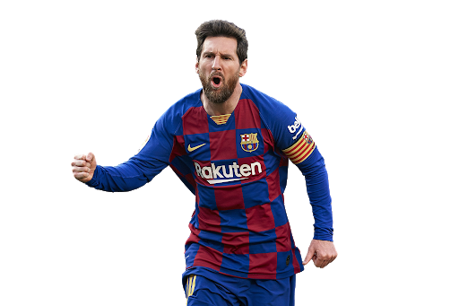
What is his name?
His name is _____.
He is _____.

Slide 8
Where is he from?
He is from _____?

Slide 9

What city are you from?
I am from Bagé.

Slide 10
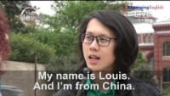
36 segundos- 1.07

Slide 11
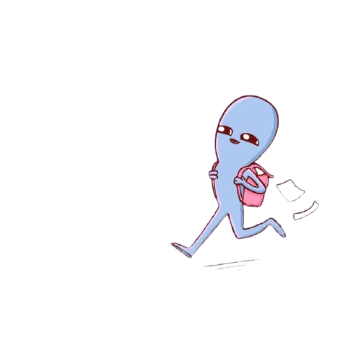
O que vocês conseguiram entender do vídeo?
Quais maneiras de perguntar de onde uma pessoa vem?

Slide 12

What is her nationality?
Bangladesh
Bangladeshi

Slide 13
What is her nationality?
She is from Bangladesh
She is Bangladeshi

Slide 14
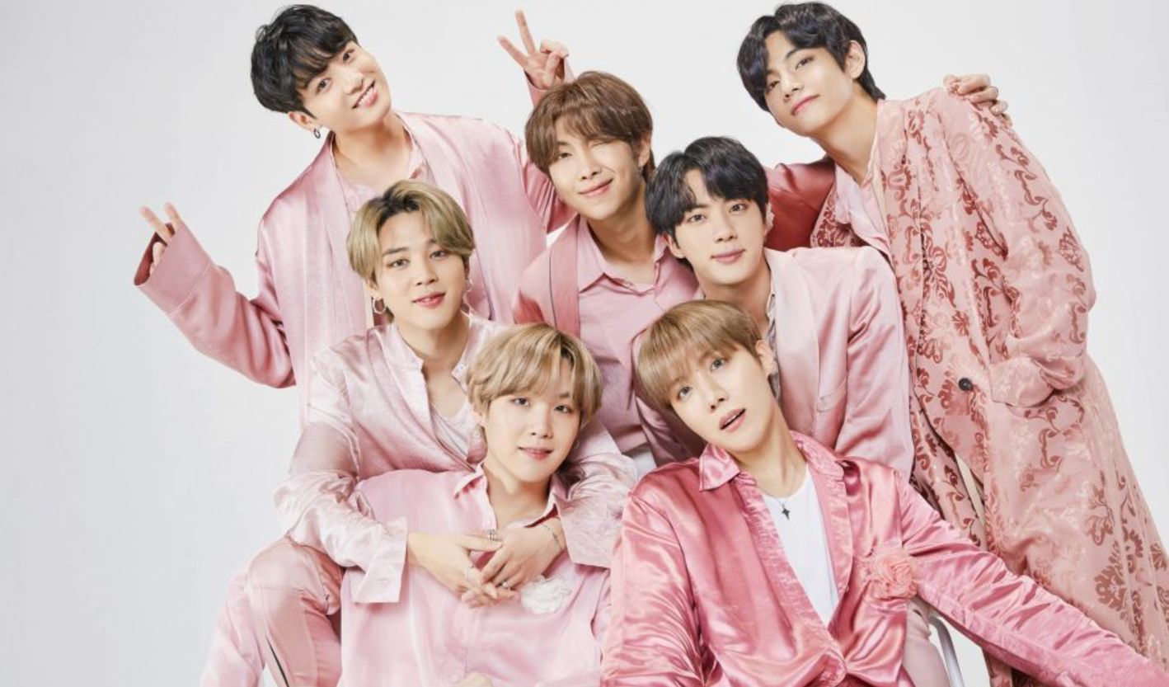
What is your nationality?
Mars -> Martian
Korea - > ??????
I am Martian.
They are _____.

Slide 15
What is your nationality?
Mars -> Martian
Korea - > ??????
I am Martian.
They are korean.

Slide 16

What is your nationality?
I am _____.

Slide 17
What is your nationality?
I am Brazilian.

Slide 18
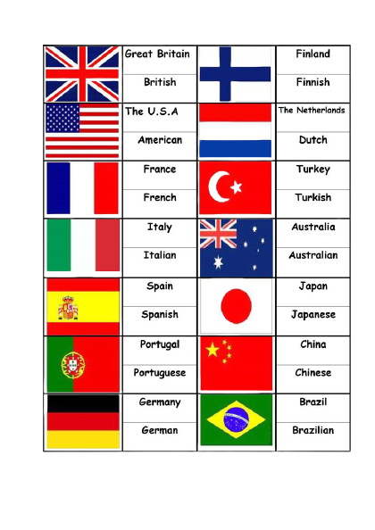
Nem sempre é só acrescentar “an”, às vezes acrescentamos “ish”, “ese” vai depender de cada país.

Slide 19
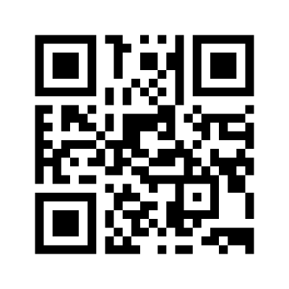

Acesse o link e vamos fazendo os exercícios simultaneamente.
https://www.menti.com/86ik45a7ef

Slide 20

How old are you?
I am one year old.

Slide 21
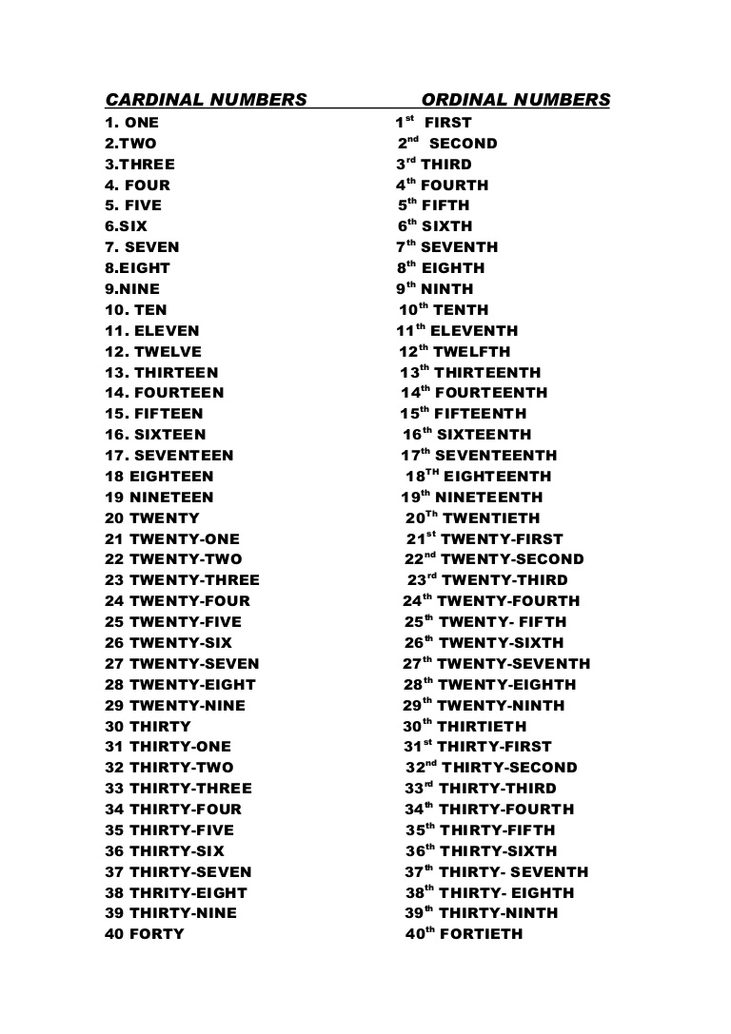


Slide 22

How old are you?
I am ______ (years old).

Slide 23
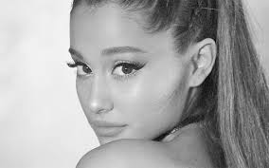

How old is she?
She is ______ (years old).
about

Slide 24

How old is he?
He is ______ (years old).
about

Slide 25
WELCOME TO YOUR ENGLISH CLASS

