Slide 1
Aula de inglês – Professor Ânderson

Slide 2






Warm-up
-Have you ever fell in love?
What relationships have you ever got involved with?
friendship
No strings attached
Hooking up
Date
Marriage

Slide 3











Warm-up
What are some motives to get dumped?
Get possessive
Cheat on somebody
Be deshonest
Get clingy
Get uninvolved emotionally
Don’t have enough time
Have diferente life goals
Get disappointed with the person’s personality
Live far away
Don’t like the family or friends
Have different tastes

Slide 4
Rules
When we are talking about the present moment or our routine we use verbs in the present, but when we are talking about a specific moment in the past we use past simple.
Last week (semana passada)
Yesterday (ontem)
Last month (mês passado)
Two days ago (Há dois dias)
One our ago (uma hora atrás)
In the morning (pela manhã)
Present
Specific moment in the past
Notes:
Write their answer on the board.

Slide 5
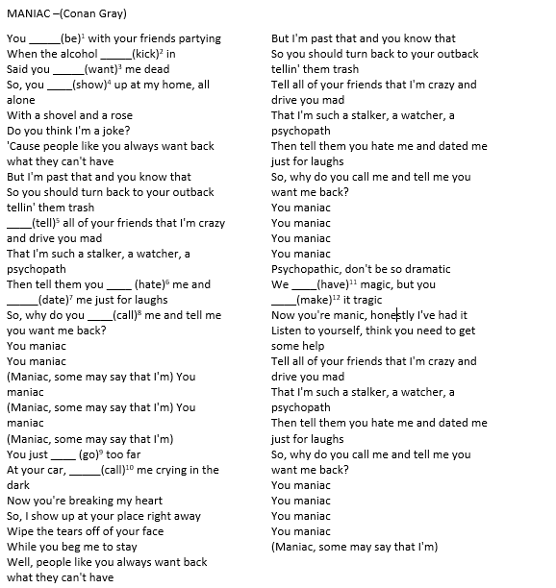
Notes:
Write their answer on the board.

