Slide 1
Aula de inglês – Professor Ânderson

Slide 2

Warm-up
-Is it difficult to you wake up in the morning?
- Do you normally get late or are you punctual?

Slide 3






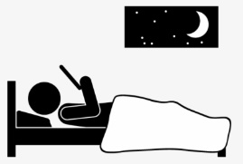



Warm-up
What are some motives to get late?
Have you gotten in these situations?
The allarm doesn’t ring
Lose the bus
Get sick
Understand the hour wrong
Get lazy
Get a flat tire
Sleep late
Forget the date
Get in the wrong place
Procastinate

Slide 4
How about last week?
Did you get late?
The allarm didn’t ring
Lost the bus
Got sick
Understood the hour wrong
Got lazy
Got a flat tire
Slept late
Forgot the date
Got in the wrong place
Procastinated
Notes:
Write their answer on the board.

Slide 5
Rules
When we are talking about the present moment or our routine we use verbs in the present, but when we are talking about a specific moment in the past we use past simple.
Last week (semana passada)
Yesterday (ontem)
Last month (mês passado)
Two days ago (Há dois dias)
One our ago (uma hora atrás)
In the morning (pela manhã)
Present
Specific moment in the past
Notes:
Write their answer on the board.

Slide 6

Let’s remember the video
The verbs in English are regular or irregular.
Regular signify that the follow the same rule?
For exemple:
I listen to music (presente simple)
I listened to music at night (simple past)
Notes:
Write their answer on the board.

Slide 7
What has changed in the sentences?
For exemple:
I listen to music (presente simple)
I listened to music at night (simple past)
Notes:
Write their answer on the board.

Slide 8
What has changed in the sentences?
For exemple:
I listen to music (presente simple)
I listened to music at night (simple past)
Notes:
Write their answer on the board.

Slide 9

What has changed in the sentences?
I work in the morning (routine)
I worked in the morning (in a specefic morning in the past)
Notes:
Write their answer on the board.

Slide 10
What has changed in the sentences?
I work in the morning (routine)
I worked in the morning (in a specefic morning in the past)
Notes:
Write their answer on the board.

Slide 11
Let’s think
What is the rule for the past?
Notes:
Write their answer on the board.

Slide 12
Let’s think
What is the rule for the past?
Add +ed
Notes:
Write their answer on the board.

Slide 13
Let’s see the rules
To put verbs in the past, we add +ed
I clean the house (routine)
I cleaned the house yesterday (specific moment in the past)
But what if the verb ends with “e” like
Procastinate?
Notes:
Write their answer on the board.

Slide 14
Procastinateed?
If the verb has “e” we just add “d”
I procrastinated two hours ago.
Notes:
Write their answer on the board.

Slide 15

Let’s remember the video
Pay attention to the “y”
Se o verbo terminar em “y” temos duas possibilidades. A primeira é o “y” ser precedido de vogal. Aí, a regra é normal. (Adiciona “ed”
Payed
Stayed
Notes:
Write their answer on the board.

Slide 16
Let’s remember the video
A segunda possibilidade é o “y” ser precedido de consoante. Aí, a regra é trocar o y por “i” e depois adicionar o “ed”
Studied
tried
Notes:
Write their answer on the board.

Slide 17
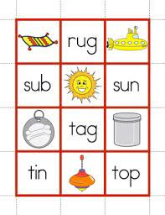
cvc
Muitas palavras terminam em consonant, vowel, and consonant.
Travel (viajar )
Tag (marcar)
Notes:
If they say they don’t have a pet, here you ask them to imagine they have one and decide some information about it.

Slide 18
cvc
Muitas palavras terminam em consonant, vowel, and consonant. Quando for esse o caso a gente dobra a última letra antes de adicionar o “ed”
Travelled (viajar )
Tagged (marcar)
Notes:
If they say they don’t have a pet, here you ask them to imagine they have one and decide some information about it.

Slide 19
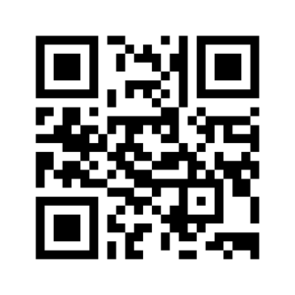
Mentimeter
Let’s exercise
Notes:
Write their answer on the board.

Slide 20

Facilidades da vida
Uma vez que a gente aprendeu o verbo é só usar ele para todas as pessoas? Sim!
I cleaned the dog.
You cleaned the dog.
He cleaned the dog.
She cleaned the dog.
It cleaned the dog.
we cleaned the dog.
They cleaned the dog.
Notes:
Write their answer on the board.

Slide 21

Verb to be
Agora vamos falar de um verbo mucho loco?
Assim, como no presente, ele é irregular.
I was happy last year.
You were happy last year.
He was happy last year.
She was happy last year.
It was happy last year.
we were happy last year.
They were happy last year.
Notes:
Write their answer on the board.

Slide 22
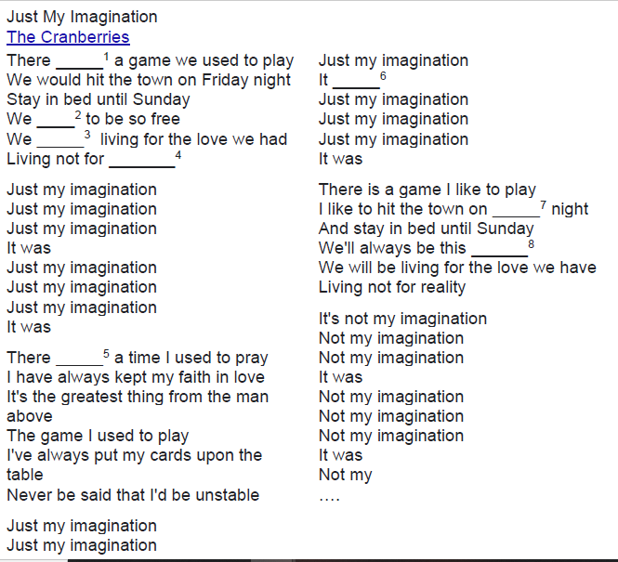
Today
Notes:
Write their answer on the board.

Slide 23
Pronúncia.
Como você pronunciaria os verbos abaixo?
Listened worked
Walked
Started
Stabed
Notes:
Write their answer on the board.

Slide 24
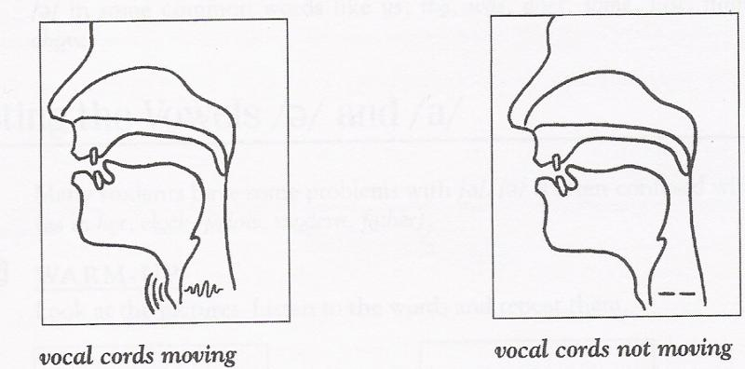
Voiced or unvoiced
Take a look in the last silable. It is voiced or unvoiced?
Notes:
Write their answer on the board.

Slide 25
Pratice
Final com t ou d?
Ed->id
Ed->t
Ed->d
Notes:
Write their answer on the board.

Slide 26
Vamos ver?
Listened worked
Walked
Started
Stabed
Notes:
Write their answer on the board.

Slide 27
Vamos ver?
->Listend ->workt
->Walkt
->Startid
->Stabd
Listened worked
Walked
Started
Stabed
Notes:
Write their answer on the board.

Slide 28
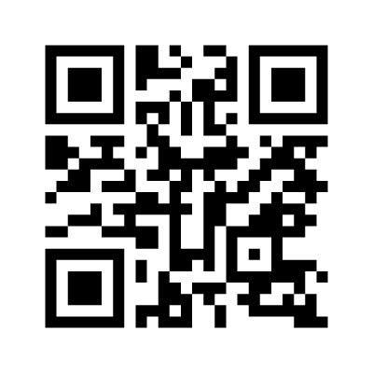
Mentimeter time
Notes:
Write their answer on the board.

Slide 29
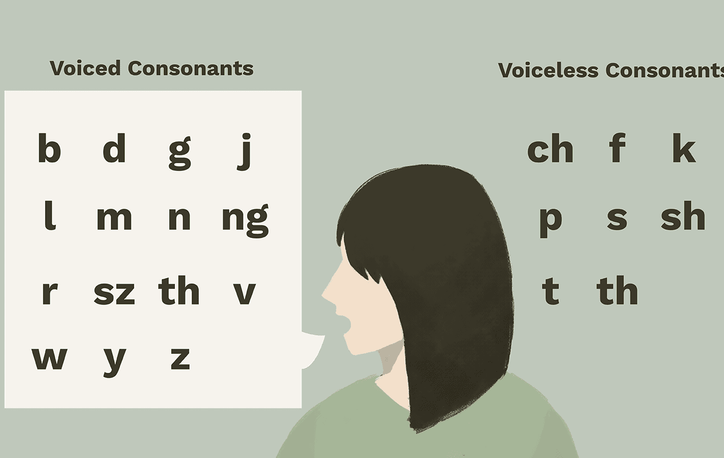
Notes:
Write their answer on the board.

Slide 30
Video passado simples
Notes:
Write their answer on the board.

Slide 31
Video passado simples irregular
Notes:
Write their answer on the board.

Slide 32
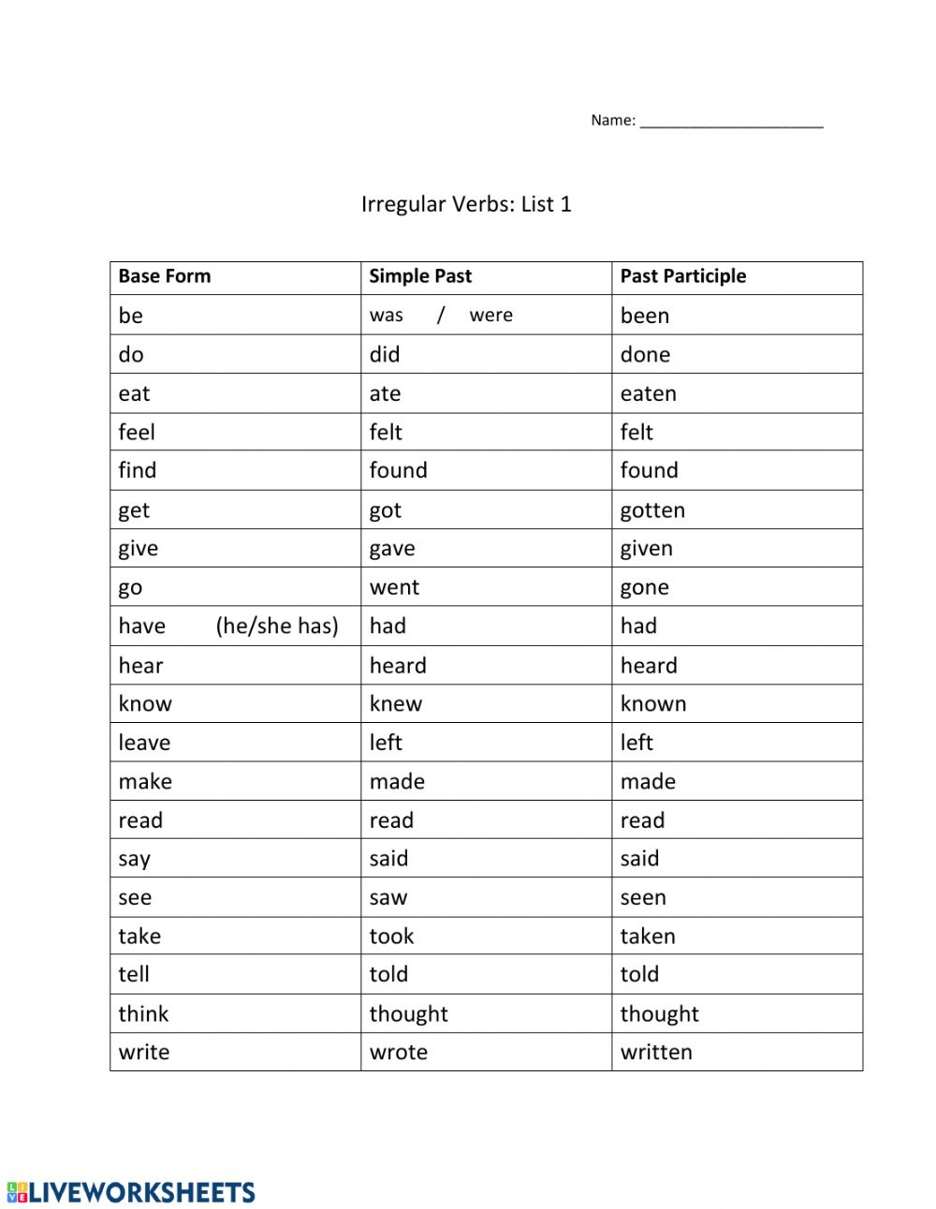
Irregulares
Notes:
Write their answer on the board.

Slide 33
Negativo
Agora vamos a forma negativa, que é mais fácil, pois ao formar frases negativas no simple past é necessário acrescentar o verbo did + not (forma contraída: didn’t). O verbo segue igual e a gente nem se preocupa se é regular ou não.
Exemplos:
The teacher didn’t (did not) wait for the students.
She didn’t (did not) sell her house. (Ela não vendeu a casa dela)
Sorry but I didn’t (did not) understand your e-mail.
My daughter didn’t (did not) finish her homework. (Minha filha não terminou a lição de casa)
They didn’t (did not) want to live in that apartment. (Eles não queriam morar naquele apartamento)
We didn’t (did not) know that beach. (Nós não conhecíamos aquela praia)
Fácil, né?
Notes:
Write their answer on the board.

Slide 34
Interrogativo
Interrogativa: Ao formar frases interrogativas no simple past é necessário colocar o auxiliar did antes do sujeito da frase, ou seja, super fácil também.
Exemplos:
Did he wash his car last week? (Ele lavou o carro dele semana passada?)
Did the boy pay for the apple? (O garoto pagou pela maçã?)
Did she start to read that book? (Ela começou a ler aquele livro?)
Where did you put my sunglasses? (Onde você colocou meus óculos?)
What did you cook for lunch? (O que você cozinhou para o almoço?)
Did they play soccer? (Eles jogaram futebol?)
Com isso, pode-se concluir que o simple past é utilizado para expressar situações e ações que começaram e terminaram no passado. E deve-se levar em consideração as regras de uso para formar as formas interrogativas, negativas e afirmativas
Notes:
Write their answer on the board.

