Slide 1
Aula de inglês

Slide 2
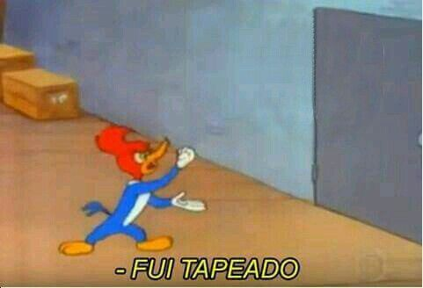
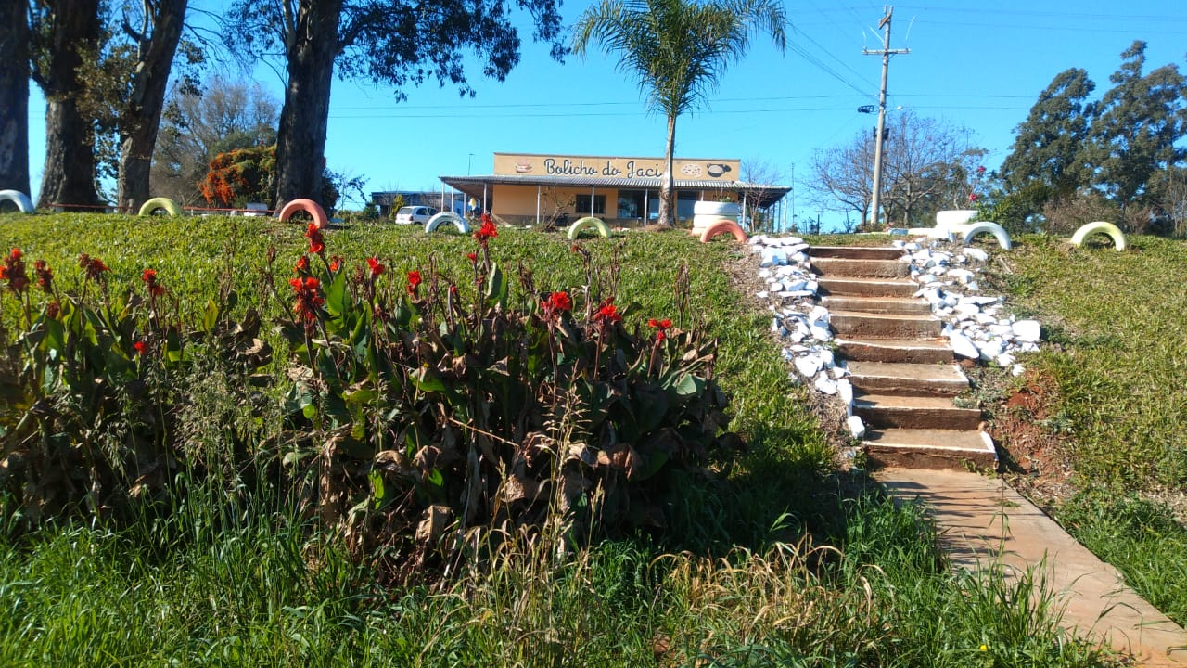
Aula de inglês

Slide 3
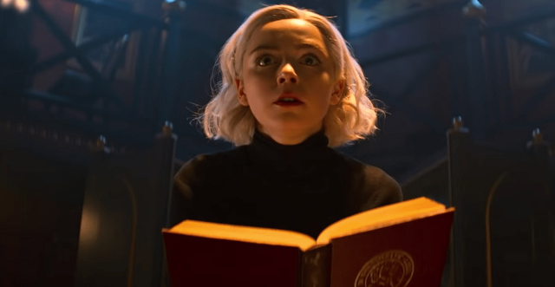
to be -> affirmative
I am a witch
You are a witch
She is a witch
He is a witch
It is magical
We are witches
They are witches

Slide 4
to have -> affirmative
I have a book
You have a book
She has a book
He has a book
It has a book
We have a book
They have a book

Slide 5

to be -> Negative
I am not a witch
You aren’t a witch
She isn’t a witch
He isn’t a witch
It isn’t' magical
We aren’t witches
They aren’t witches

Slide 6
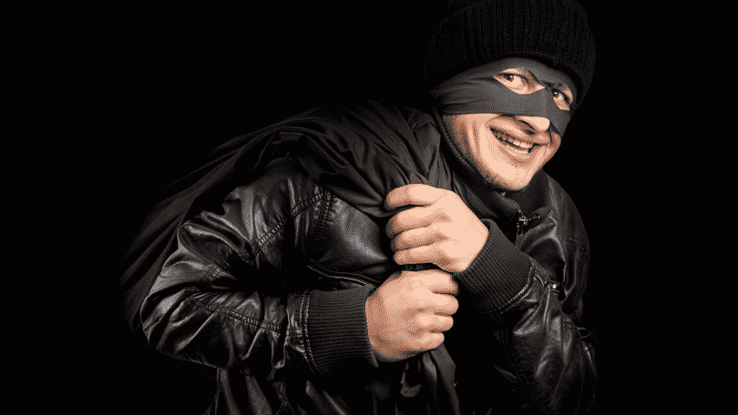
to have -> Negative
I don’t have a book
You don’t have a book
She doesn’t have a book
He doesn’t have a book
It doesn’t have a book
We don’t have a book
They don’t have a book

Slide 7
to be -> interrogative
Am I a witch?
Are you are a witch?
Is she a witch
Is he a witch?
Is it magical?
Are we witches
Are they witches?

Slide 8
to have -> Interrogative
Do I have a book?
Do You have a book?
Does She have a book?
Does He have a book?
Does It have a book?
Do We have a book?
Do They have a book?

Slide 9
Verbos auxiliares
Não precisam de “do”.
Would
Can
Could
May

Slide 10
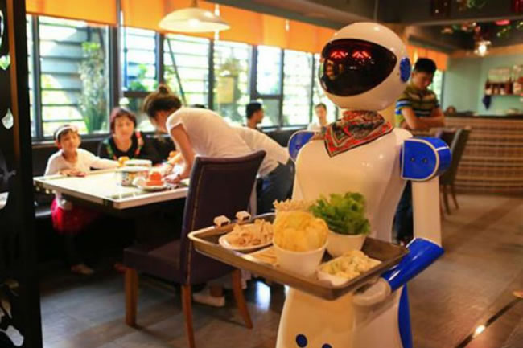
Restaurants are fun

Slide 11

Warm-up
Do you prefer to eat at home or in a restaurant?
What is your favorite Restaurant? Why?
3) Where is it located?
4) How often do you go there?
5) What food do you eat there?

Slide 12






Warm-up
4) What is important when you go to a restaurant?
Space
Price
Location
Attendance
Beauty
(be beautiful)
The food

Slide 13






Warm-up
5) You normally eat out ….
By plane
By Train
By car
By bus
By bicycle
On foot

Slide 14

Imagine these situations
I want a sandwich!
I want a coffee!
Bring me a pizza!
Are these sentences polite or rude?

Slide 15
Imagine these situations
I want a sandwich!
I want a coffee!
Bring me a pizza!
Are these sentences polite or rude?

Slide 16
Imagine these situations
I want a sandwich!
I want a coffee!
Bring me a pizza!
How can we transform them into polite sentences?
Notes:
Put their ideas on the board. Don’t correct them here. Just take notes on the board and later they will correct themselves.

Slide 17
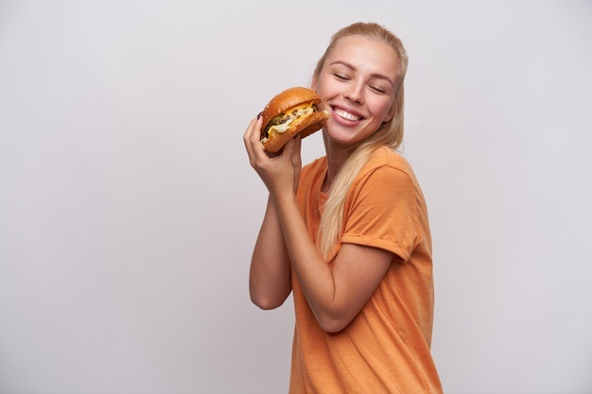
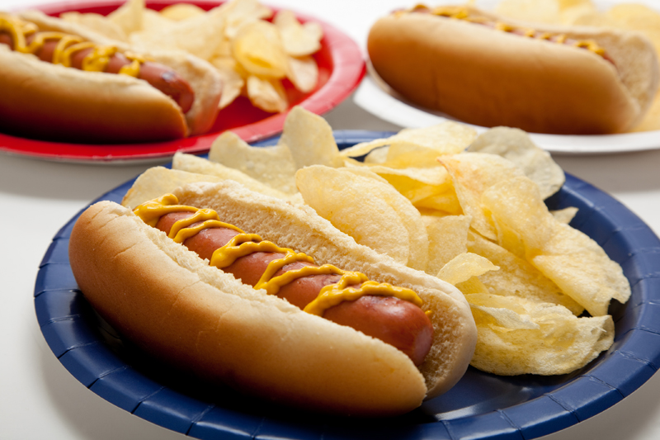
Imagine this situation
You entered in the snack bar because you are hungry.
How do you ask for a hotdog and a burger?

Slide 18


Imagine this situations
I would like a hotdog and a burger, please.
Notes:
Go back to the sentences on the board from slide number 8. Rewrite them using would like.

Slide 19

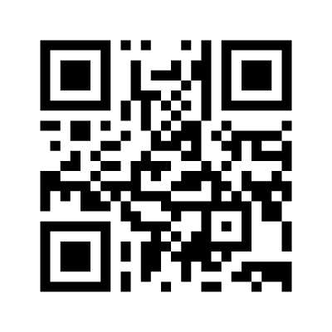
Let’s go to a café, what would you like to order?
I would like ______.

Slide 20

What food wouldn’t you like to have?
I wouldn’t like ______.

Slide 21

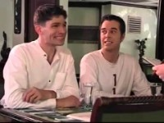
Watch a video

Slide 22
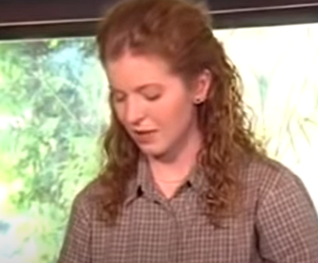

Video review
Do you remember her?
What is her occupation?
She is a waitress.

Slide 23
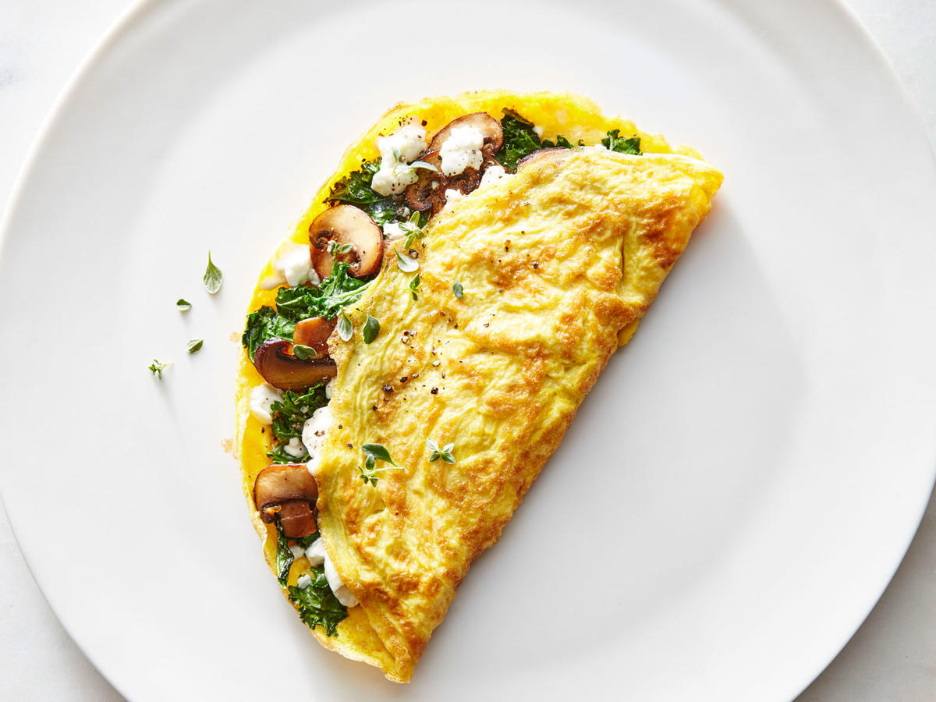
Video review
What does she like to eat for breakfast?
Omelette

Slide 24
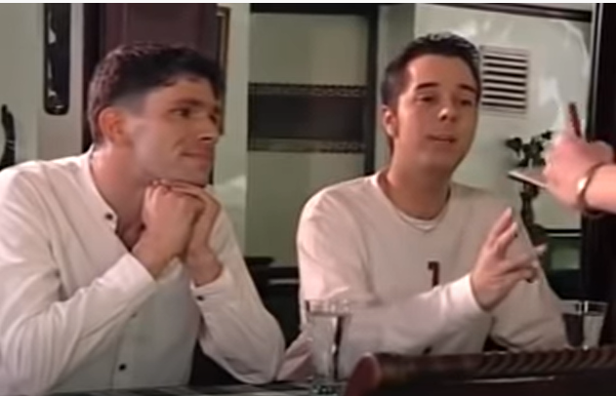
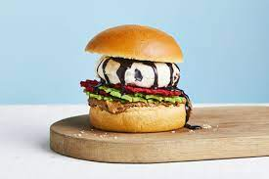
Video review
What would he like to eat?
He would like to eat hamburger and ice cream

Slide 25
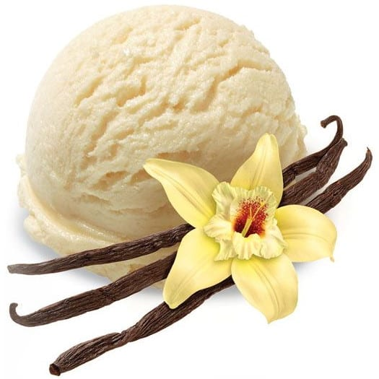
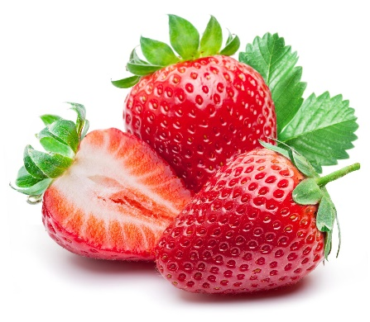
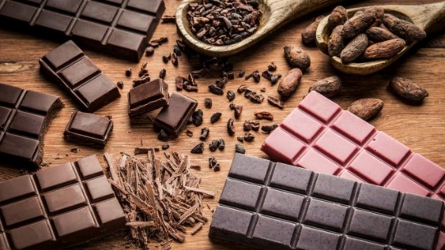
Video review
What kind of ice cream does he choose?
Chocolate
Vanilla
Strawberry

Slide 26
Aula 2 de inglês

Slide 27
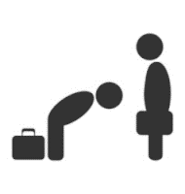
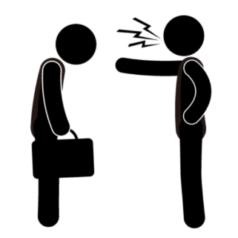
Do you consider her polite or rude?
Polite
rude

Slide 28
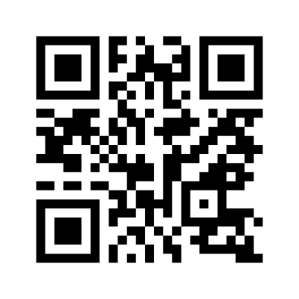
Pratice
Let’s imagine you are a waitress/waiter like the woman in the video.
Notes:
Here, you have the students trying to create a “Would you like...” question.

Slide 29

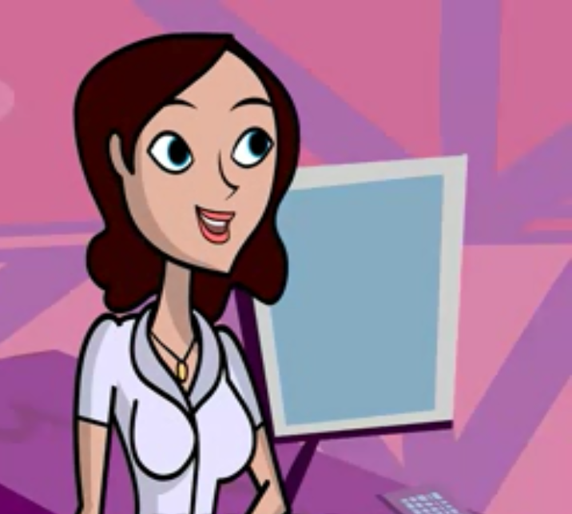
What is the difference?
You would like a hotdog.
Would you like a hotdog?

Slide 30
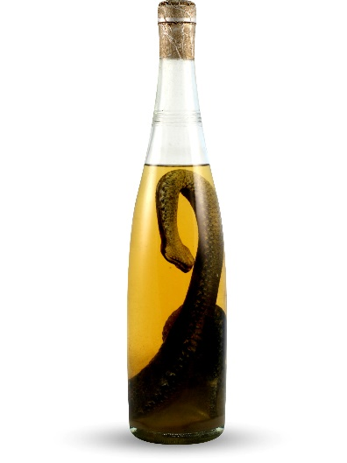

Imagine this situation
You are in China and a friend invite you to drink Snake wine.
Snake wine is an alcoholic beverage produced by infusing whole snakes in rice wine or grain alcohol.
Would you like to drink it?

Slide 31
When do I use it?
Would like
- Aspiration
- Demand

Slide 32
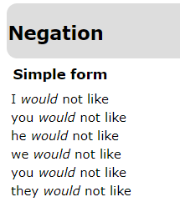
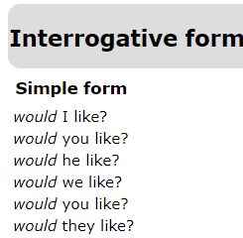
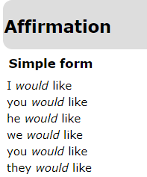
When do I use it?
Would like

Slide 33
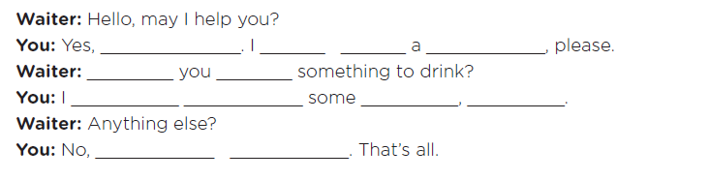
Practice!
Let’s complete the conversation in a restaurant.

Slide 34
Practice!
Let’s complete the conversation in a restaurant.
You may.
would
like
Pizza
Would
like
would
like
coke
please
Thank
you

Slide 35
Watch a video

Slide 36
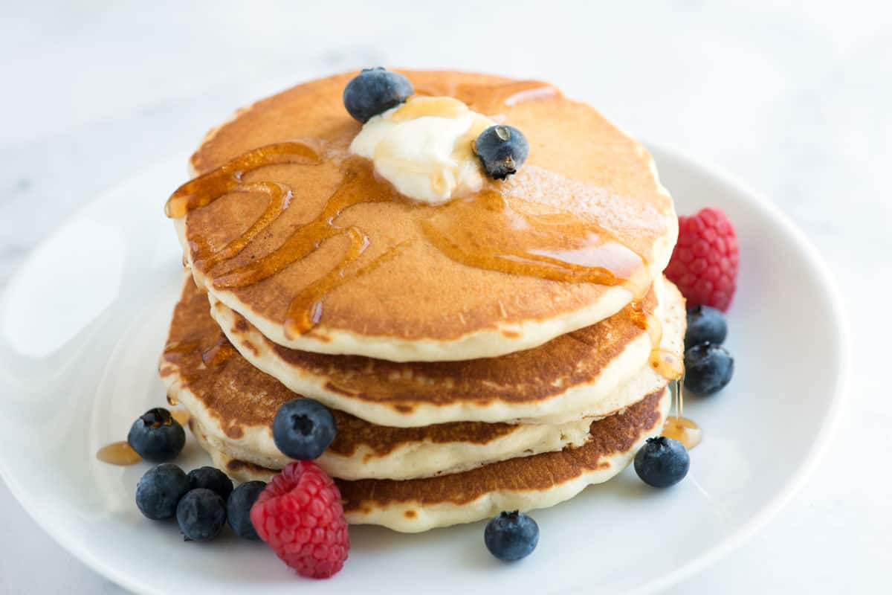
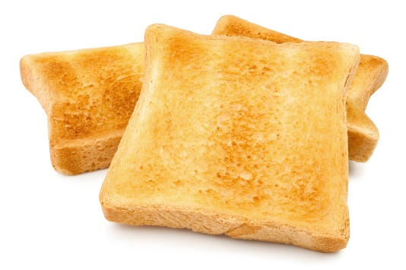
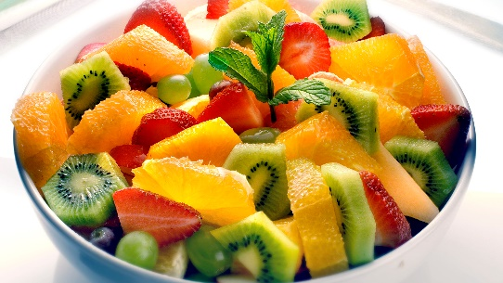
Requesting
At the beginning of the video, the first boy asks for some food. Do you remember what are them?
Pancakes
toast
Fruit salad

Slide 37
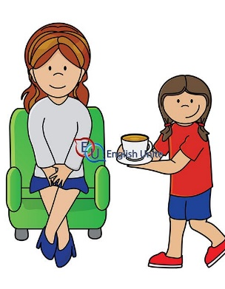
How else can I request
I would like three pieces of toast?
Can you bring me three pieces of toast?

Slide 38
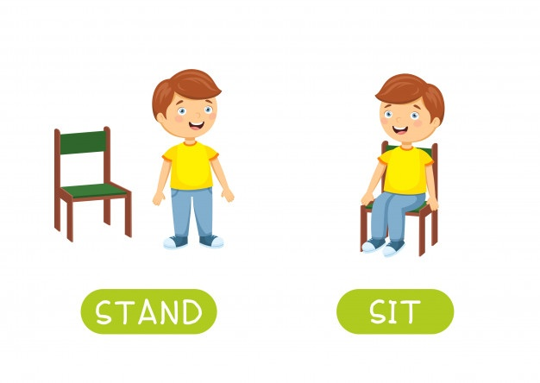
Requesting
Can you bring me the menu?
Yes, I can. No problem.
Can I sit here?
Yes, you can sit here.

Slide 39
Can, Could or May?
What is the difference?
Hey mom! Can you shut the door?
Hello, sir. Could you shut the door?
Hello, mister president. May you shut the door?

Slide 40
Can, Could or May?
What is the difference?
Hey mom! Can you shut the door?
Hello, sir. Could you shut the door?
Hello, mister president. May you shut the door?
Informal
Neutral
Formal

Slide 41
When do I use it?
Can
Could
May
- Requisition
- Favor
- Solicitation
- Permission
- Demand
- Desire

Slide 42
What is the difference?
Can
More appropriate for friends and family
Could
More appropriate for people we don’t have intimacy or we don’t now.
May
More appropriate for people we want to show respect or that you have a professional relation

Slide 43
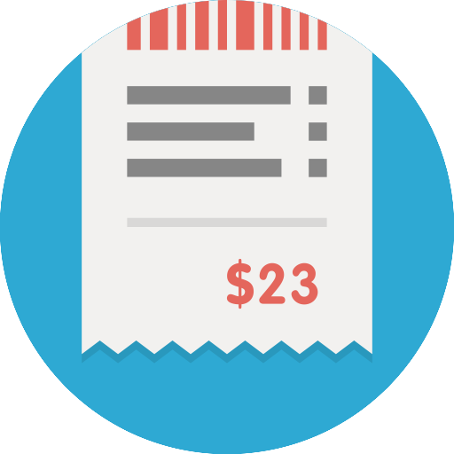

Requesting
Imagine we are in a restaurant now.
How do you ask the waiter to have these items?
Bill

Slide 44
Requesting

Slide 45
Requesting
Can I have the menu, please?

Slide 46
Requesting
Bill

Slide 47
Requesting
Bill
Can I have the bill, please?

Slide 48
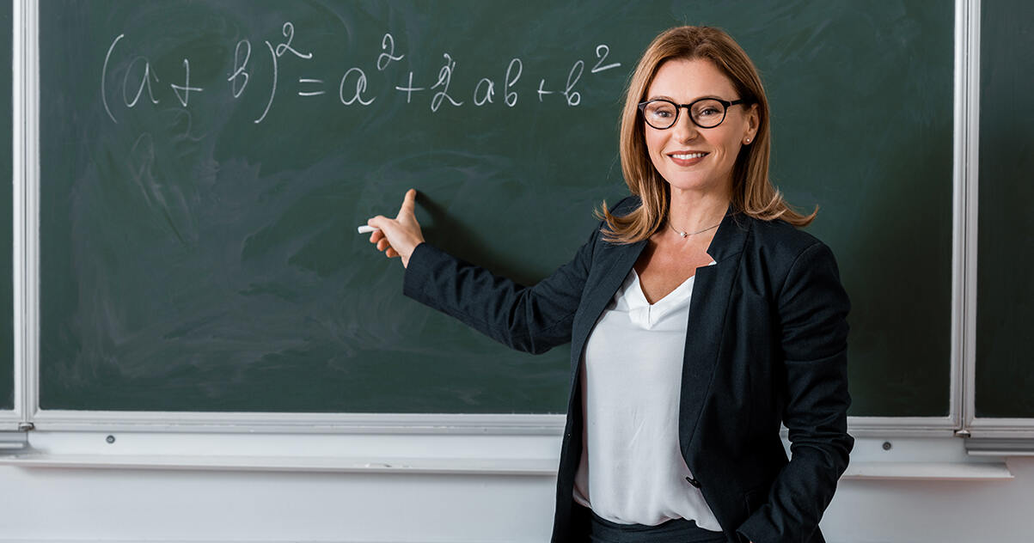
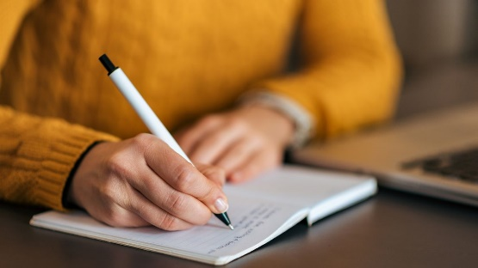
Let’s imagine the person and create a question
teacher
write
Could I write?
May I write?

Slide 49
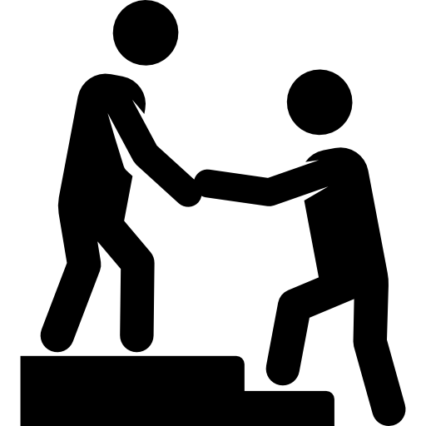
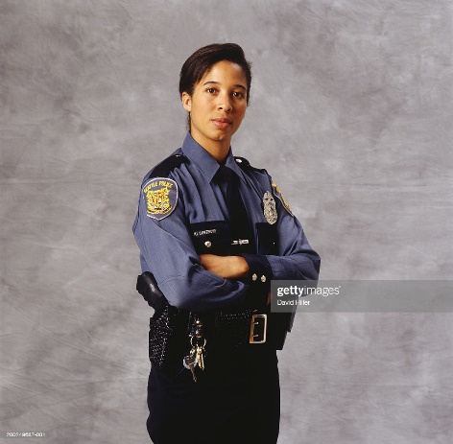
Let’s imagine the person and create a question
Police officer
Help me
May you help me?

Slide 50
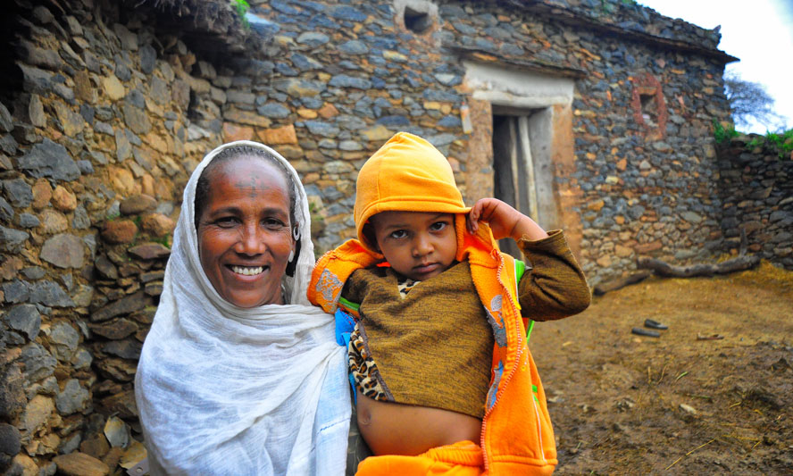
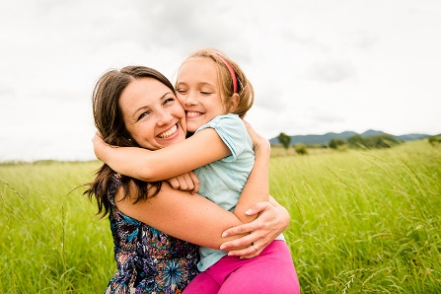
Let’s imagine the person and create a question
Hug me
Aunt (family member)
Can you hug me?

Slide 51
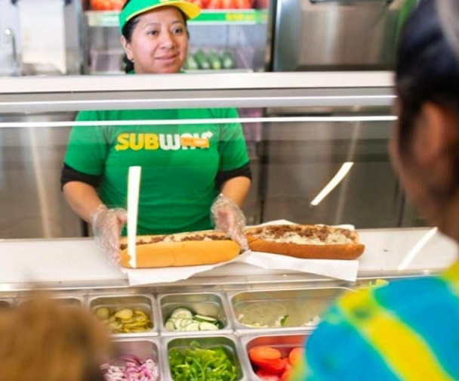
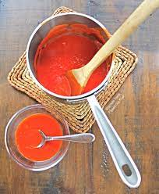
Let’s imagine the person and create a question
Subway attendant
Put extra sauce
Could you put extra sauce?

Slide 52
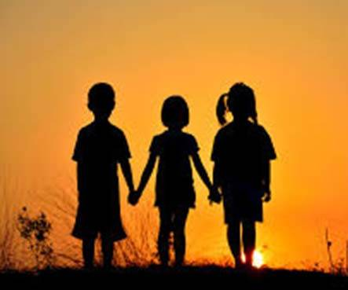
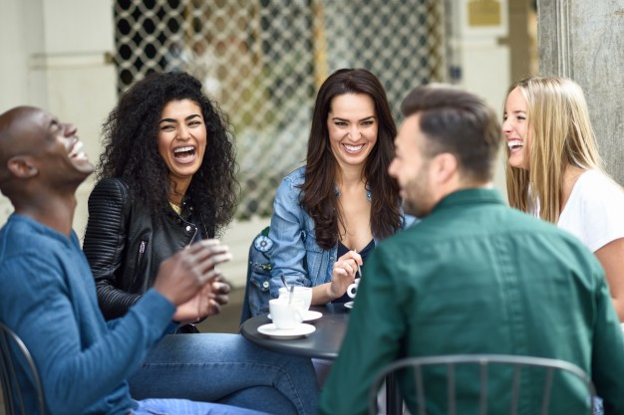
Let’s imagine the person and create a question
Friend
Hang out
Can you hang out

Slide 53
O que você colocaria nos balões seguintes

Slide 54

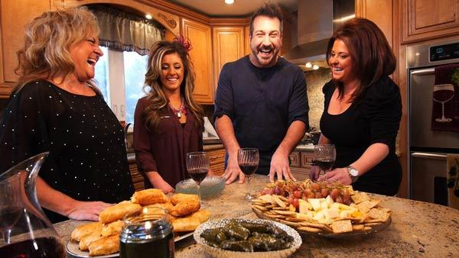
Drinking wine with friends

Slide 55
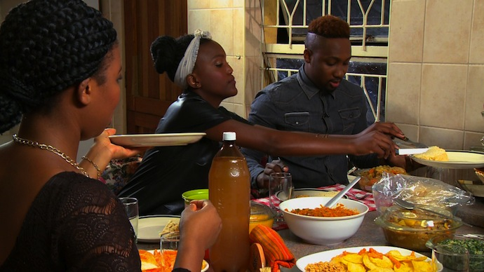
Eating smashing potatos

Slide 56
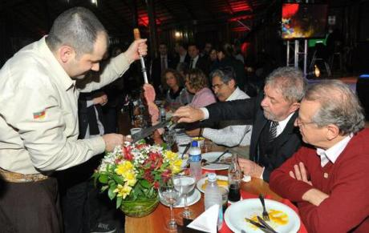
Having churrasco with the ex-president

